Slide 1

Collective Impact in Action

Slide 2

What is Community Vision?
Established in 1995…
Our mission is to bring people and resources together to achieve the community’s vision.

Slide 3

Collective Impact is an approach to solving social problems that’s based on the idea that no organization acting alone can solve
large-scale issues.
For 20 yrs. under our umbrella we have a multitude of efforts and collaboration at work!

Slide 4
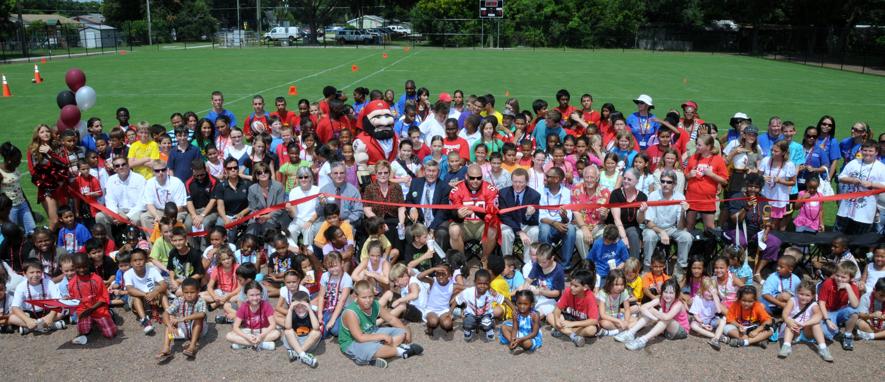
Collective Impact efforts can greatly accelerate the pace of change and drive deep and lasting social impact.
Community Vision is the spine organization that plays the role of convener in Osceola County.
Notes:
4

Slide 5
Pillar Program of Work
Community Connectivity
Capacity Building
Community Health
Leadership-Full Community
Poverty Elimination
Notes:
5

Slide 6

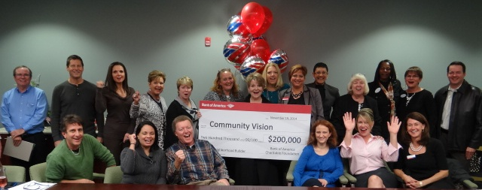
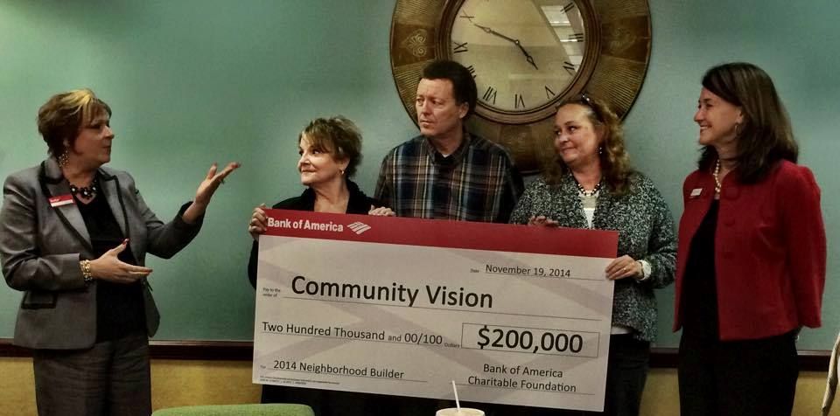
2014 Neighborhood Builder Award
Smallest organization in history of recognition effort…
64 in the Country

Slide 7
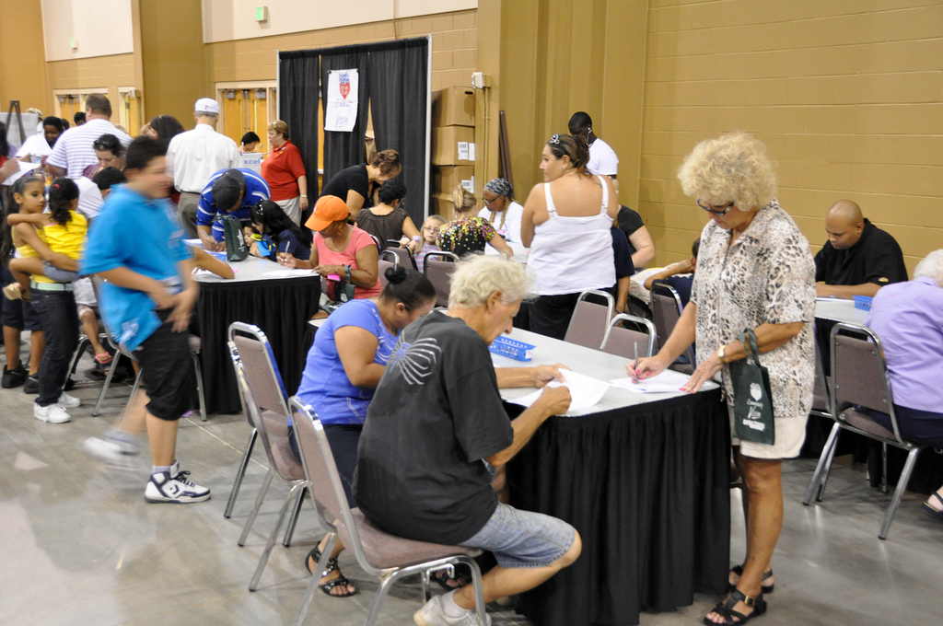
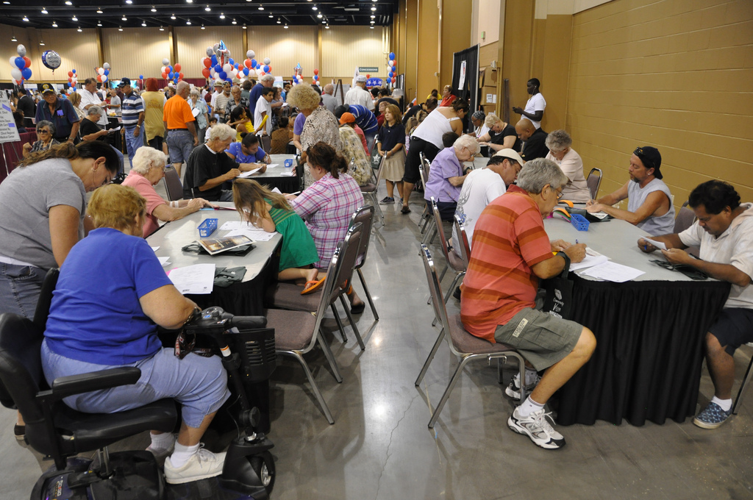
Community Outreach
Taking the Pulse of the community through surveys and visioning
Sharing Recommendations with Policy-Makers and Change Agents
Notes:
7

Slide 8
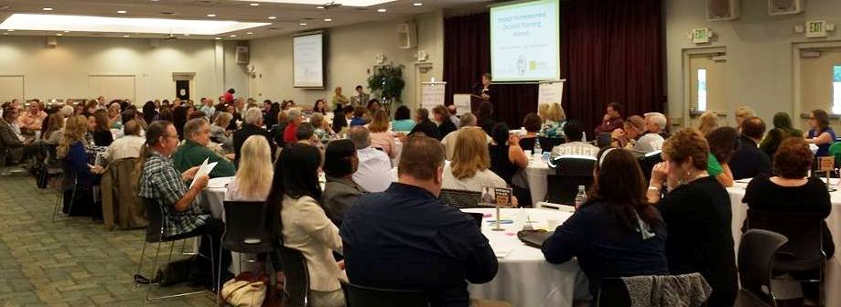
Impacting Homelessness
Community Vision hosted Spring Planning retreat to create:
Shared vision
Mission
Determine focus areas
Representative Task Force resulted
Notes:
8

Slide 9
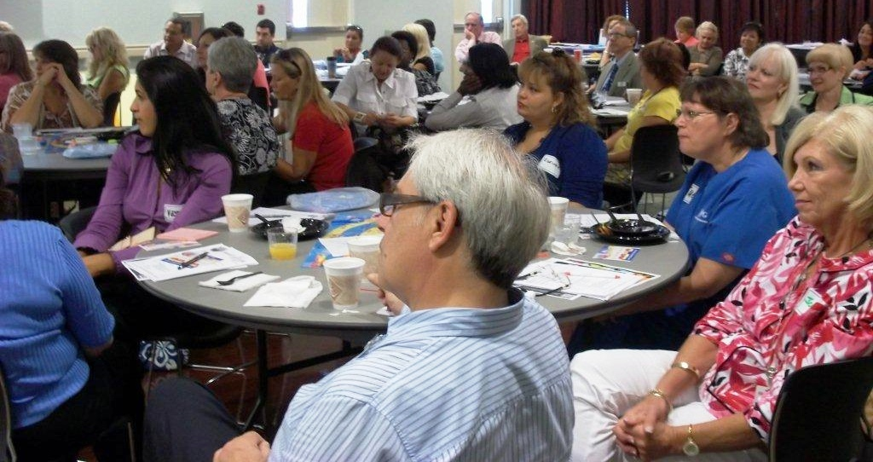
Implementing Solutions Together

Slide 10
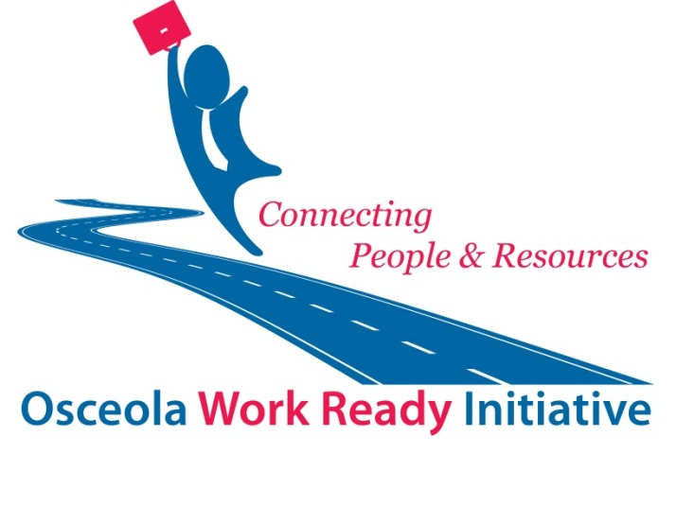
Facilitating Collective Impact!
Notes:
10

Slide 11

Breaking the Cycle of Poverty
Outreach Education and Sponsored Training
Supported by City of Kissimmee CDBG Grant, Wells Fargo, Duke Energy, Bank of America, and Anonymous Funder
15 Low Income, Homeless/ Precariously Housed and Veterans comprise classes
97% graduation rate
Career Path Training

Slide 12

Impressive Stats
48 CNAs… Health Care Career Path
  38 working in field
  6 awaiting test
  3 Continuing Education
  9 Pilot Basic Construction
  8 working in Trades
  Total 60 Lives Transformed
  105 Children in Stable Housing

Slide 13

Key Elements Making Project OPEN Successful
All in same cohort – become family
Candidates recommended by partner organizations
Obstacles removed
Vetting by panel
        Case Management

Slide 14

Success Elements Continued…
Dedicated person supportive, caring
and nonjudgmental
Strict compliance to rules
Nurturing environment
Employment Boot Camp… existing demand
Family and community celebrates graduation

Slide 15

Health
Leadership
Council
ESTABLISHED IN 1998
Public and Private Health leaders provide
employment to graduates.

Slide 16

Project OPEN Differentiates itself from other programs…
Quality not Quantity
High Touch vs. High Tech

Slide 17

OPEN Door to additional certification training with Valencia College
Basic Construction
Advanced Manufacturing
Welding

Slide 18

Participants are the Star Fish

Slide 19
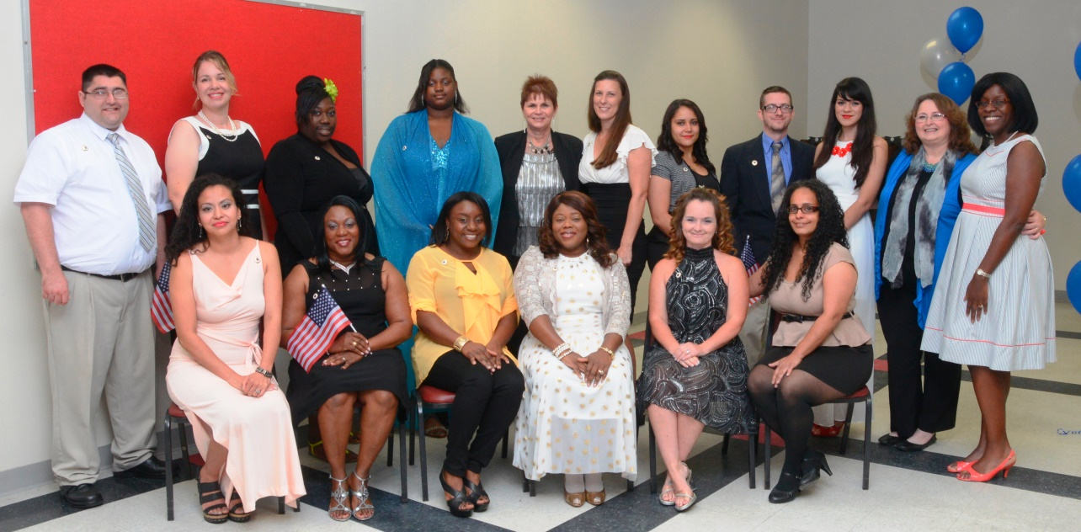

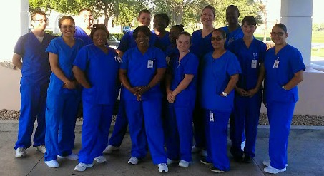
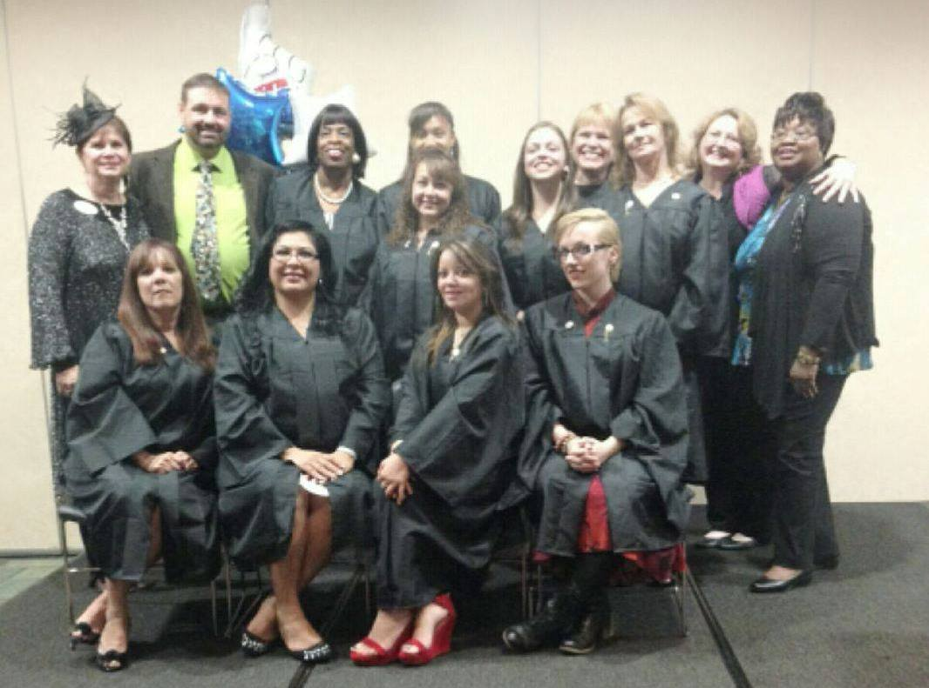

Slide 20
704 Generation Point
Kissimmee, FL 34744
Phone: 407-933-0870 Fax: 933-0942
www.communityvision.org
Notes:
20

