Slide 1
The Denson Apartments
Supportive Housing for Homeless Veterans
Durham is the 4th largest city in North Carolina.
As of July 2014, The U.S. Census Bureau estimated the City’s population to be 251,893.
Once referred to as “The tobacco capitol of the world”, Durham is known today as the City of Medicine
Durham is home to Duke University and North Carolina Central University.
Notes:
Vacant Positions
Network Analyst – Reclassify to Senior Network Engineer
System Coordinator - New Position $76,230/yr in Customer Service
Re-org Positions
Help Desk supervisor - Move from Customer Service to Technical Support
IT Infrastructure Manager - Reclassify to lead technical position
1 developer - Reclassify and move position from EAS to PMO
1 developer - Move from EAS to Web Applications
1 DBA – Reclassify as developer and move to Web Applications

Slide 2
Veteran Statistics
The 2012 Veteran population in North Carolina was 771,654, ranking the state 9th in the U.S.
Nationally, 17% of homeless adults are veterans.
In 2014 Durham mayor William ‘Bill’ Bell signed on to the presidents’ Challenge to End Veterans Homelessness by the end of 2015.
The Denson Apartments dedicated for homeless veterans is helping to meet that challenge.

Slide 3
Partnership and Collaboration
The City of Durham partnered with CASA, a regional non-profit developer of supportive housing.
The North Carolina Housing Finance Agency provided additional HOME funding for Denson I.
The Home Depot Foundation supported the project with a donation.
The Durham VA Medical Center made referrals of VASH-eligible veterans.

Slide 4
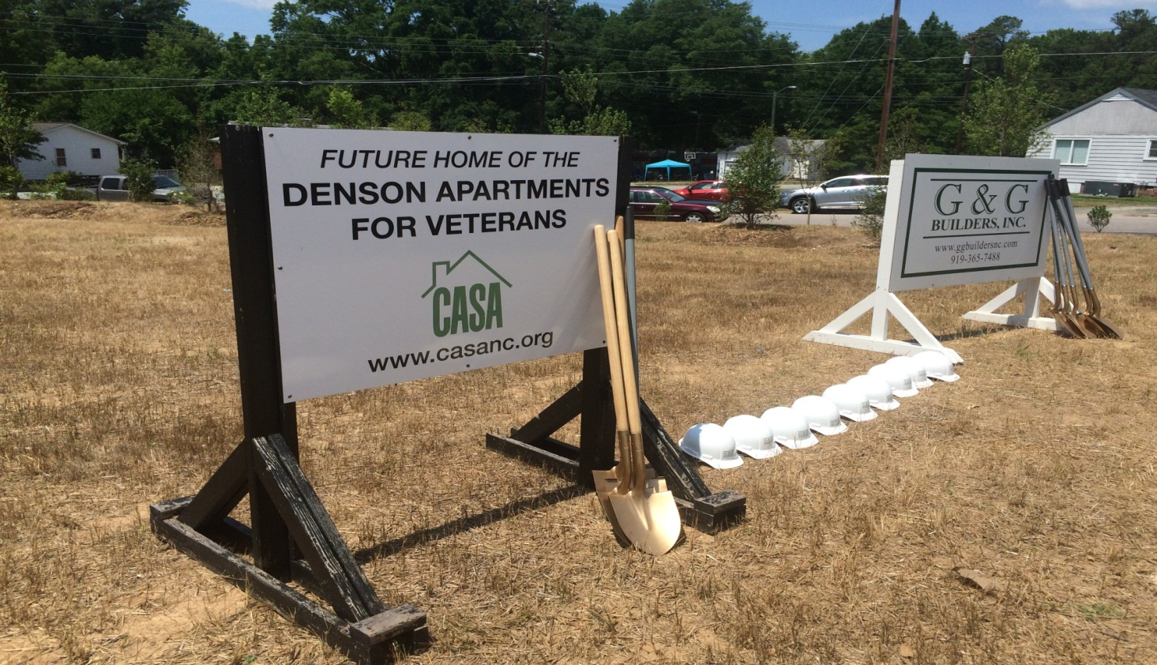
Denson Groundbreaking
February 7, 2014
1598 Sedgefield Road

Slide 5
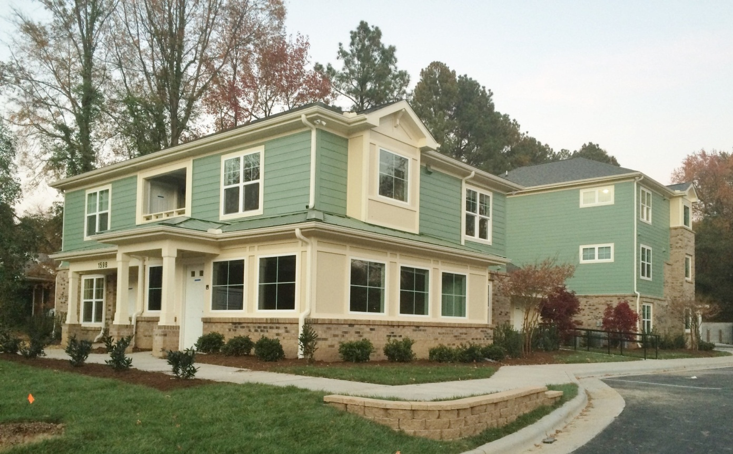
Denson I – Front View

Slide 6
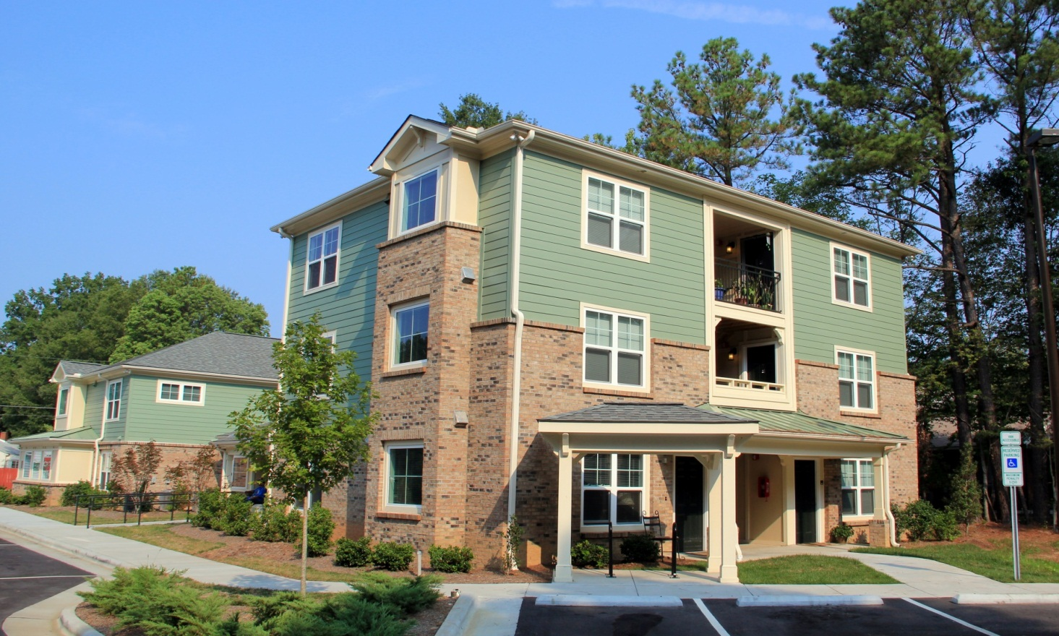
Denson I – Back View

Slide 7
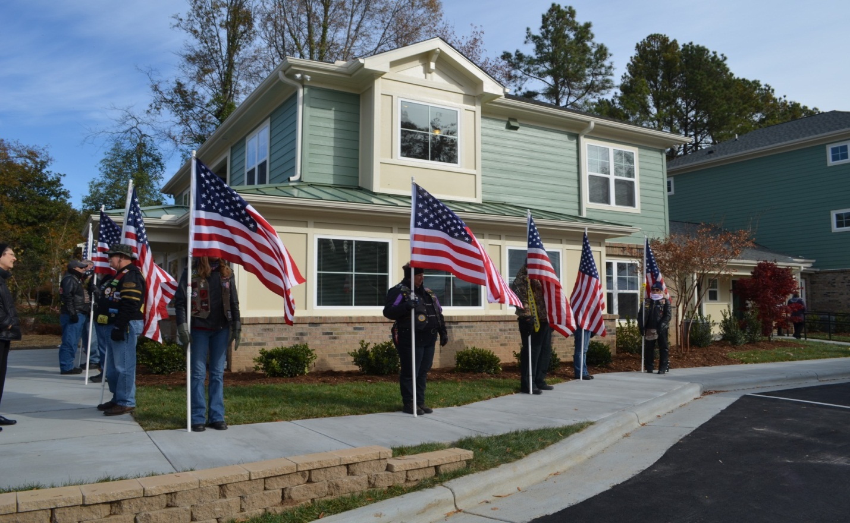
Dedication Ceremony
November 19, 2014

Slide 8
Welcome Home!
“They were here for us when we needed them. We need to be here for them when they need us.”
- Retired federal judge and Navy veteran Alex B. Denson for whom the complex was named. Judge Denson advocated for veterans housing after he grew tired of seeing veterans trapped in a cycle of poverty in his courtroom.

Slide 9
Leveraging Funds
Durham HOME CHDO | $253,031
Durham General Funds | $251,969
HUD Continuum of Care | $400,000
NC HFA HOME | $411,682
Private Foundation | $46,500
CASA Equity | $95,932
Home Depot Foundation | $75,000
Total | $1,534,114

