Slide 1
COLLABORATIVE PROXIMITY
BONNIE LANE SENIOR APARTMENTS, CORA COLEMAN SENIOR CENTER AND BOB PRICE RECREATION CENTER & WALKING/JOG PATH

Slide 2
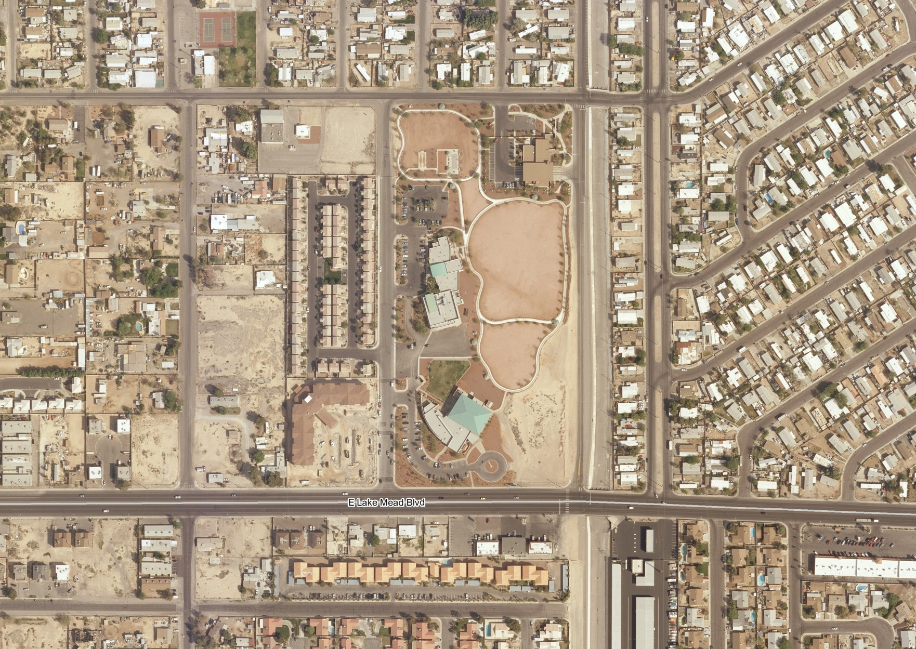
SUNRISE MANOR
CC Fire Station
Cora Coleman Senior Center
Bob Price Recreation Ctr & Jog Path
Bonnie Lane Senior Apts

Slide 3
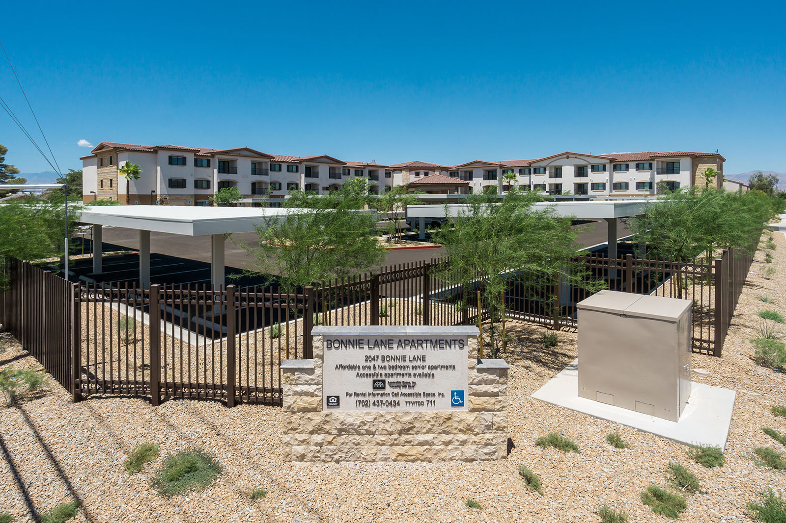

Slide 4
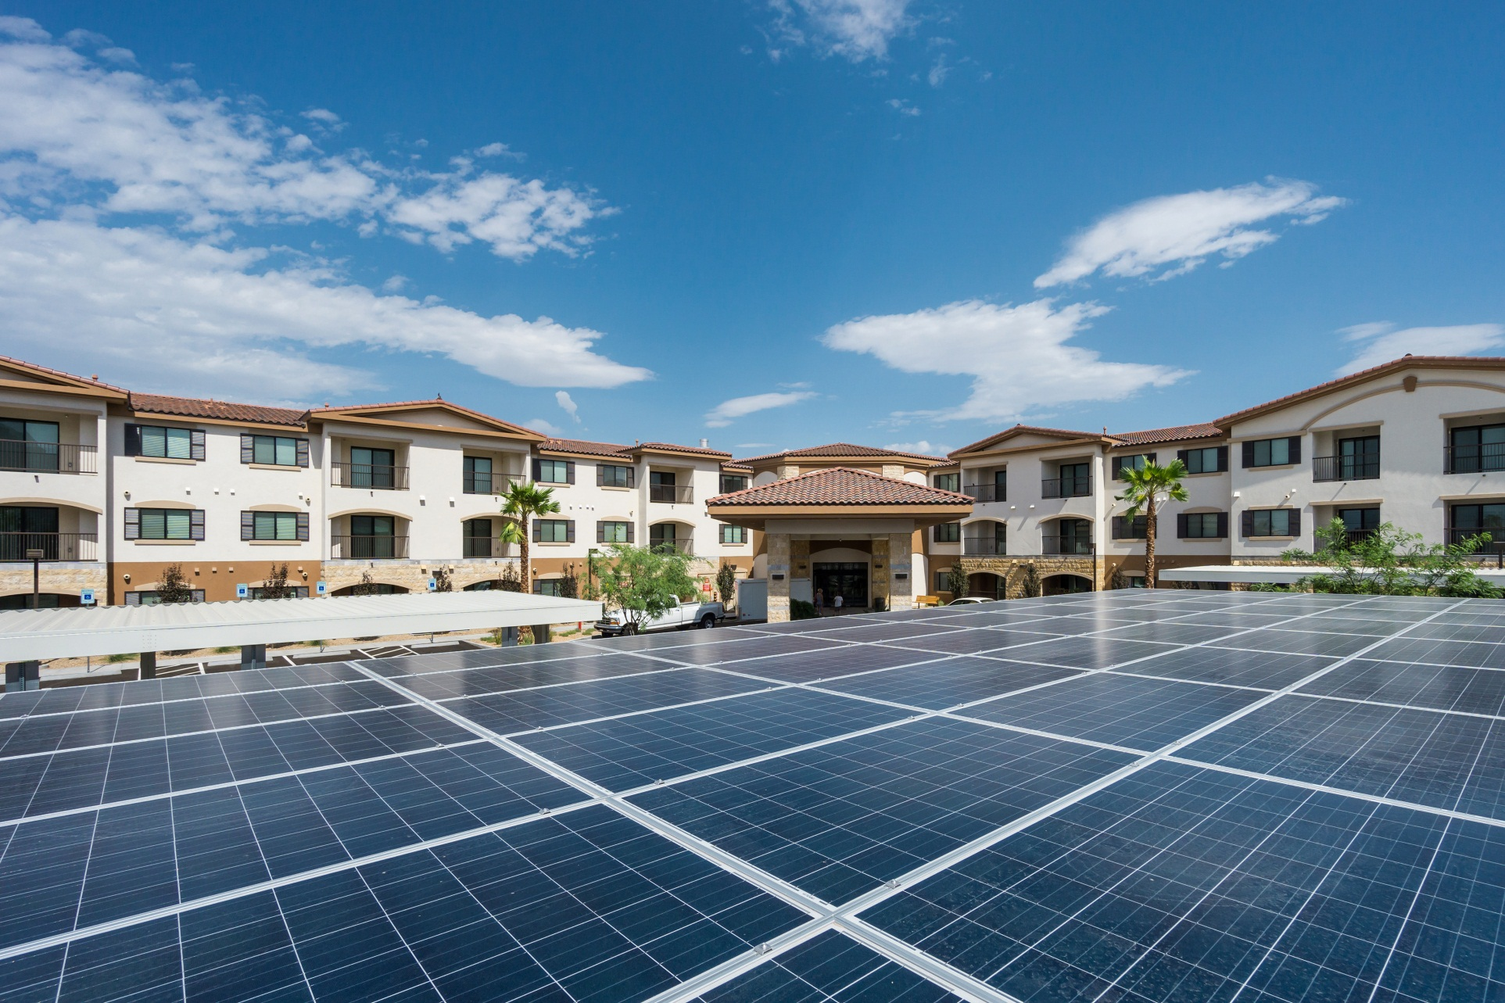
BONNIE LANE SENIOR APARTMENTS

Slide 5
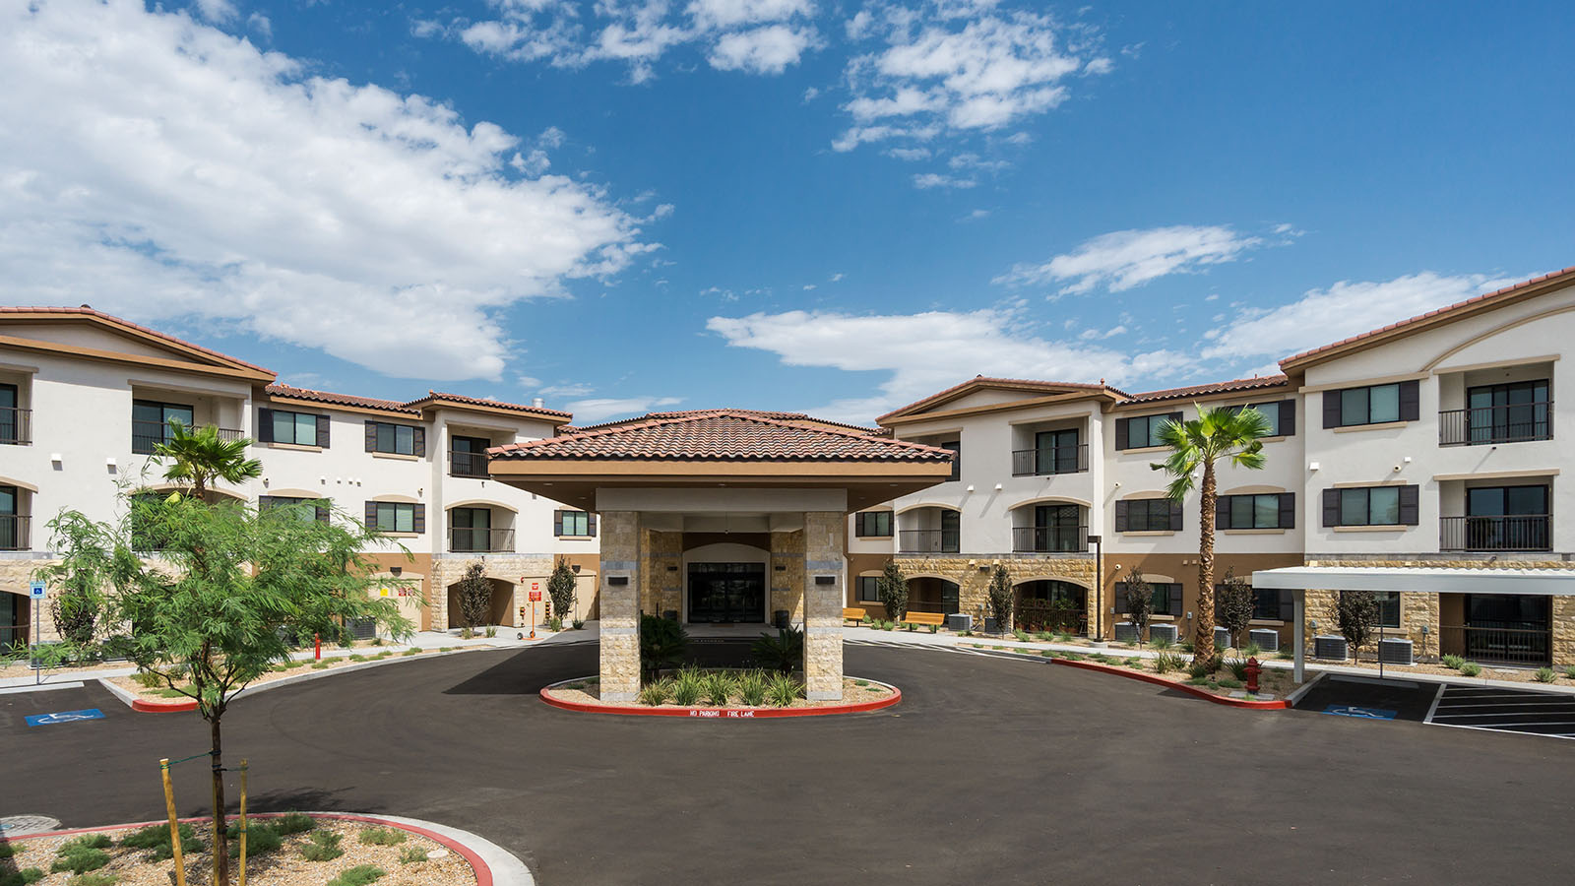

Slide 6
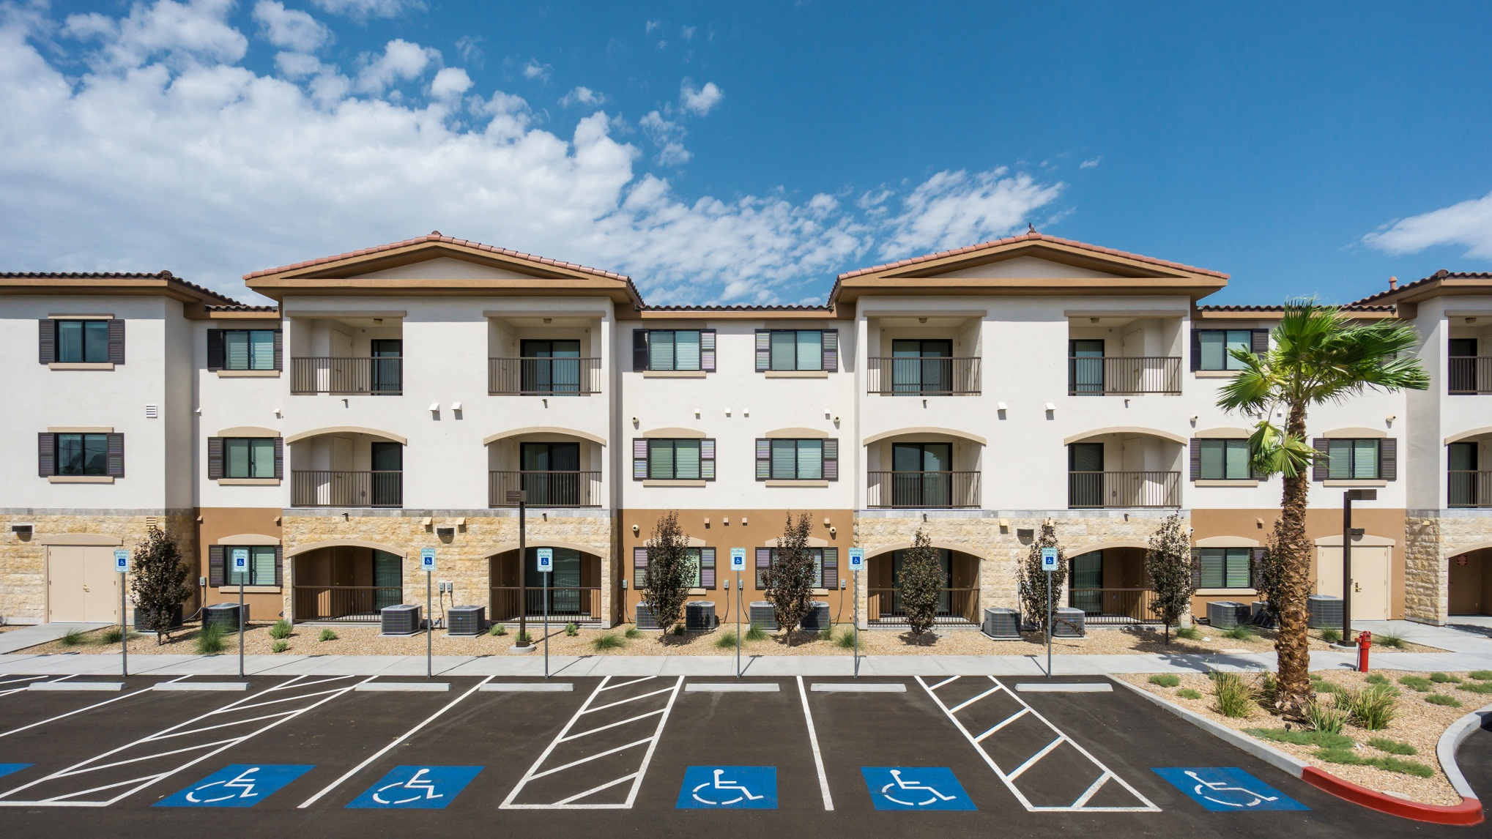

Slide 7
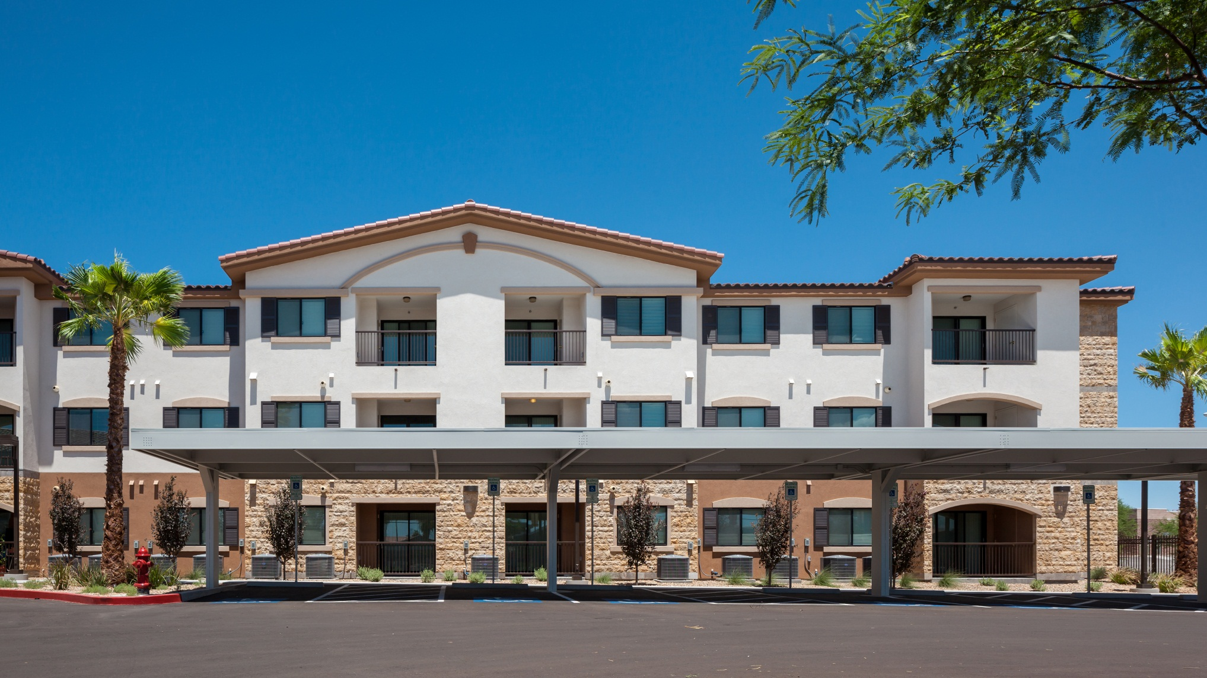

Slide 8
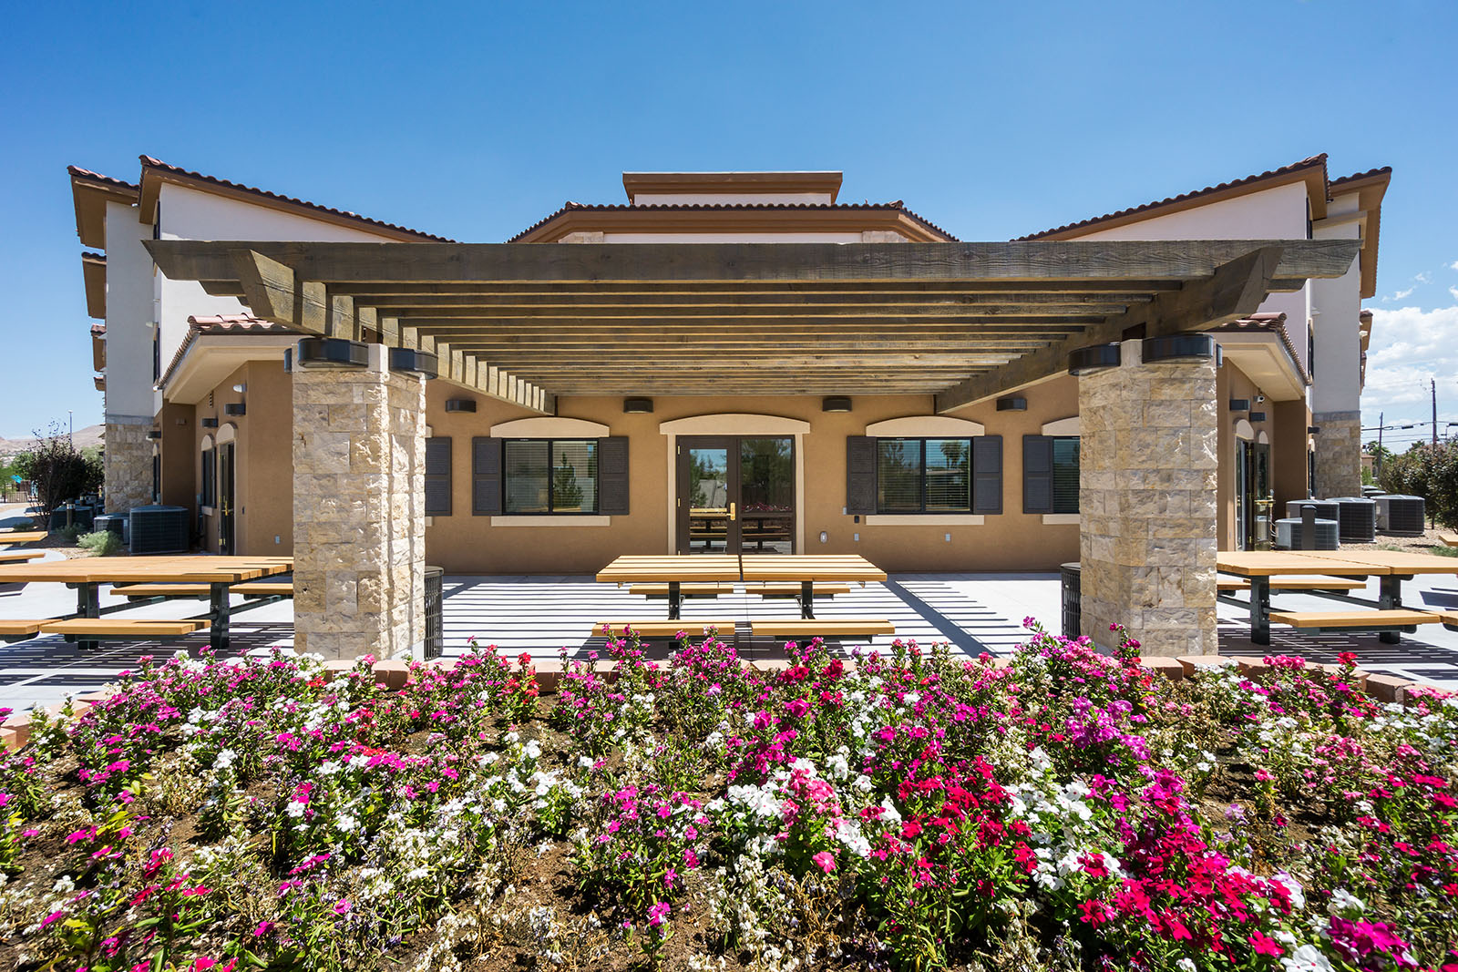

Slide 9
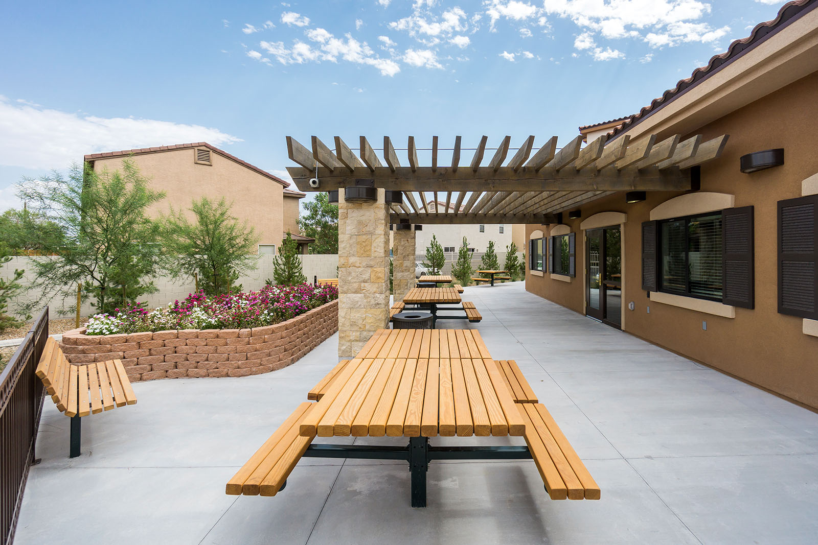

Slide 10
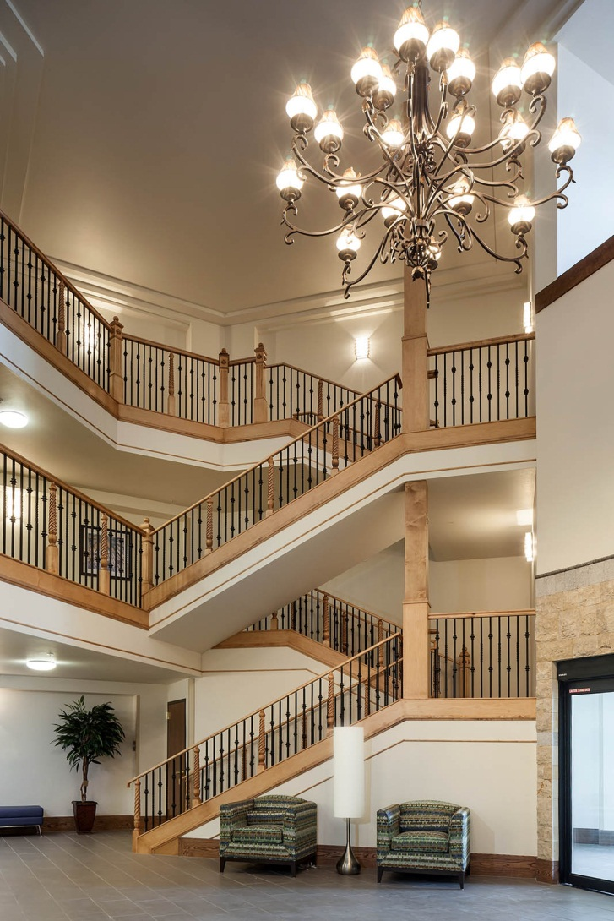

Slide 11
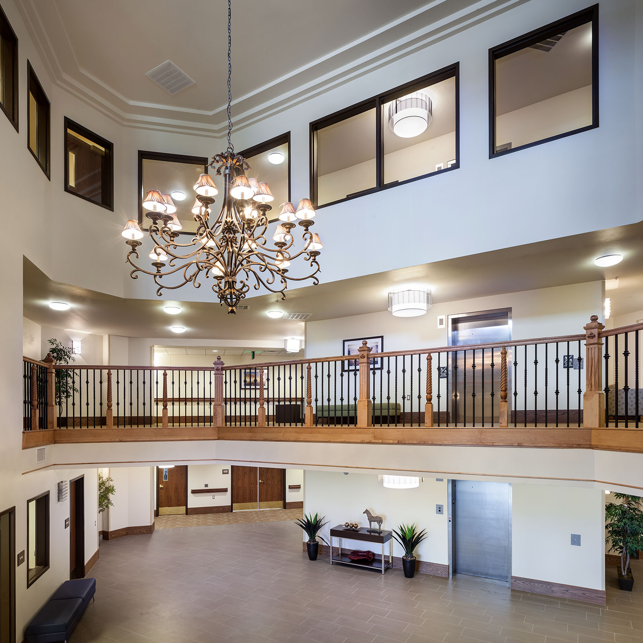

Slide 12
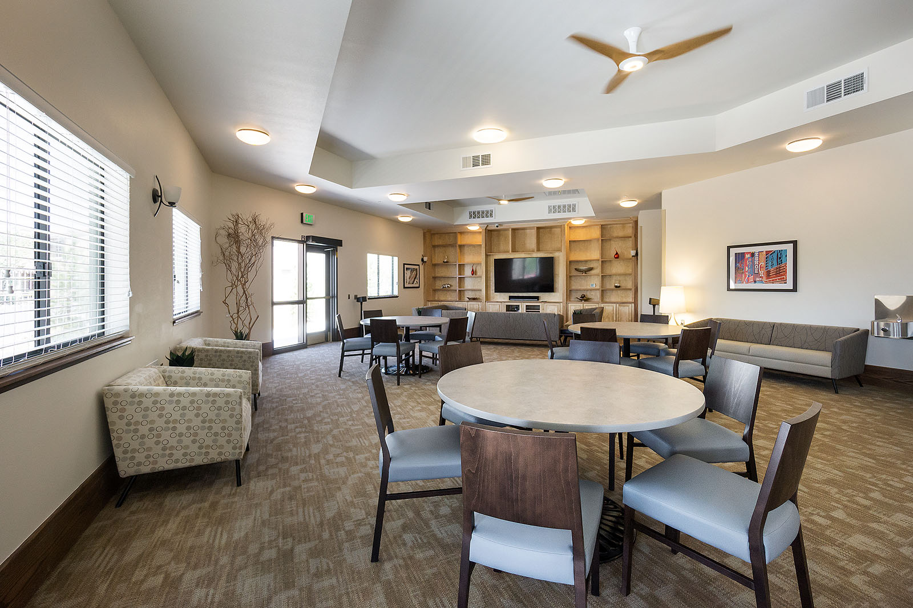

Slide 13
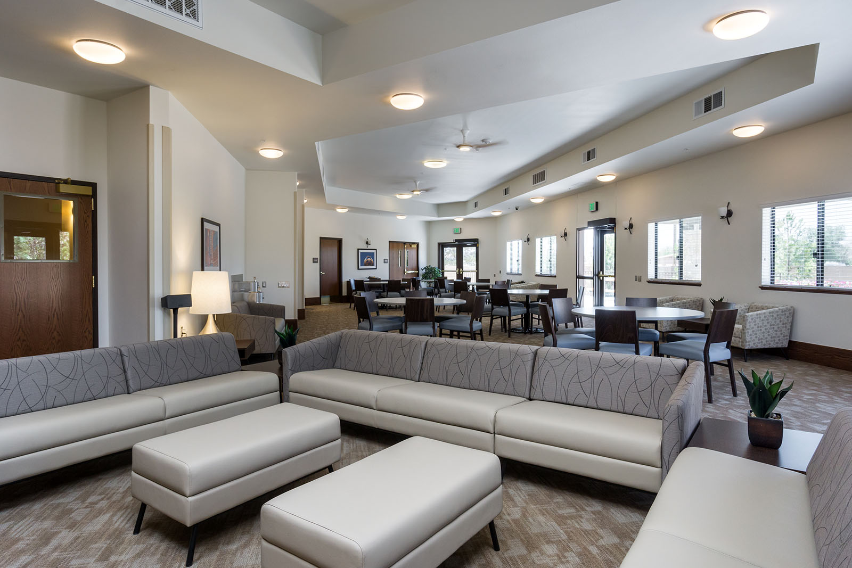

Slide 14
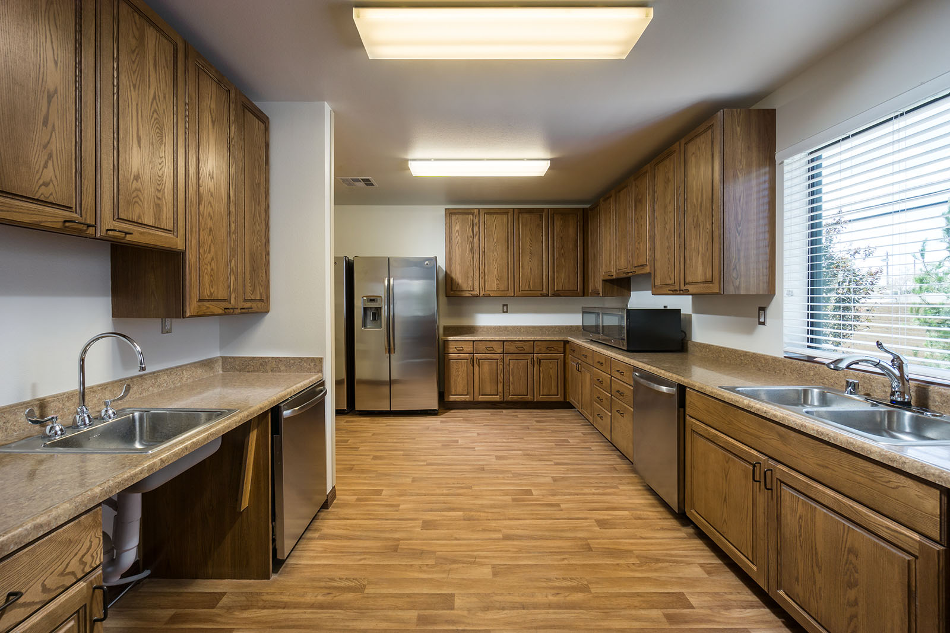

Slide 15
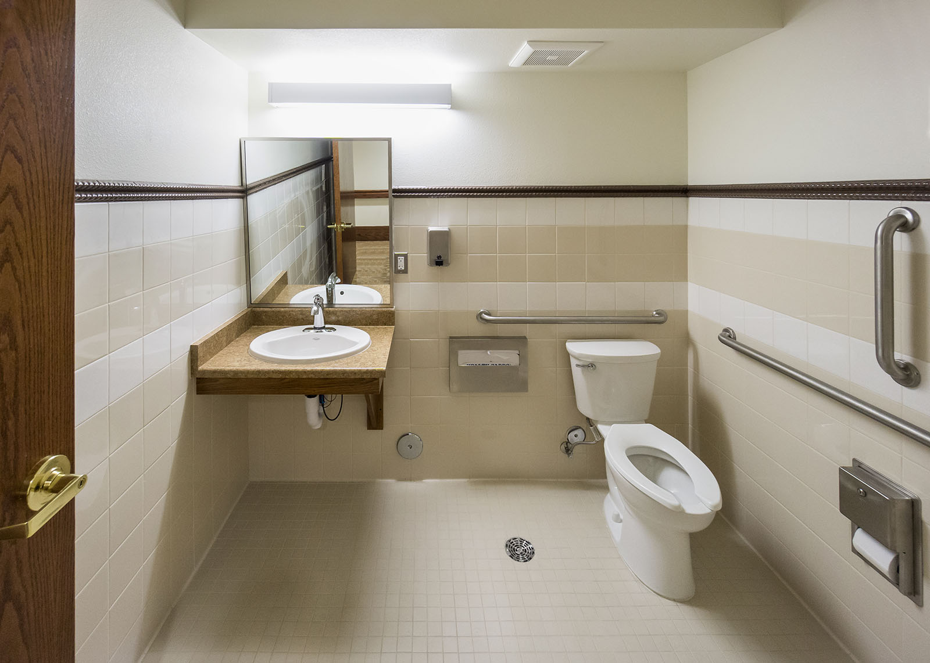

Slide 16
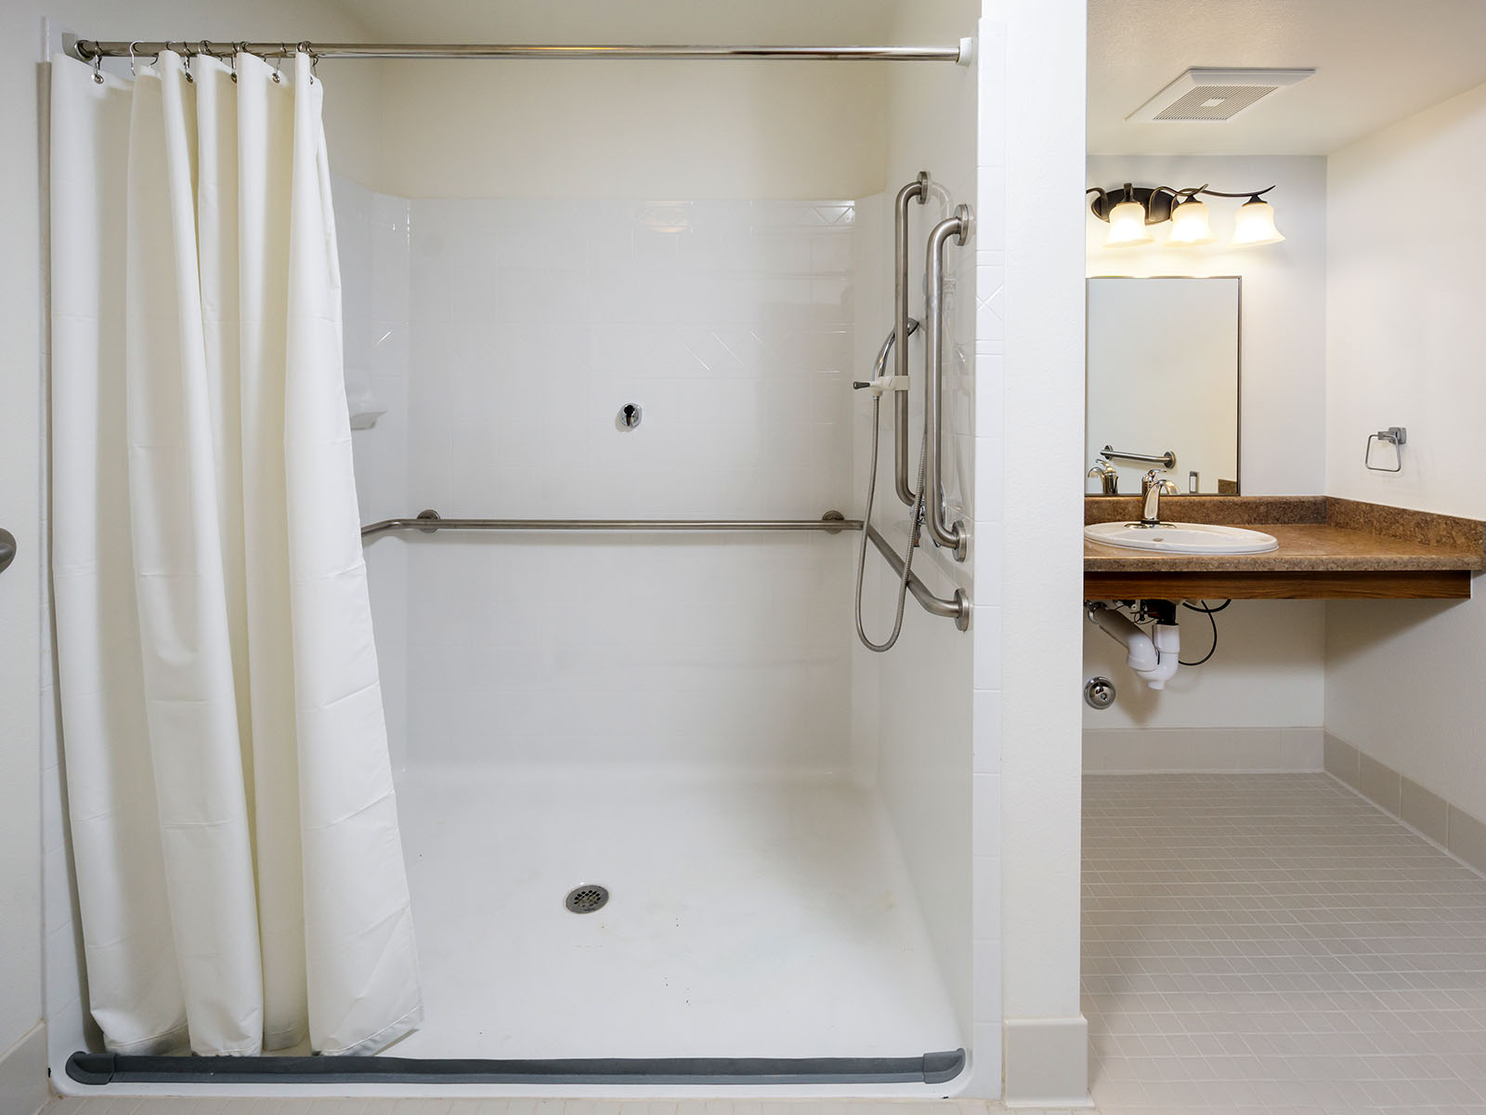

Slide 17
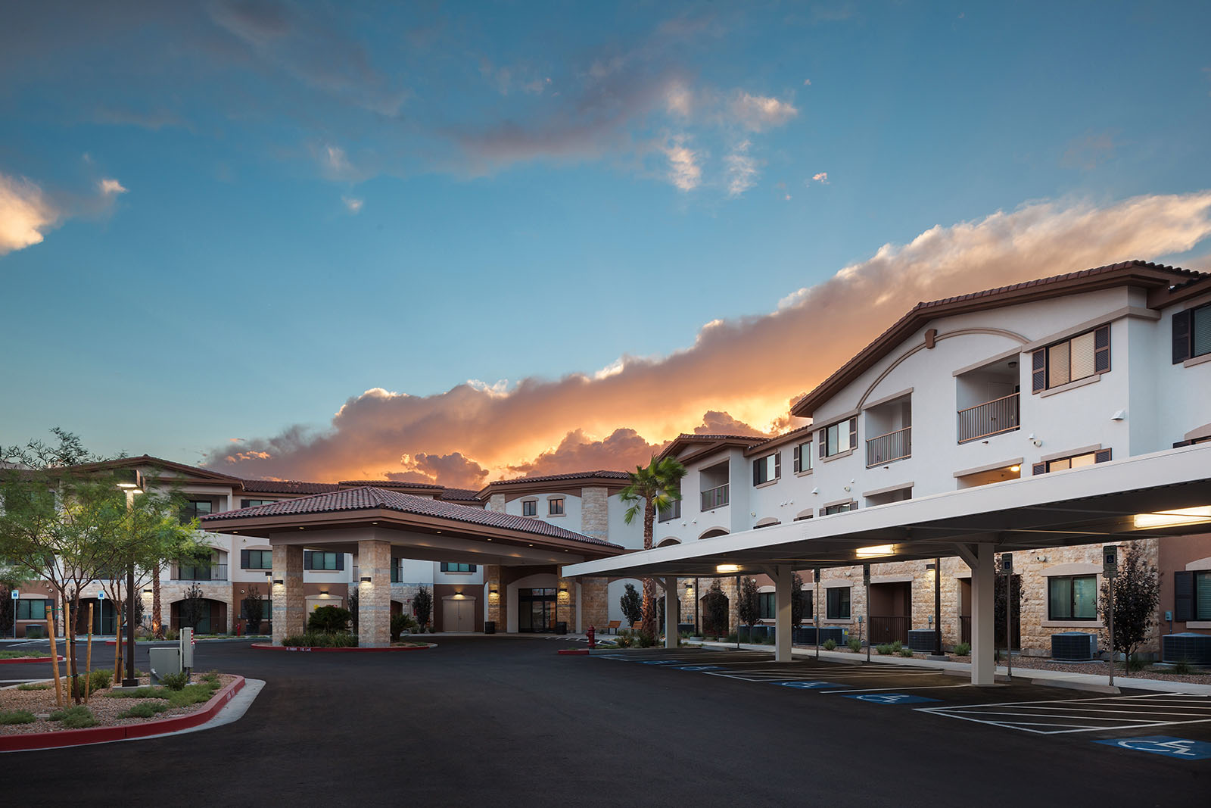

Slide 18
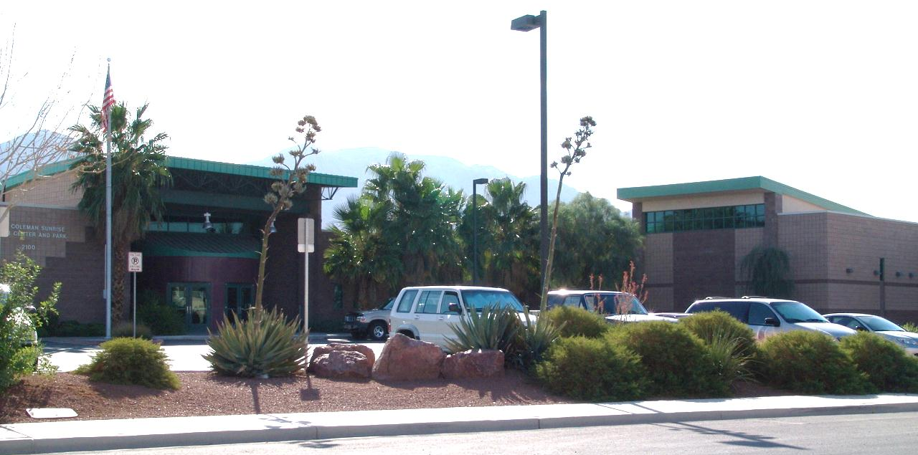
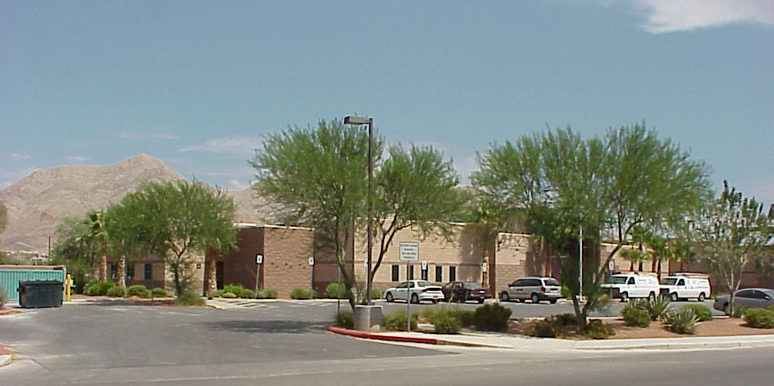
CORA COLEMAN SENIOR CENTER

Slide 19
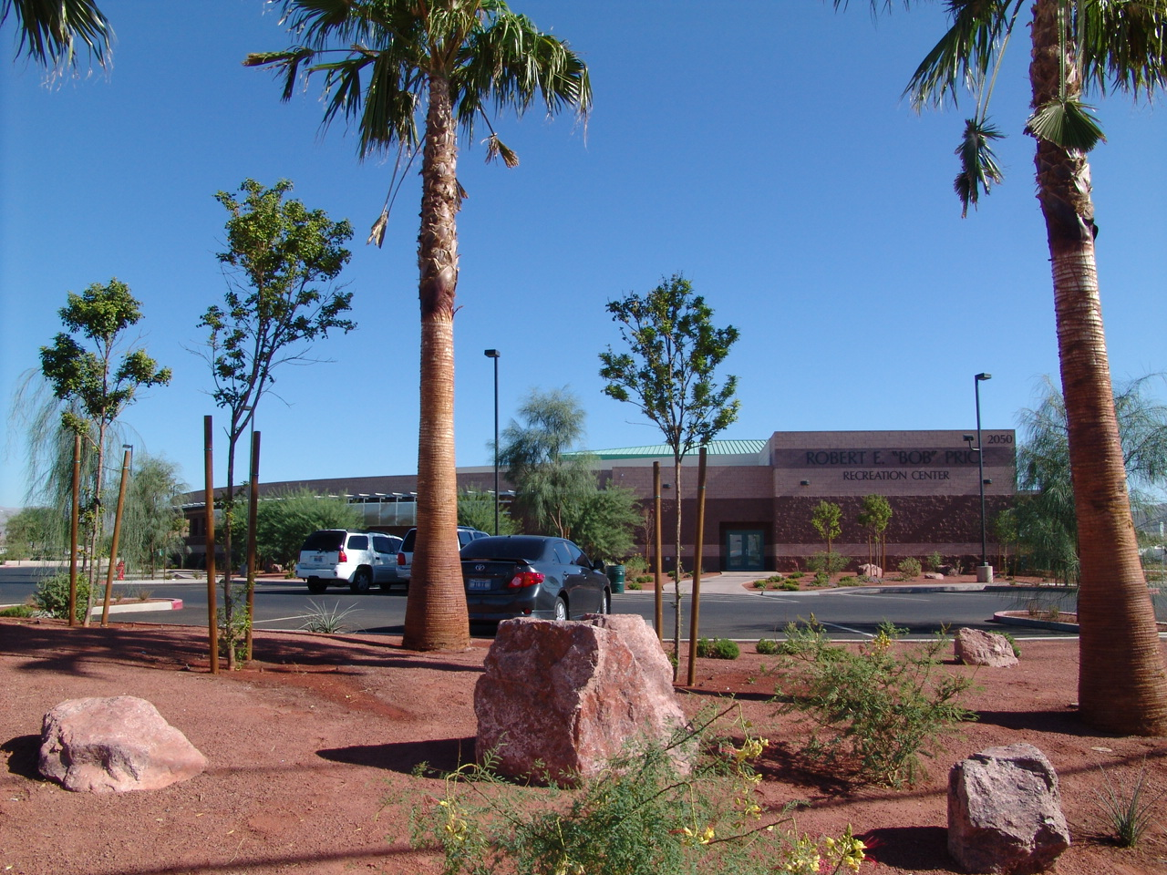
BOB PRICE RECREATION CENTER

Slide 20
BOB PRICE RECREATION CENTER

Slide 21
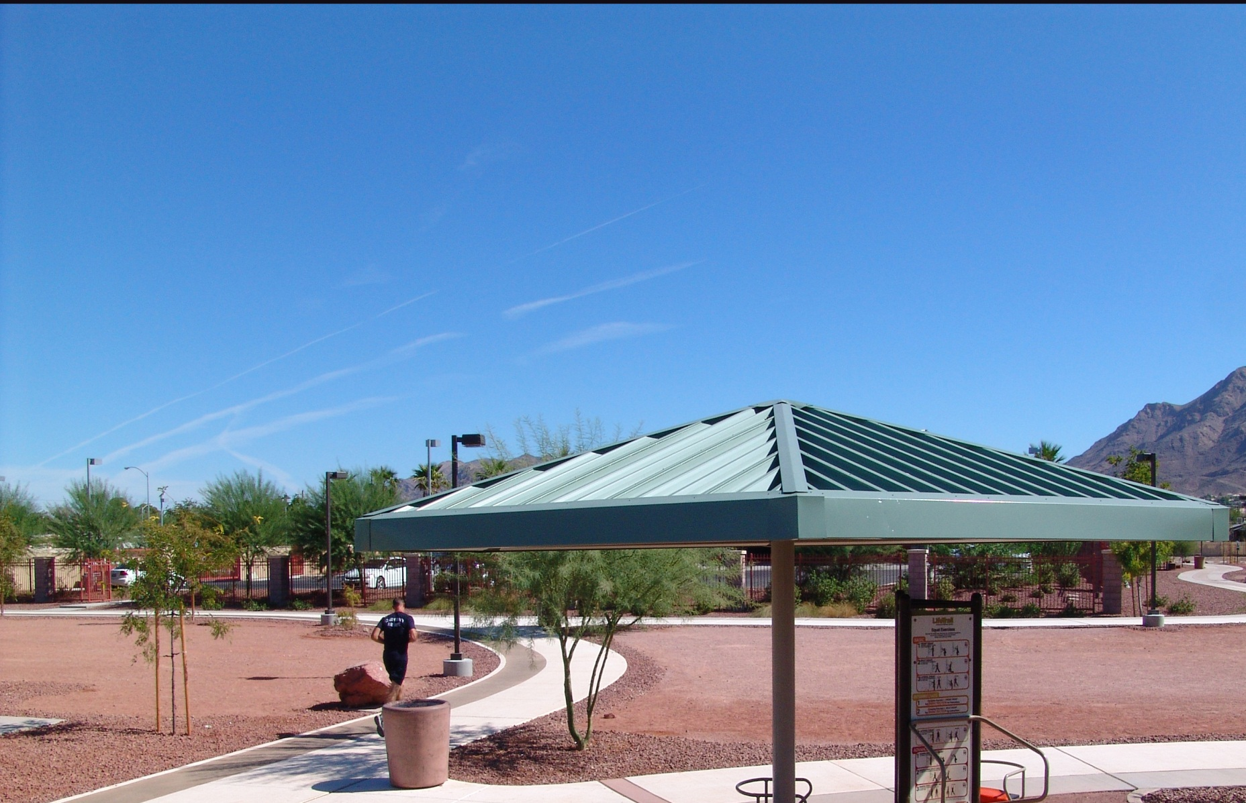
BOB PRICE JOG PATH

Slide 22
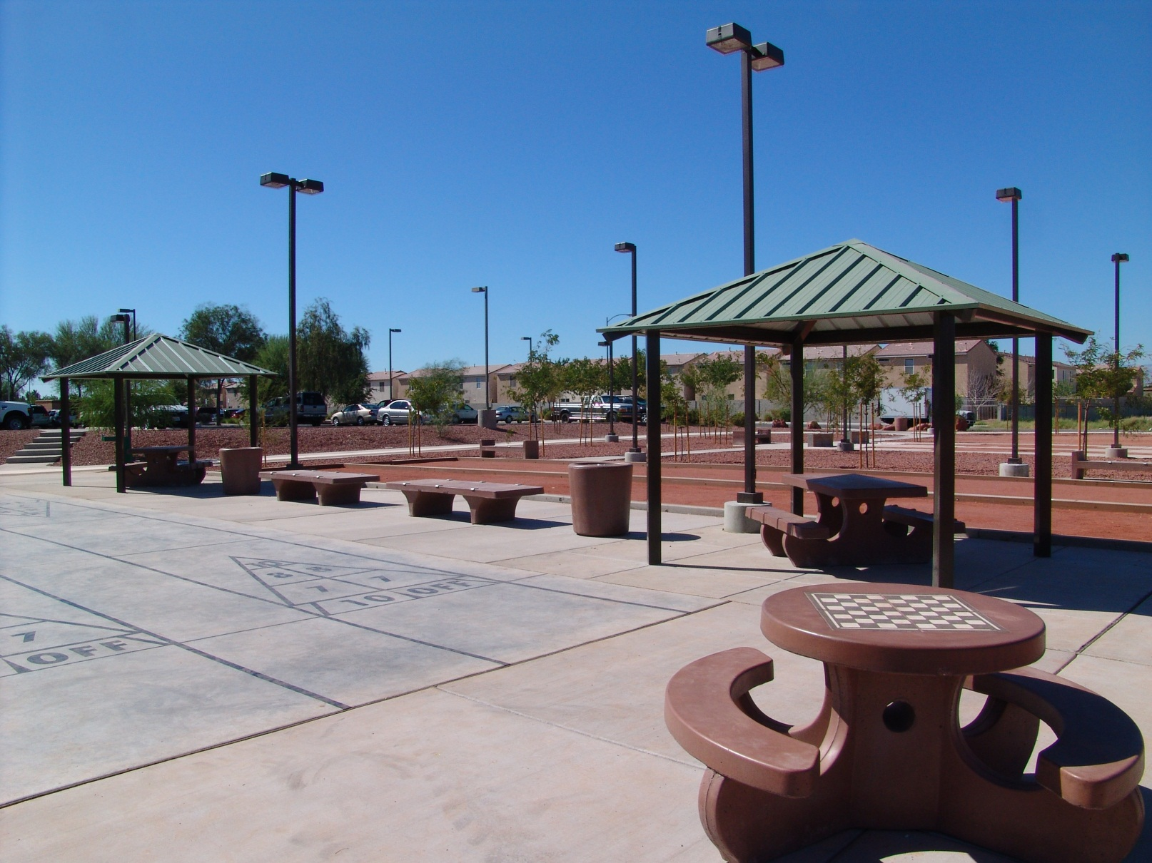
BOB PRICE JOG PATH & PARK

