Slide 1


Burlington Skatepark
2016 NCDA Audrey Nelson Award
NCDA Winter Legislative Conference
Washington, DC
January 22, 2016

Slide 2
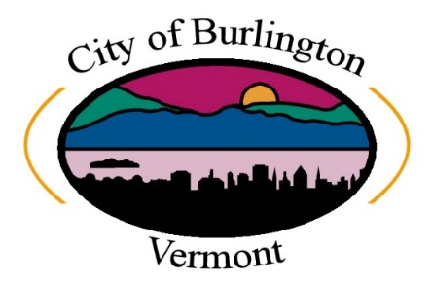
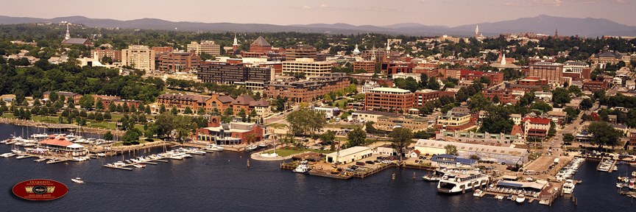
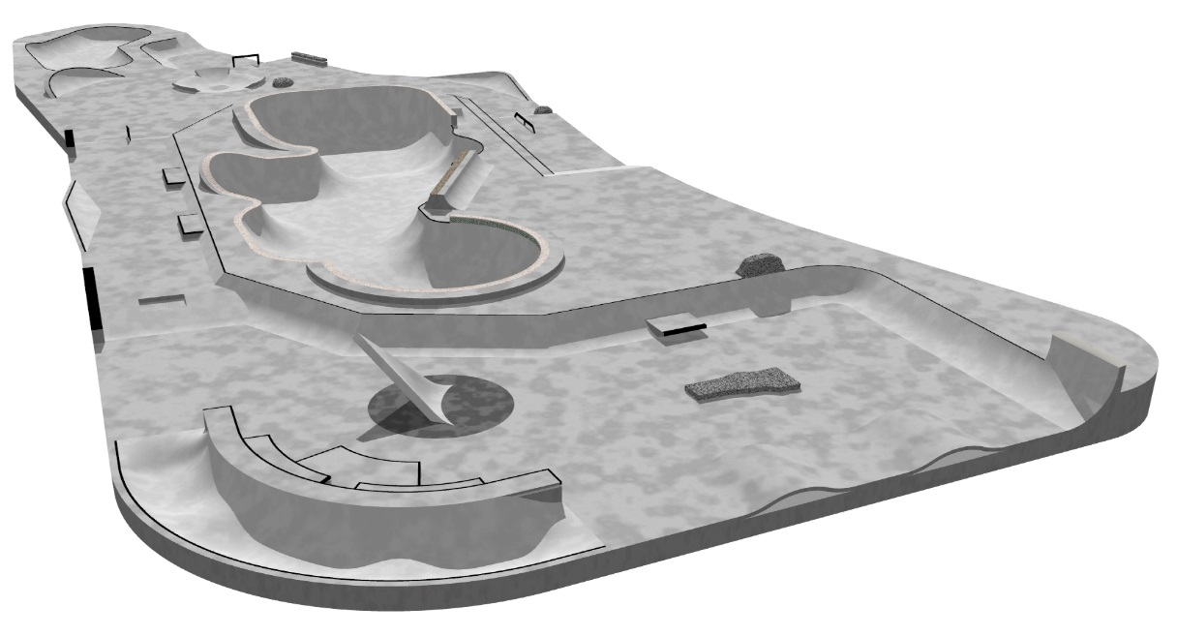
About Burlington Vermont
Population – 42,417
FY15 CDBG - $732,146
FY15 HOME - $351,855
LMI Citywide – 59% - area-wide benefit
Neighborhood Revitalization Strategy Area
Mean age of a skateboarder is 21.5
A university population of 16,057 with median age of 21
Median Age in Burlington is 29
~3,679 Skateboard and BMX Participants in Burlington.
Over 1,300 Friends - Skatepark Facebook Page

Slide 3
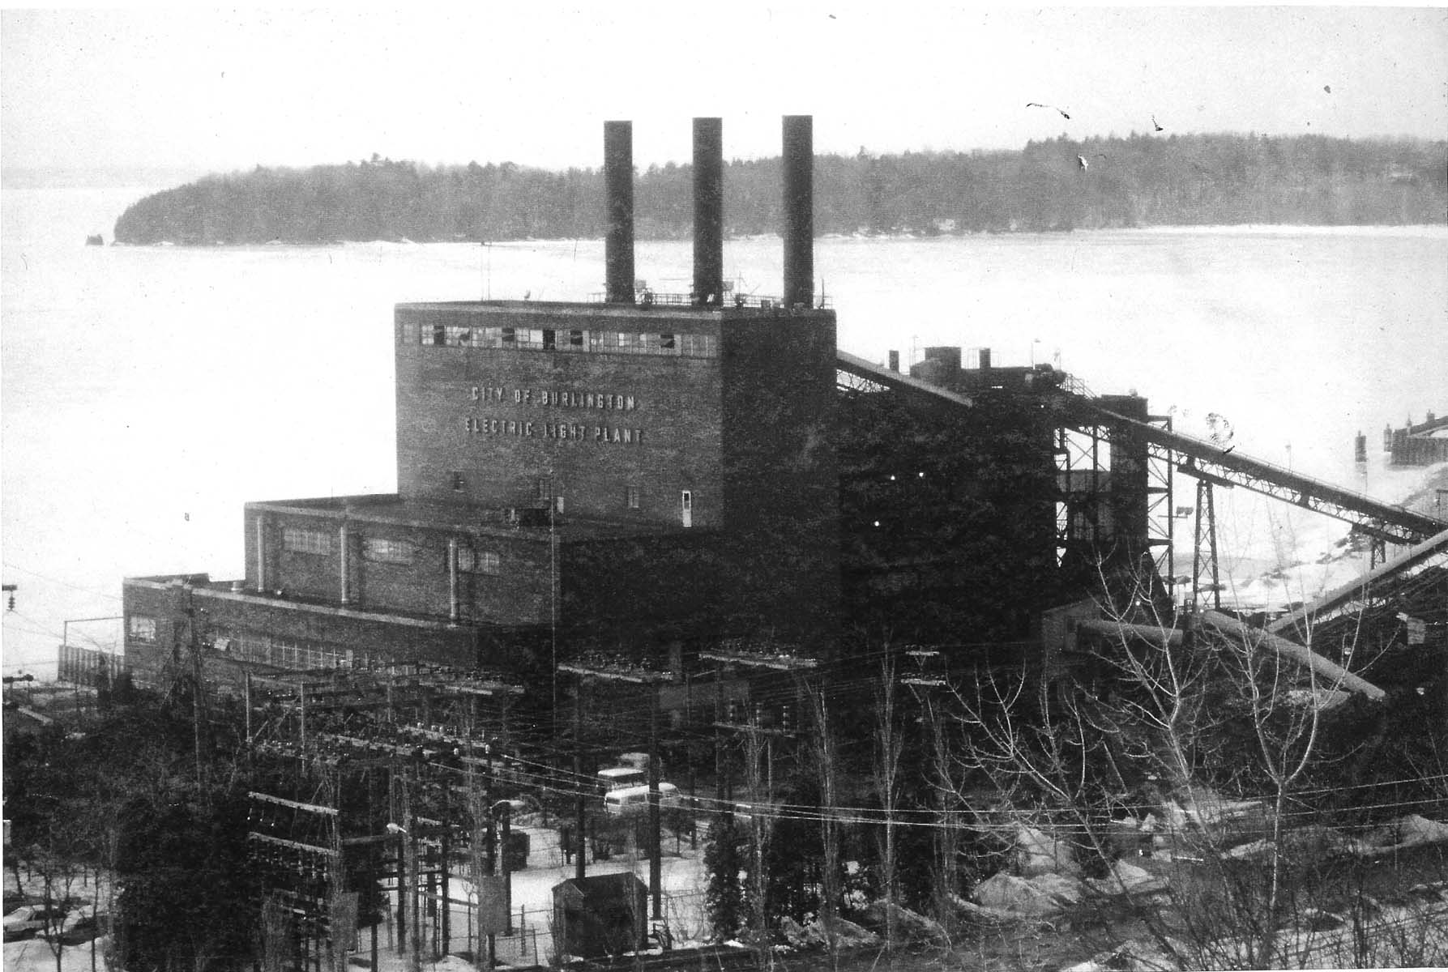
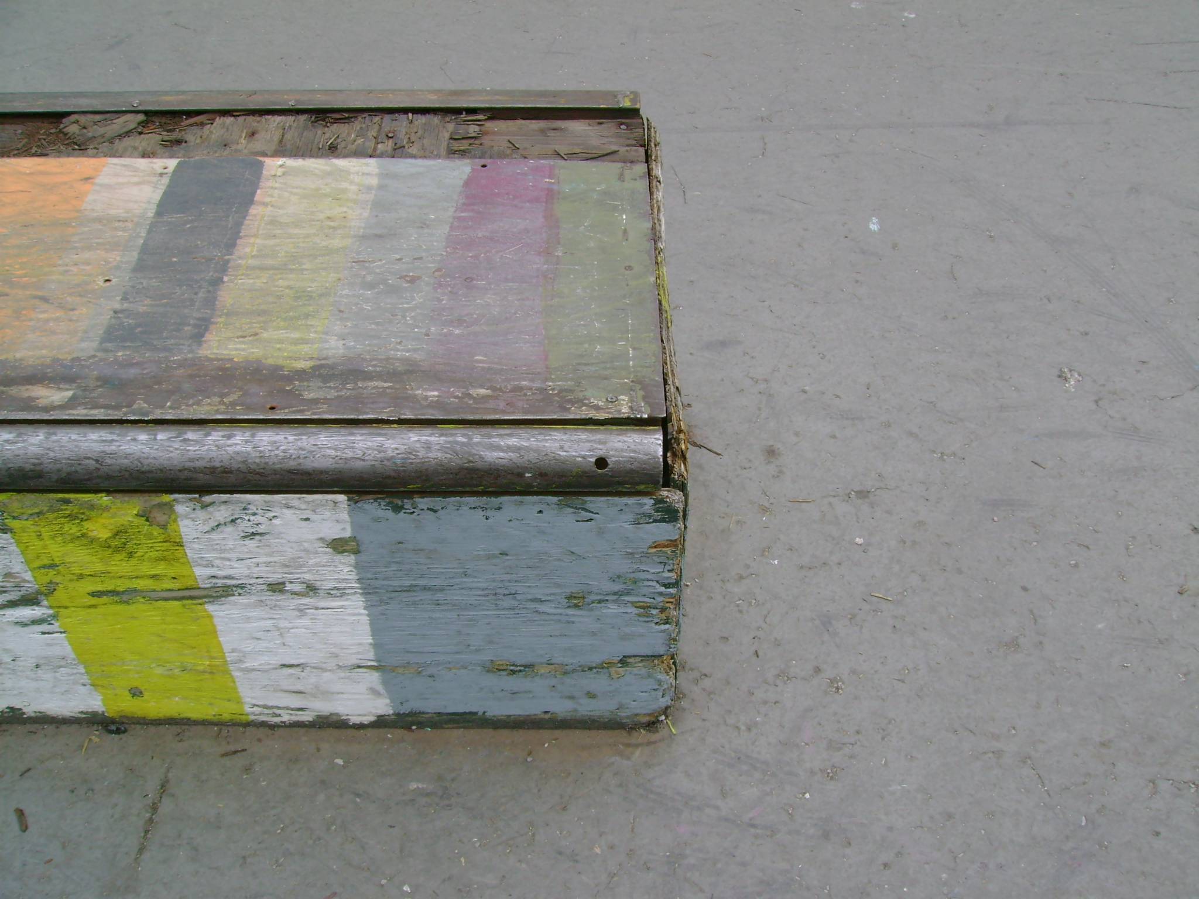
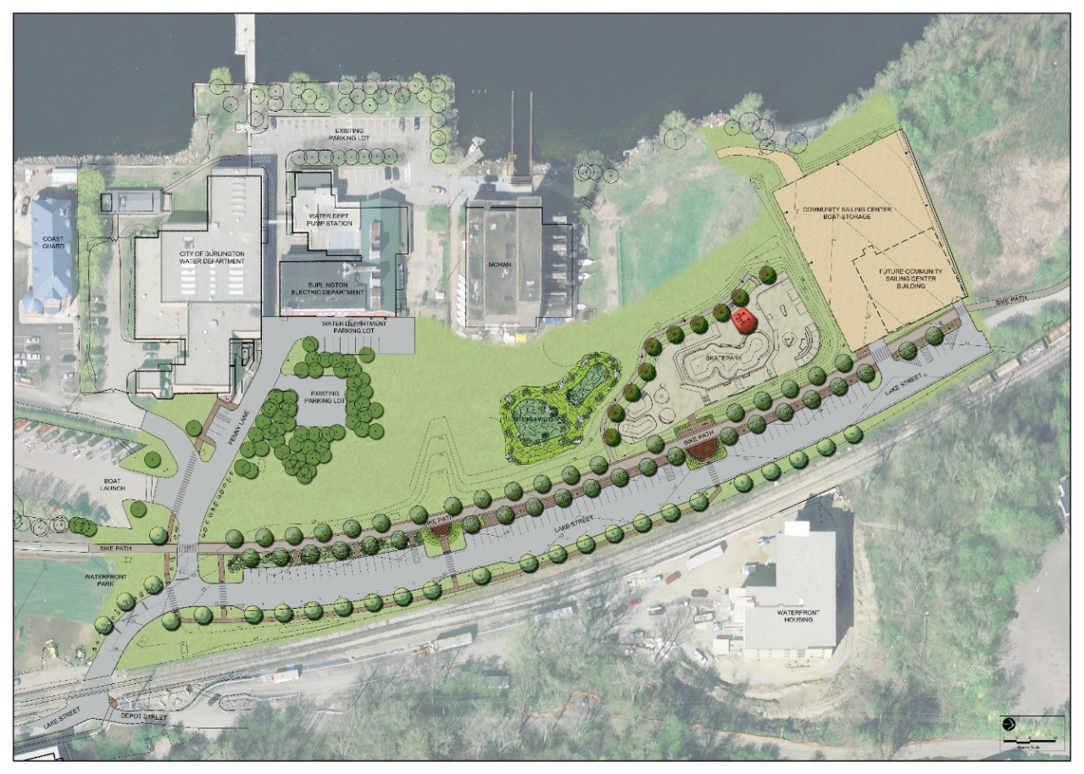
Waterfront Community & Economic Opportunity
Revitalization of post-industrial waterfront
Aging facility built 15 years ago posed hazards
Home to Professional Skaters, Snowboarders & Skiers - Grass roots/community driven need for new facility
Skatepark – significant cornerstone to Burlington’s Waterfront Access North redevelopment project
Skateparks are Regional & Worldwide Attractions Sparking Economic Vitality – Already visitors are coming from Canada, California and New York to skate
Economic opportunity for 8+ action sports related businesses
3 Skate Shops with 6 Full Time and 24 Part Time Jobs
Free and improved access to a state of the art facility made of more sustainable materials - concrete and steel with special custom tile inlay with all 6 peaks over 4,000 feet in Vermont
Condition of old wood and steel skate park
Waterfront Access North Site Plan

Slide 4
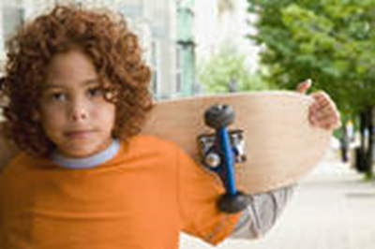
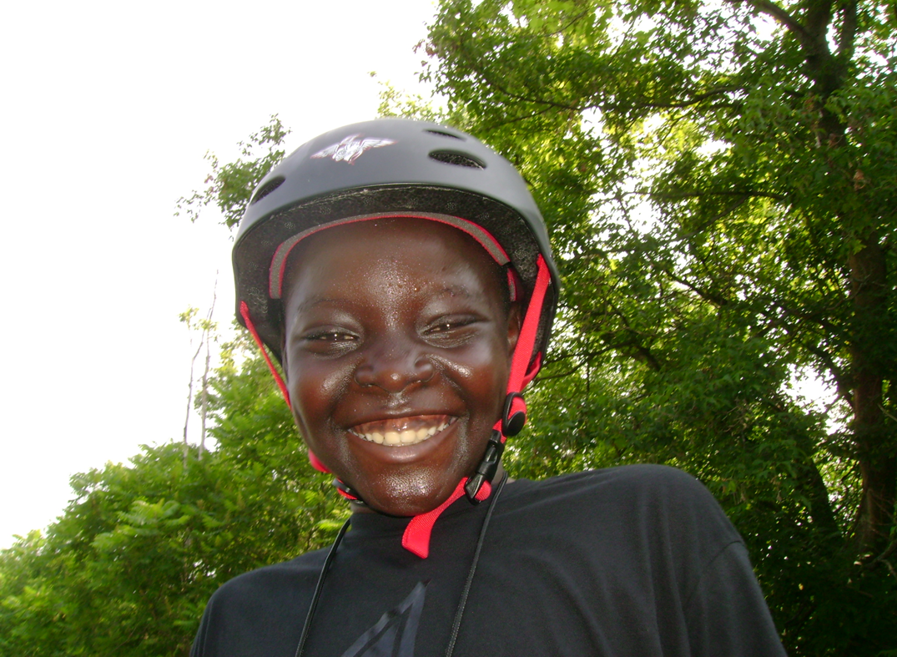
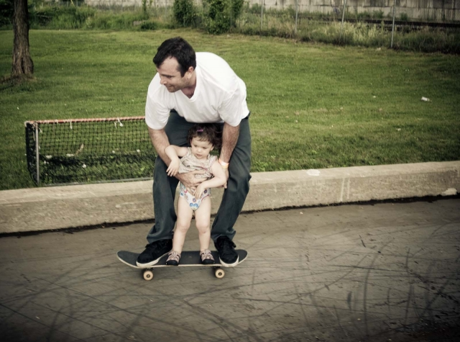
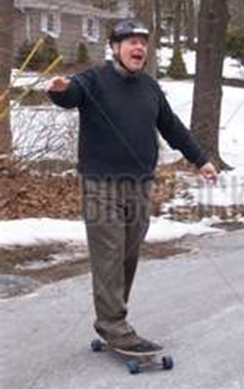
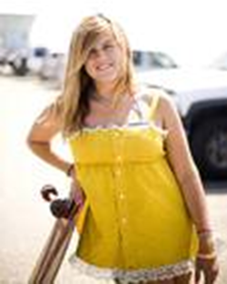
This Project Represents Burlington’s Core Values
Outdoor/recreational community with a history of action sports and nationally known ‘action sports’ companies like Burton Snowboards and Fuse Marketing
Low barrier entry, low cost activity – open to all ages, multi-generational, non-income restricted
Skateparks provide an alternative to organized sports – it has increased 40% since 2008.
  Skateparks encourage creativity and physical well-being
Public Waterfront Access
Sustainable Project
Burlington Go Skate Day 2010 – before the new skatepark
There are over 13 million skateboarders in the USA, 15% (and growing) are girls.

Slide 5

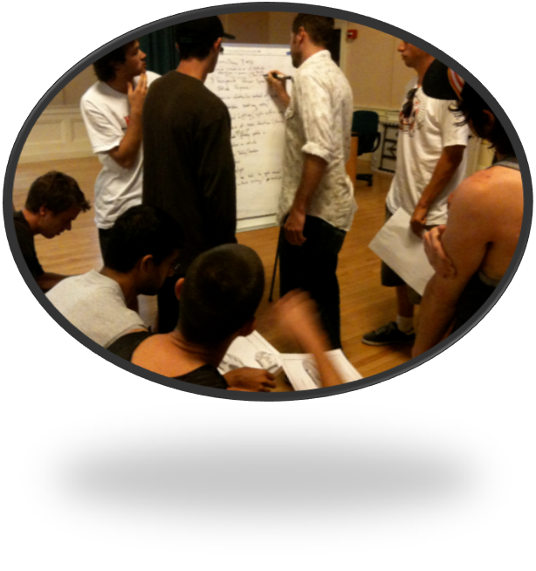
Burlington Best Practice - Civic Engagement
Community members – younger and engaged in community process – growing our future leaders
Shows by example - you can make a difference if you engage
Advocacy for the project itself
Fundraising on an individual and business level
Part of the design process

Slide 6
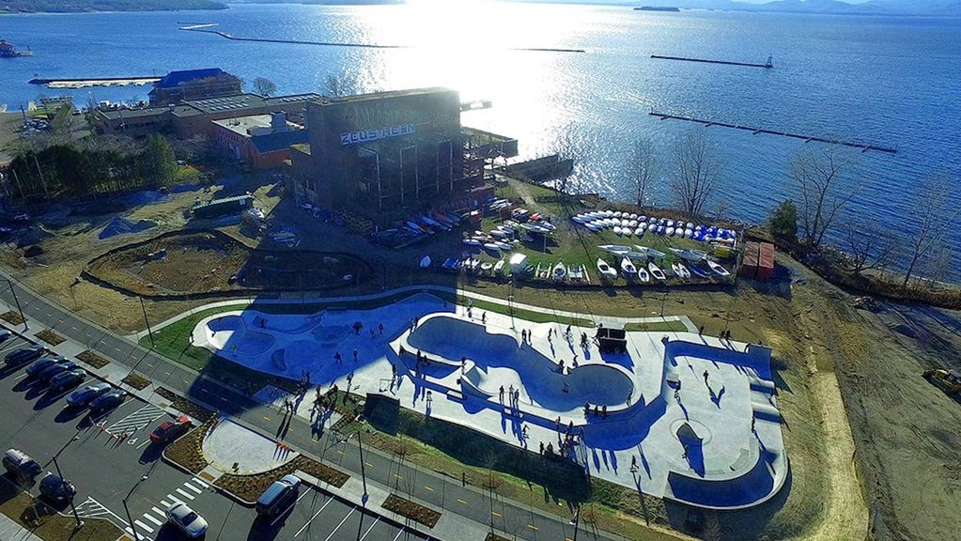
Remediation of Brownfields – Big Results
Able to achieve so much in one location
Remediated a significant Brownfield returning it to public use
Stormwater – innovative and beautiful constructed wetlands with interpretation
Overhead public and private utilities relocated underground
Transportation – new street, lighting, trees, sidewalks and bike path
Recreation – improved access with new section of Bike Path and new 21,000sf skatepark facility
Access for all to our waterfront-Lake Champlain

Slide 7
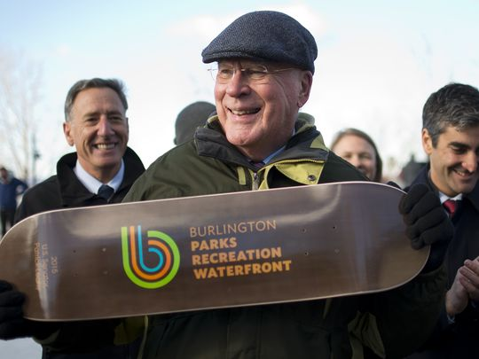
Budget/Leverage
22 funding sources – federal/state/local/private
EPA/HUD/FHWA (incl. TIGER)
CDBG - $3737.00
Section 108/BEDI - $410,154 for infrastructure in the area
Local – voter approved – at 70% 2012- existing TIF(tax increment financing) district $2.9 million into WAN and 2014 – additional $500K
Skatepark ($1.365 million) was 15% of the larger $9.1M Waterfront Access North project
Support from the Mayor, Council, Federal delegation and citizens
Senator Leahy, Governor Shumlin and Mayor Weinberger at the opening where the community presented them with skateboards to show their appreciation

Slide 8
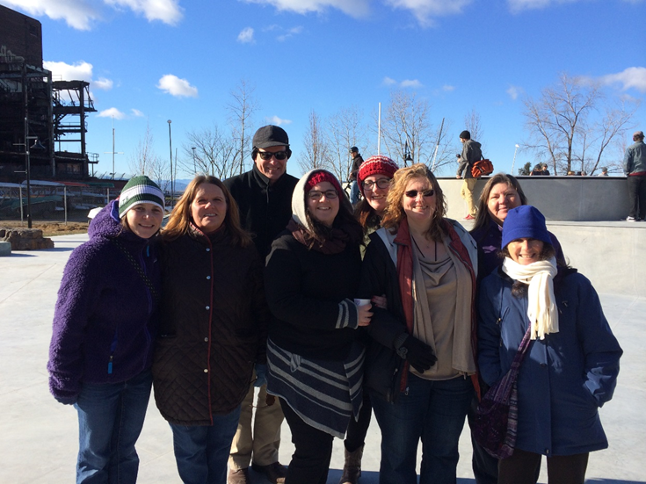
For more information
Marcy Esbjerg
Assistant Director
Community, Housing & Opportunity Programs
Community & Economic Development Office
Burlington, VT
Burlingtonvt.gov/cedo

