Slide 1

American Community Survey (ACS)
Using Census Data by Block Group
January 21, 2016
Presentation at the National Community Development Association Winter Legislation and Policy Meeting
Dave Raglin and Gretchen Gooding
American Community Survey Office
Notes:
The American Community Survey: Using Census Data by Block Group - Congressional Ballroom II
Experts from the U.S. Census Bureau will provide session participants with a demonstration on how to access and use the block group level data available through the American Community Survey, including a real-time example of block group data. HUD staff will discuss how the ACS data is used to create its Low/Mod Income Summary information and how the ACS data feeds into the CDBG formula calculations.
Moderator: Sheryl Kenny, Grants Manager, Arlington, TX
Speakers:
Gretchen Gooding, American Community Survey Office, U.S. Census Bureau, Washington, DC
David Raglin, American Community Survey Office, U.S. Census Bureau, Washington, DC
Steve Johnson, Director, Entitlements Division, HUD, Washington, DC
Arlington, Texas (1216.044)
Block Group 4, Census Tract 1216.04, Tarrant County, Texas

Slide 2
Outline
American Community Survey (ACS) basics
Resources for learning more
Accessing block groups in American FactFinder
Stay in touch
Questions
Notes:
I’ll start today by going over the basics of the American Community Survey (ACS); including the history of the survey, how the data are collected, the topics included in the content of the survey, and the geographies covered by the survey.
Next, I’ll cover some resources available to you for learning more about the ACS,
followed by information about the different ACS data products available and the different ways to access those data products.
I’ll reserve some time at the end for any questions you might have.

Slide 3
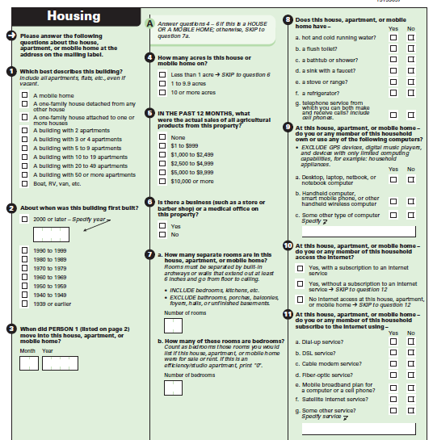
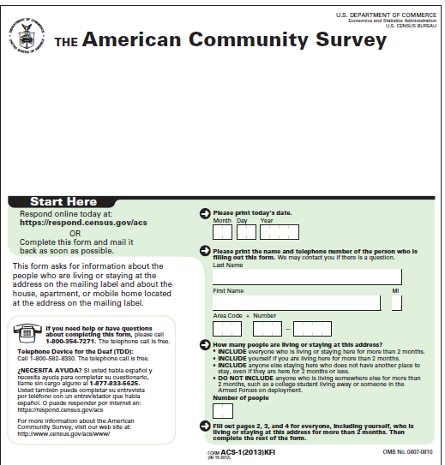
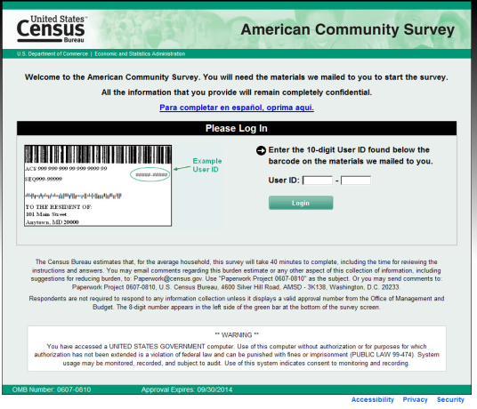
ACS Basics
Ongoing monthly survey sent to 3.5 million addresses per year to produce detailed population and housing estimates each year
  Visit 20,000 Group Quarter facilities and sample approximately 194,000 residents each year
Designed to produce critical information on small areas and small population groups previously collected on the decennial long form
Covers 35+ topics and supports over 300 known Federal Government uses
Data released twice annually
  1-year estimates (12 months of data)
  5-year estimates (60 months of data)
Notes:
The American Community Survey is an ongoing national survey that samples approximately 3.5 million addresses annually, which comes out to about 290,000 addresses per month. These data are collected continuously throughout the year, to produce detailed population and housing estimates each year.
The survey covers the resident population of the United States and Puerto Rico for those people living in housing units and group quarters. Housing units include living arrangements such as a typical house, apartment, or mobile home. Group quarters are group living arrangements that are owned or managed by an entity or organization (for example, dorms, correctional facilities, or barracks).
The survey produces critical information for small areas and small population groups – the ACS is the only source of information for many of its topics in these small areas.
These estimates are designed to produce critical information that was previously collected in the decennial census. Our estimates, covering more than 35 topics support more than 300 known federal uses and countless nonfederal uses.
We release two different sets of estimates each Fall (annual 1-year and 5-year period datasets).

Slide 4
Census & ACS
1790
1800
1810
1820
1830
1840
1850
1790-1930 Census
one form to all households
1860
1870
1880
1890
1900
1910
1920
1930
1940
1950
1940-2000 Census
short form & long form
1960
1970
1996
1980
1996-2004 ACS
demonstration period
1990
2000
2000
2010
2020
2005
2005-present ACS/PRCS
annual estimates for all geographies
2010
2010 Census and future
short form only
2020
Notes:
The first census of the United States was conducted in 1790, and occurred every ten years with one form being sent to all households until 1930.
From 1940 to 2000, the decennial census contained a short form that was sent to all households and a long form that was sent to a sample of households.
In 2000, a large scale demonstration of the American Community Survey was conducted, and the ACS/PRCS was fully implemented in 2005.
In 2010 and moving forward, the decennial census is only a short form sent to all households because the ACS collects information once collected by the long form.

Slide 5
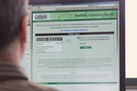



ACS Data Collection Process
Online
Mail
Telephone
Personal Visit
Self-Response Modes
Non-Response Modes
Notes:
The American Community Survey data collection operation uses four modes that take place over a three-month period: Internet, mail, telephone, and personal visit.
For most housing units, the first phase of data collection includes an invitation for the household to respond via Internet which is mailed to the sample address. If the household does not respond via Internet, a paper questionnaire is sent to the sample address for the household to complete and return by mail. Internet data collection started in 2013.
If no response is received by mail or Internet, the Census Bureau follows up with computer assisted telephone interviewing, or CATI, if a telephone number is available for the address.
If the Census Bureau is unable to reach an occupant of the unit using CATI, or if the household refuses to participate, the address may be selected for computer assisted personal interviewing, or CAPI. At any point in this process, receipt of an Internet response or a completed paper questionnaire from the sampled address results in the address being removed from the data collection workload.

Slide 6




ACS Content
Social
Demographic
Age
Hispanic Origin
Race
Relationship
Sex
Computer & Internet Use
Costs (Mortgage, Taxes, Insurance)
Heating Fuel
Home Value
Occupancy
Plumbing/Kitchen Facilities
Structure
Tenure (Own/Rent)
Utilities
Vehicles
Year Built/ Year Moved In
Ancestry
Citizenship
Disability
Educational Attainment
Fertility
Grandparents
Language
Marital Status
Migration
School Enrollment
Veterans
Housing
Economic
Class of Worker
Commuting
Employment Status
Food Stamps (SNAP)
Health Insurance
Hours/Week, Weeks/Year
Income
Industry & Occupation
35+ Topics
1000+ Tables
11 Billion Estimates
Notes:
--The content collected by the American Community Survey can be grouped into four main types of characteristics – social, economic, housing, and demographic.
Let’s take a closer look at the type of information each of these categories contain.
--Social characteristics include topics such as education, marital status, fertility, veterans, disability status, place of birth, citizenship status, year of entry, language spoken at home, migration, and others.
--The American Community Survey also collects basic demographic characteristics such as sex, age, race and Hispanic origin. This is the same information that was collected by the 2010 Census.
--Economic characteristics include such topics as employment status, income, commuting to work, occupation, industry, health insurance and others.
--Housing characteristics include topics such as tenure (whether you own or rent your home), information about occupancy and the structure itself, home value, housing costs (incl. mortgages, taxes and insurance, utilities, and plumbing/kitchen facilities and others.
-These topics are used to produce more than 1,000 tables for local communities resulting in more than 11 billion estimates each year.
6

Slide 7
Selected Census Geographic Concepts
Nation
Metropolitan and Micropolitan Areas
American Indian/
Alaska Native Areas/
Hawaiian Home Lands
Zip Code Tabulation Areas
Urban Areas
Regions
States
Congressional Districts
School Districts
Places
Counties
Public Use Microdata Areas (PUMAs)
Alaska Native Regional Areas
State Legislative Districts
Census Tracts
930,000 Geographic Areas
35,000+ Communities
Block Groups
7
Notes:
These are some of the geographies for which ACS data is produced and the relationship between them. Lower geographic areas fit neatly within the larger areas directly connected with lines. For example, school, congressional, and state legislative districts fit neatly within states and do not cross state boundaries. However, they may cross boundaries of counties or metropolitan areas.
It is important to note the difference between Legal and Administrative areas and Statistical areas.
First, Legal/administrative areas have legally described boundaries; they may provide governmental services or may be used to administer programs. (Examples are Counties, Incorporated Places, Congressional Districts, and School Districts)
Statistical geographic areas are defined primarily for data tabulation and presentation purposes.
(Examples are Public Use Microdata Areas, Census Tracts, and Block Groups).
Block groups are statistical divisions of census tracts and are defined to contain a minimum of 600 persons or 240 housing units and a maximum of 3,000 people or 1,200 housing units. In the American Community Survey, block groups are the lowest level of geography published.
Census tracts are small, relatively permanent of a county or county equivalent. Census tracts generally have a minimum population of 1,200, or 480 housing units, and a maximum population of 8,000 people or 3,200 housing units. Tracts have an optimum size of 4,000 people or 1,600 housing units.

Slide 8
Availability of ACS Data Products
Estimated Population of Geographic Area | 1-Year Estimates | 3-Year Estimates | 5-Year Estimates
65,000 or more | X | X | X
20,000 to 64,999 |  | X | X
Less than 20,000 |  |  | X
Planned Release Date | September 2016 | N/A | December 2016
Notes:
ACS data products are released only one year after the data is collected, and the first year of data collection with a full sample was in 2005.
Thus, ACS data that was collected in 2006 was released in 2007 as 1-year estimates.
ACS 3-year estimates, pooling data collected over 36 months between 2005 and 2007 were first released in 2008, one year after the third full year of ACS data collection.
ACS 3-year estimates were then released each year using the 3 most recent years of data.
ACS 5-year estimates, pooling data collected over 60 months between 2005 and 2010 were released for the first time in 2010, one year after the fifth full year of ACS data collection.
ACS 5-year estimates were then released each year using the 5 most recent years of data.
ACS data are available for geographic areas with a population of 65,000 or more in the form of 1-year and 5-year estimates. ACS data are only available for geographic areas with a population less than 64,999 in the form of 5-year estimates.
In 2015, the U.S. Census Bureau has discontinued the 3-year estimates in order to prioritize activities that would preserve the integrity of the sample, enhance the quality of the entire data set, and ensure a better experience for the respondent (reinstating an operation that collects data left incomplete by respondents, additional training for field representatives, continued review of the survey questions, and expanded outreach and partnership with stakeholders).
Although the Census Bureau would discontinue the 3-year product, every community in the nation will continue to receive detailed social, economic, housing and demographic characteristics through the 1-year and 5-year products. (Additionally, past 3-year data products, for populations of 20,000+ are still available to the public.)

Slide 9
Outline
American Community Survey (ACS) basics
Resources for learning more
Accessing block groups in American FactFinder
Stay in touch
Questions
Notes:
Now we’ll talk about some resources for learning more about the ACS

Slide 10
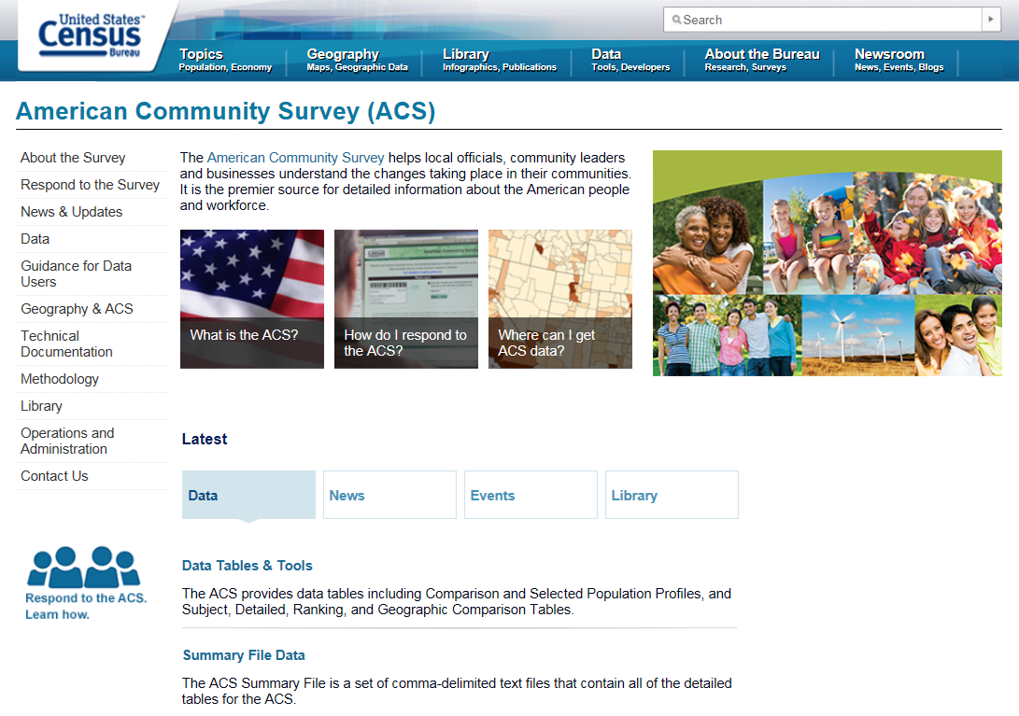
ACS Main Page
census.gov/acs
Notes:
The American Community Survey Web site has a lot of information about the program, data products, and helpful information and tools for data users.

Slide 11
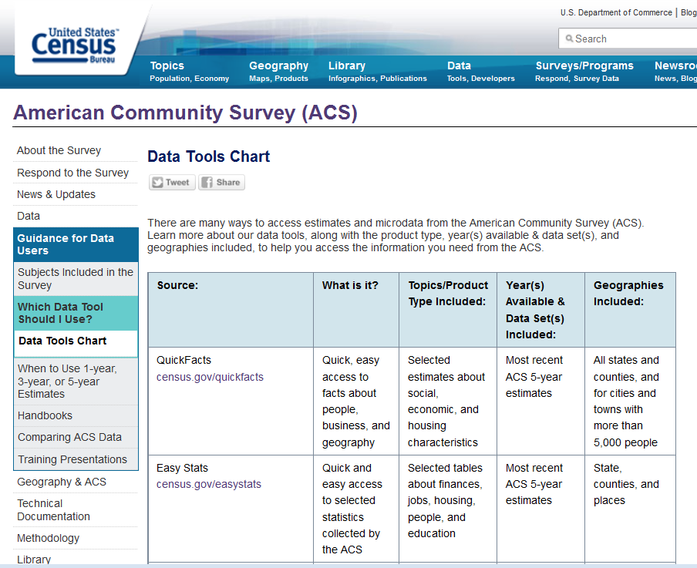
Data Tools Chart
census.gov/programs-surveys/acs/guidance/which-data-tool/data-tools-chart.html
Notes:
Today we are focusing on FactFinder, but this page shows other ways to get ACS data. Some are meant for more novice users while others are for “data junkies”.

Slide 12
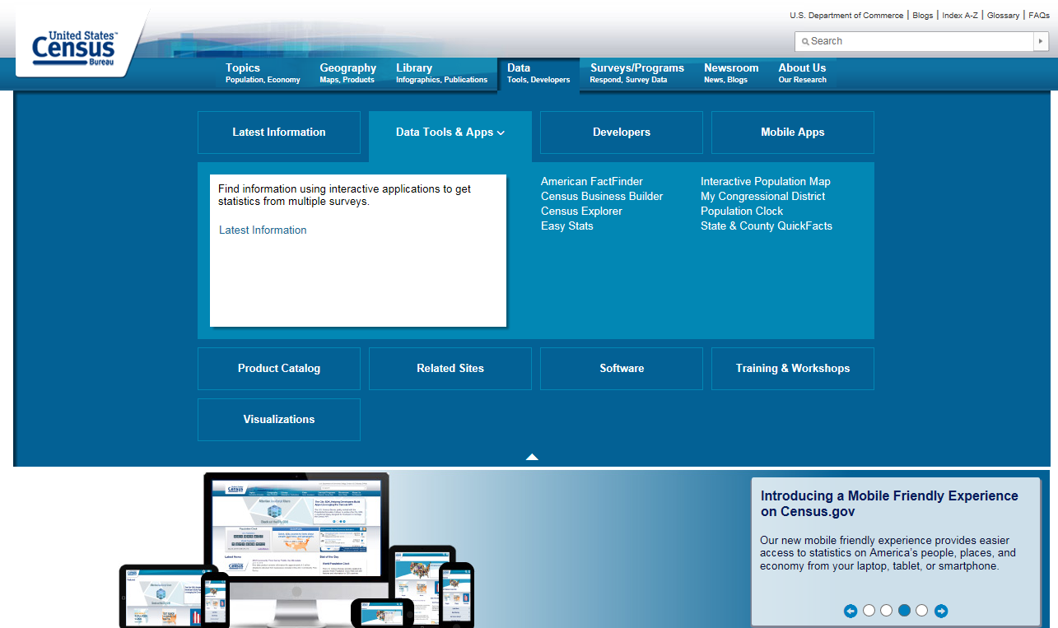
Find Data Tools on Census.gov
12
Notes:
All data tools are available from census.gov. Choose the data tab at the top, then click the Data Tools & Apps button.

Slide 13
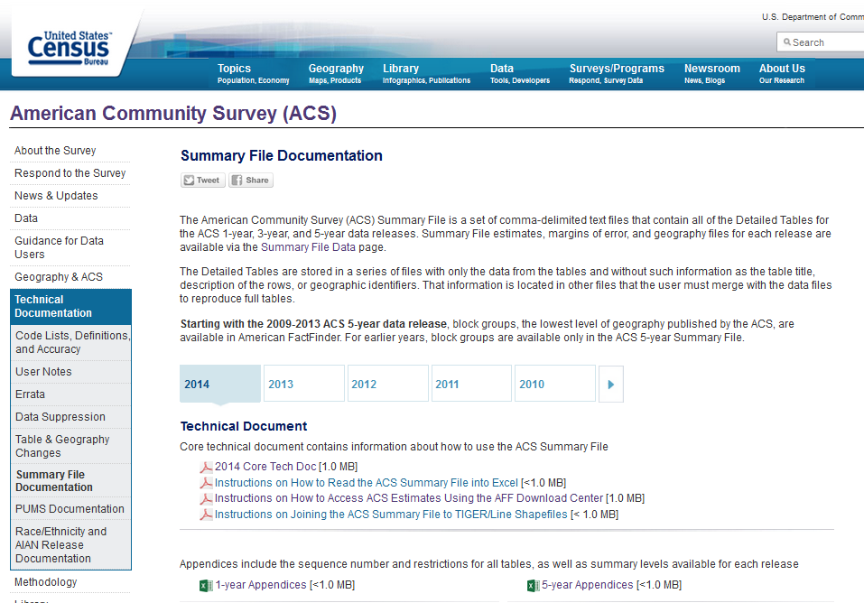
Block Group Availability
census.gov/programs-surveys/acs/technical-documentation/summary-file-documentation.html
Notes:
-You can use Appendix B from the 5-year Summary File documentation to see a list of all tables, and if they are available at the BG level

Slide 14
Outline
American Community Survey (ACS) basics
Resources for learning more
Accessing block groups in American FactFinder
Stay in touch
Questions
Notes:
Next, we’ll talk about how to access block groups in American FactFinder.

Slide 15
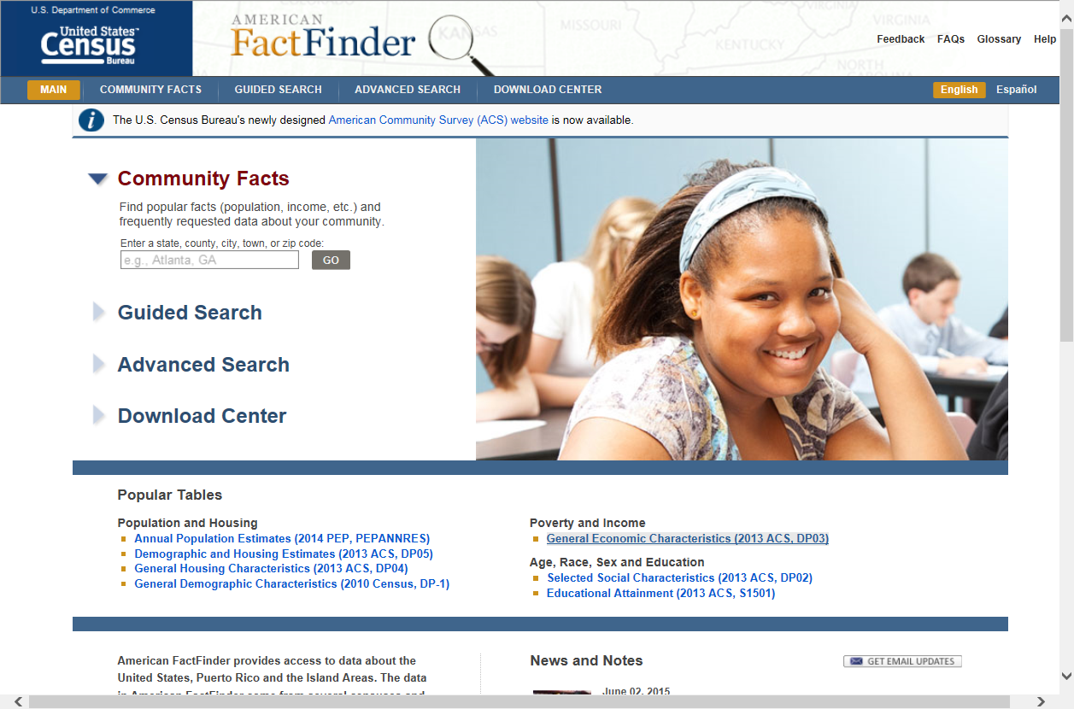
American FactFinder
When to use:
Search all ACS data for all geographies down to the block group level
factfinder.census.gov
15
Notes:
American FactFinder is the most comprehensive tool for accessing Census Bureau statistics. Users can still choose between several speeds:
-Community Facts delivers quick facts
-Guided Search walks users through the process of finding what they need.
-Advanced Search allows for very specific queries
-Download Center allows users to download an entire dataset and explore it on their own.

Slide 16
Two Options to Find
Block Groups in AFF
AFF Advanced Search
  Useful if you only want a few BGs
AFF Download Center
  Useful if you want all BGs in your state

Slide 17
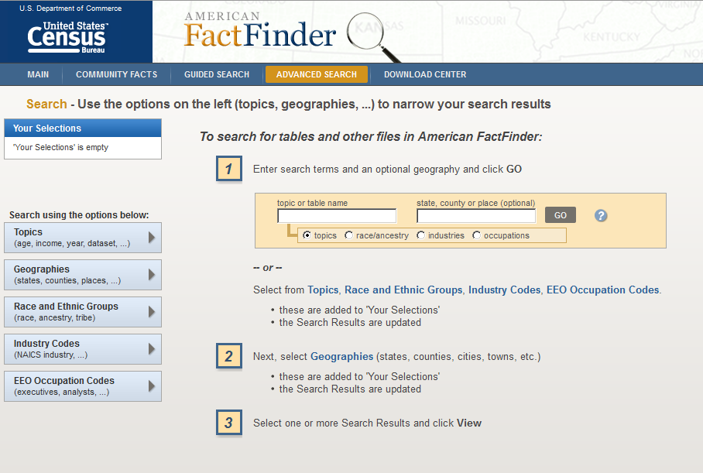
Option 1-AFF Advanced Search
17
Notes:
Here are some quick tips for using the Advanced Search:
-Make sure Your Selections is empty
-Narrow your selections by choosing parameters on the left.
-Generally, start with the Geographies tab

Slide 18
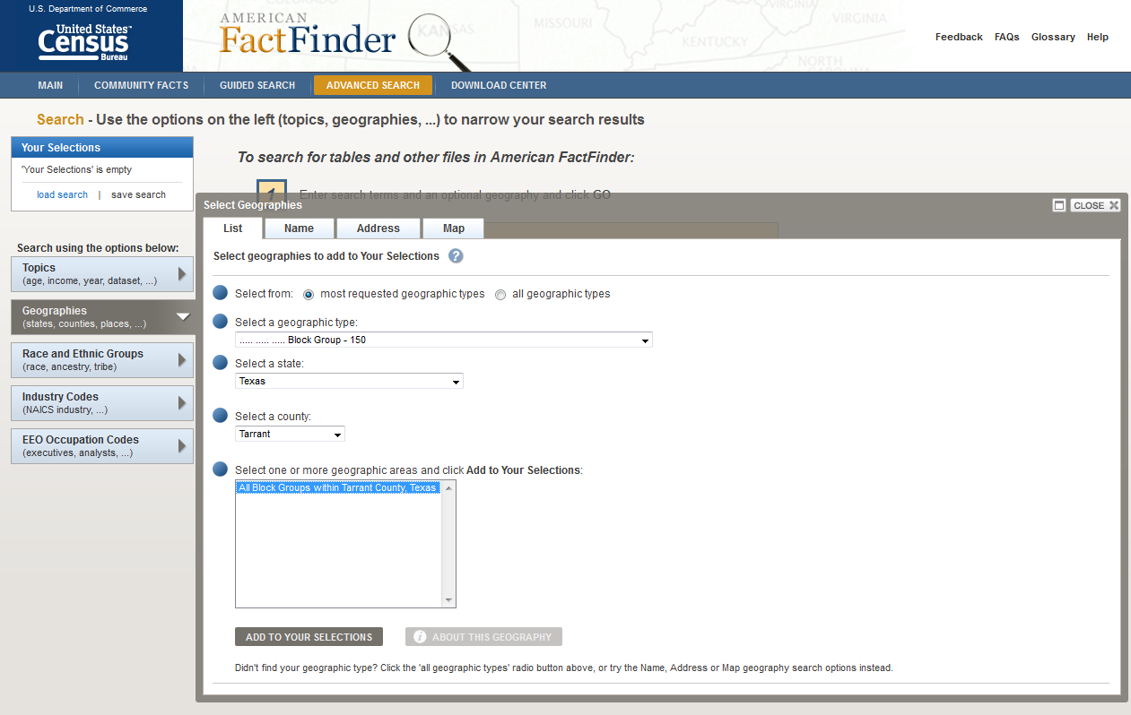
AFF Geographies-List Tab
Notes:
-Click on Geographies, then List
-Select “Block Group-150” under “Select a geographic type”
-Here, we selected “Texas” under “Select a state”
-Here, we selected “Tarrant” under “Select a county”
-Select “All Block Groups within Tarrant County, Texas” then click “Add To Your Selections”

Slide 19
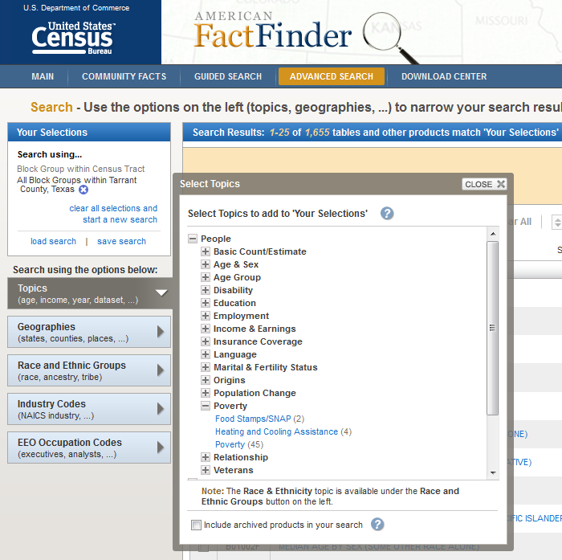
Selecting a Topic
Notes:
-You should see “All Block Groups within Tarrant County, Texas” in “Your Selections”
-Close the “Geographies” overlay screen
-There are 1,655 tables available for this geography
-Next, select a topic
-Click on Topics→People→Poverty→Poverty
-You should see Poverty in “Your Selections”
-Close the “Topics” overlay screen
-There are now 45 tables available for this topic and geography

Slide 20
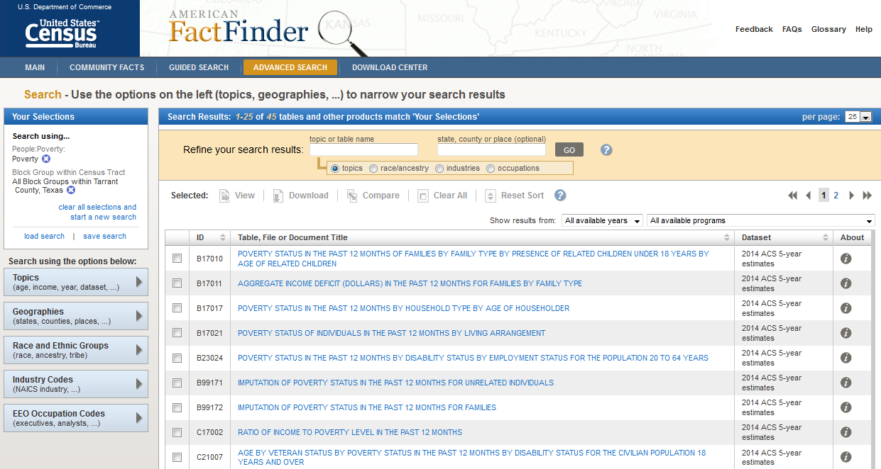
Selecting a Table
Notes:
-You should see Poverty in “Your Selections”
-There are now 45 tables available for this topic and geography
-From here, click on the blue table title corresponding to your table of interest

Slide 21
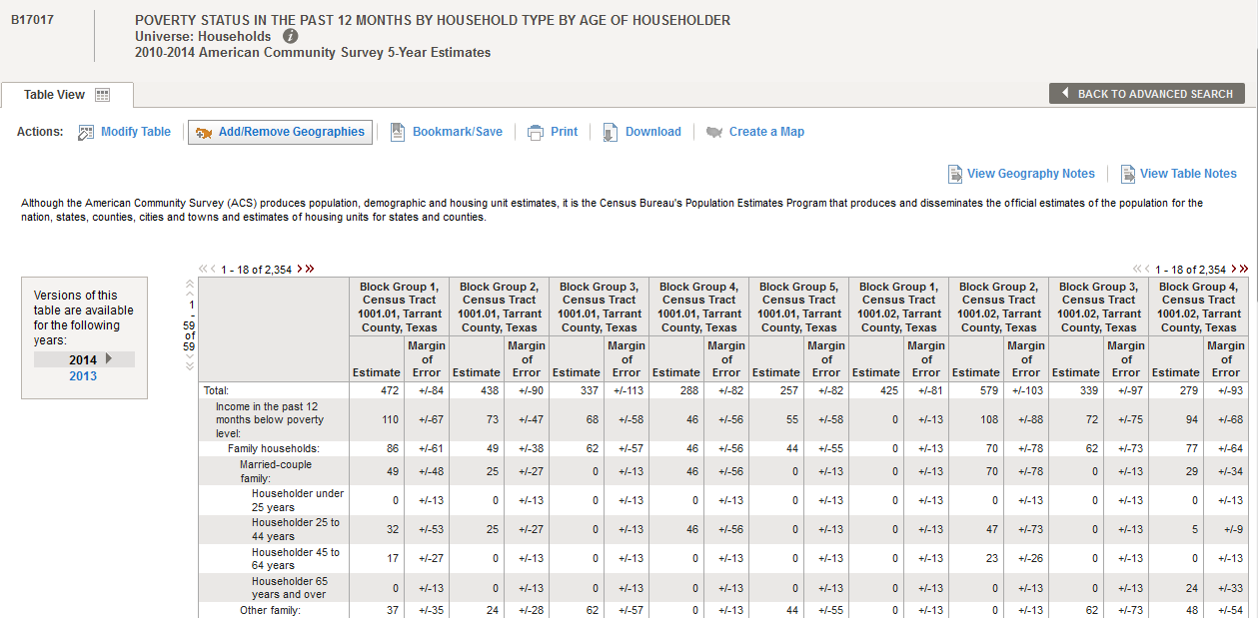
Table B17017
Notes:
POVERTY STATUS IN THE PAST 12 MONTHS BY HOUSEHOLD TYPE BY AGE OF HOUSEHOLDER
Universe: Households
2010-2014 American Community Survey 5-Year Estimates

Slide 22
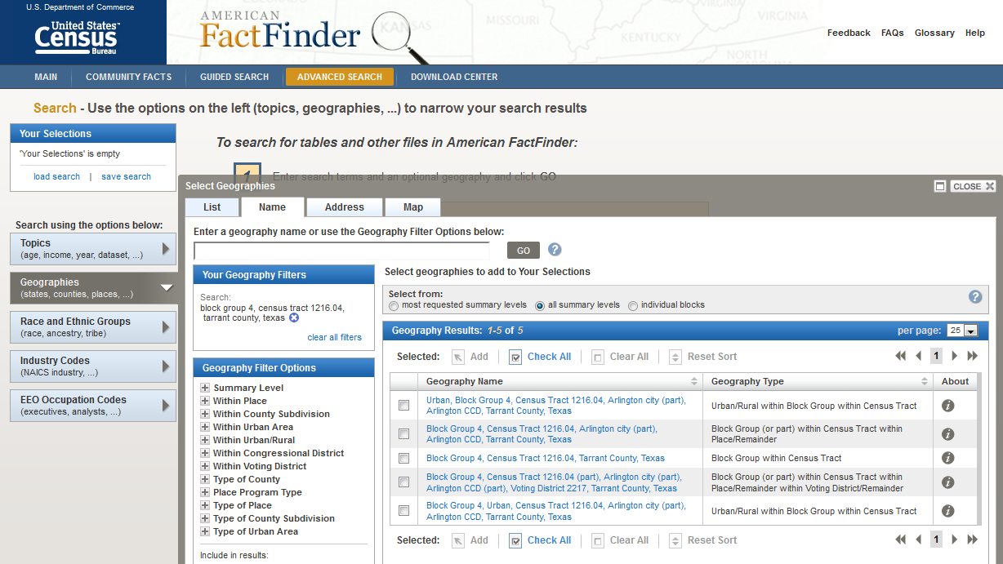
AFF Geographies-Name Tab
Notes:
-Click on Geographies, then Name
-Select “all summary levels” under “Select from:”
-Enter name of block group (block group 4, census tract 1216.04, tarrant county, texas)
-Click on corresponding Geography Name to add to “Your Selections”

Slide 23
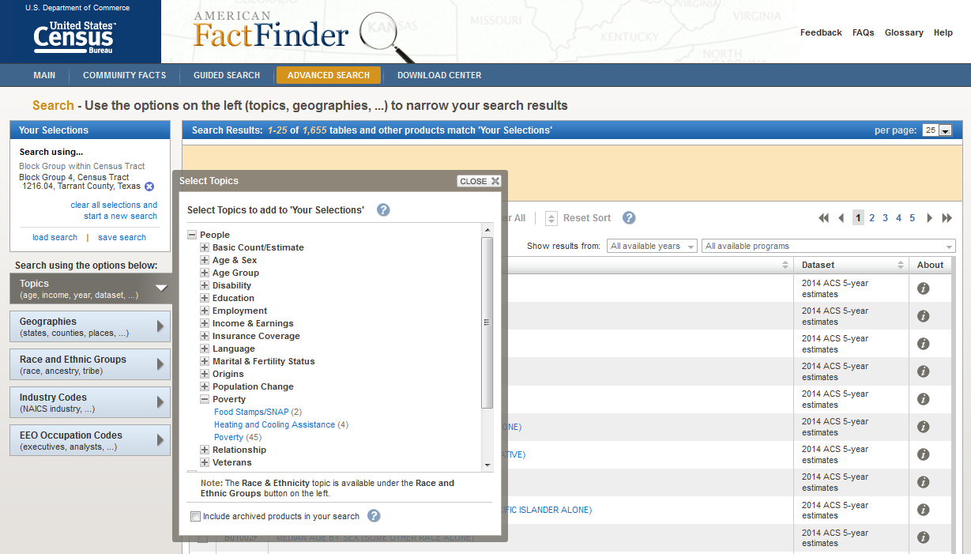
Selecting a Topic
Notes:
-You should see your BG in “Your Selections”
-Close the “Geographies” overlay screen
-There are 1,655 tables available for this geography
-Next, select a topic
-Click on Topics→People→Poverty→Poverty
-You should see Poverty in “Your Selections”
-Close the “Topics” overlay screen
-There are now 45 tables available for this topic and geography

Slide 24
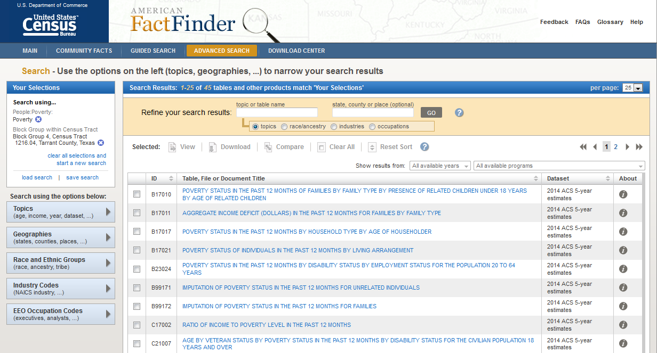
Selecting a Table
Notes:
-You should see Poverty in “Your Selections”
-There are now 45 tables available for this topic and geography
-From here, click on the blue table title corresponding to your table of interest

Slide 25
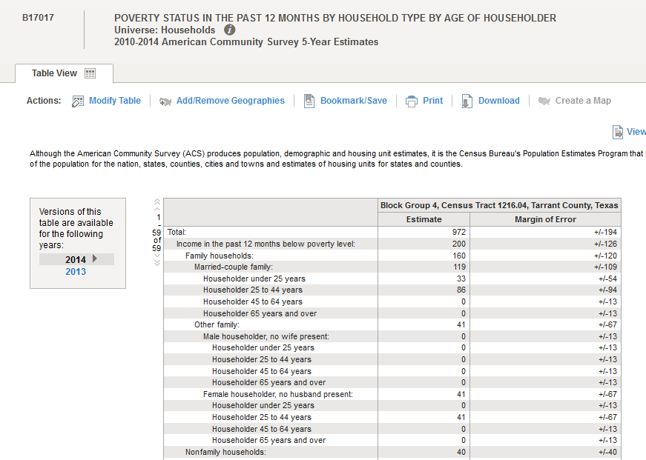
Table B17017

Slide 26
Data Product Types
Profiles
Tables
  Data Profiles (DP)
  Narrative Profiles (NP)
  Comparison Profiles (CP)
  Selected Population Profiles (S0201)
  Detailed Tables (B or C)
  Subject Tables (S)
  Ranking Tables (R)
  Geographic Comparison Tables (GCT)
26
Notes:
-Product Types is a topic you can select in AFF.
-The letters in parentheses next to the profiles and tables correspond to the beginning of the table ID in AFF
-Through American FactFinder, you can access a wide range of American Community Survey Data Products.
Profiles
--offer a broad look at a community’s social, economic, housing, and demographic characteristics
--generally include many different variables
--geography or population group is at the center
Tables
--a precise or detailed view of a subject
--subject matter is at the center of the table
--Data profiles Provide broad social, economic, housing, and demographic profiles.
--Narrative profiles Summarize the information in the data profiles using concise, nontechnical text.
--Comparison profiles offer comparisons of estimates across ACS years.
--Selected population profiles Provide broad social, economic, and housing profiles for a large number of race, ethnic, ancestry, and country/region of birth groups.
--Detailed tables Provide access to the most detailed ACS data and crosstabulations of ACS variables.
--Subject tables Similar to data profiles but include more detailed ACS data, classified by subject.
--Ranking tables Provide state rankings of estimates across 86 key variables.
--Geographic comparison tables Compare geographic areas other than states (e.g., counties or congressional districts) for key variables.

Slide 27
Table Numbering
B
06
004
A
PR
B=Data Product Type (Base Table)
06=Subject (Place of Birth)
census.gov/programs-surveys/acs/guidance/comparing-acs-data/2014.html
004=Sequential Number
A=Race/Hispanic Origin (White Alone)
PR=For Puerto Rico Geographies Only
Notes:
B06004APR (Place of Birth White Alone in Puerto Rico) - most complex example of a table number
The first letter is the data product type:
B: base table
C: collapsed table
S: Subject Table, etc.
The next two numbers are the Subject
06: Place of Birth
21: Veteran Status
27: Health Insurance
(The full listing of these can be found at the url there)
The next three numbers are the sequential number of the table. Many table numbering schemes stop here.
A letter A-I at the end means the table is filtered for one race or hispanic origin category
A PR at the end means the table is available for Puerto Rico only.

Slide 28
Subject Categories
01: Age and Sex
02: Race
03: Hispanic Origin
04: Ancestry
05: Citizenship
06: Place of Birth
07: Residence 1 year ago
08: Commuting
09: Children
10: Grandparent
11: Household Type
12: Marital Status
13: Fertility
14: School Enrollment
15: Educational Attainment
16: Language Spoken

Slide 29
Subject Categories
17: Poverty
18: Disability
19: Income
20: Earnings
21: Veterans/Military Service
22: Food Stamps
23: Employment Status
24: Industry and Occupation
25: Housing
26: Group Quarters
27: Health Insurance
28: Computer/Internet Use
98: Quality Measures
99: Imputation/Allocation

Slide 30
Poverty Tables
17 series
26 tables, 3 by race/Hispanic origin
Poverty status of individuals by topics like:
  Sex, age, educational attainment, work experience, employment status, children, unrelated people, nativity

Slide 31
Poverty Tables
Poverty status of families by topics like:
  Household type; number of related children, persons and workers in family; income source; work experience; age of householder; educational attainment of householder; owner/renter
Ratio of income to poverty by topics like:
  Age, family type, related children, health insurance status (in B27 Series)

Slide 32
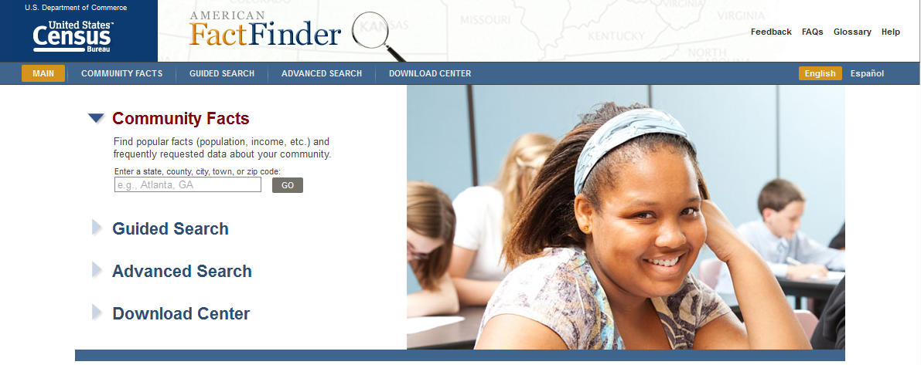
Option 2-AFF Download Center
factfinder.census.gov
Notes:
Now that we know about Advanced Search, let’s access block groups using the AFF Download Center.

Slide 33
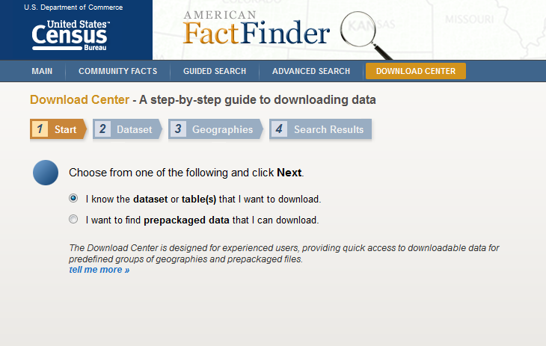

1. Start
Notes:
Choose the radio button “I know the dataset or table(s) that I want to download”
Click “Next”

Slide 34
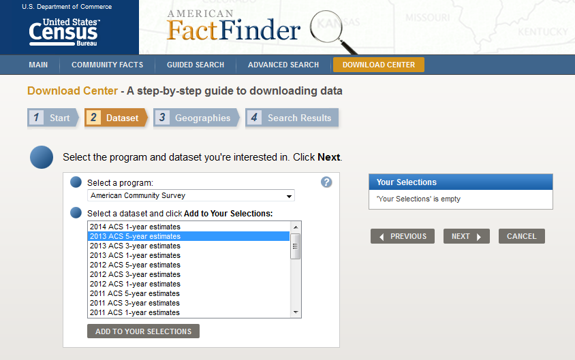
2. Dataset
Notes:
Under the “Select a program” dropdown, select “American Community Survey”
Under the “Select a dataset and click Add to Your Selections” dropdown, we will pick the “2013 ACS 5-year estimates” for this demo.
Click on the “ADD TO YOUR SELECTIONS” button
Click “Next”

Slide 35
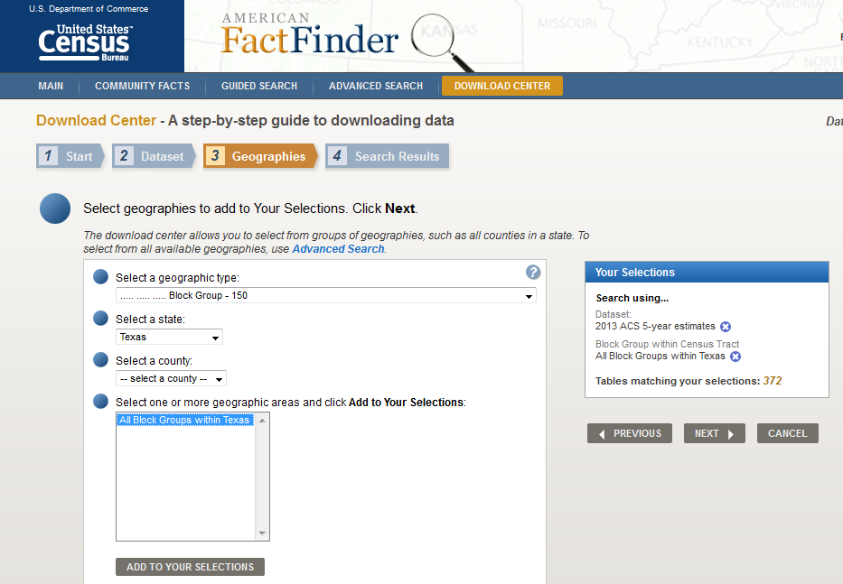
3. Geographies
Notes:
Under the “Select a geographic type” dropdown, select “Block Group”
Under “Select a state,” choose your state of interest. Here, we will use Texas.
Under “Select a county,” choose your county or counties of interest. You can also bypass this step and select “All Block Groups within Texas” under “Select one or more geographic areas and click Add to Your Selections.” The Download Center is the only spot in AFF where you can get all block groups for your state. The Advanced Search tab only lets you select all block groups for your county.
Click “Next”

Slide 36
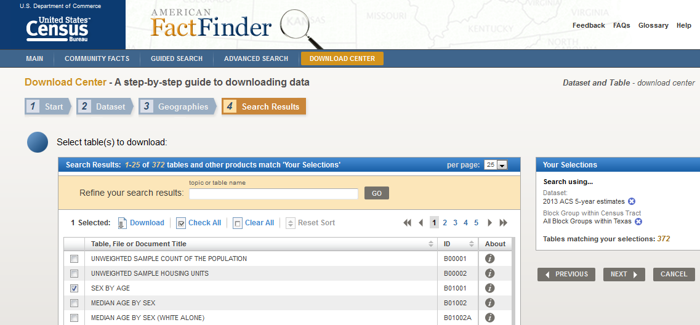
4. Search Results
Notes:
Under “Select table(s) to download,” check the box next to your table(s) of interest. Here, we select Table B01001 Sex by Age.
Click “Next”
A window will appear confirming your selections. Click “OK”
Another window will appear as your table(s) is downloading. When the file is complete, click the “Download” button to save the file to your computer.

Slide 37
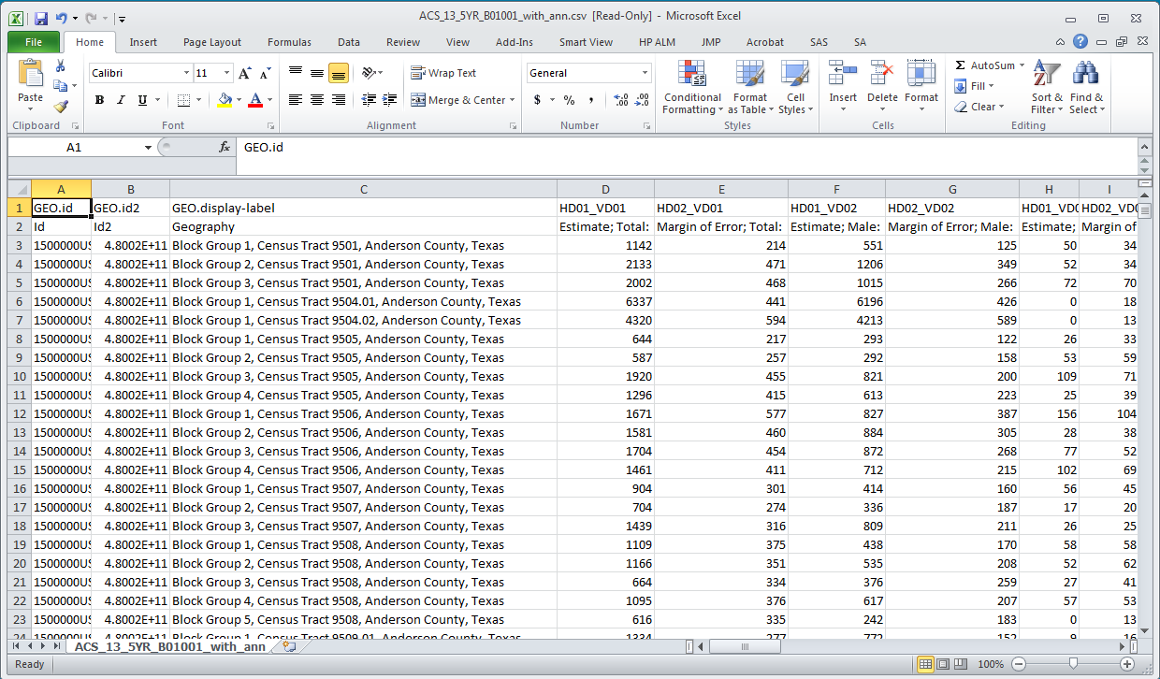
Table B01001
Notes:
Here, we unzipped the CSV file “ACS_13_5YR_B01001_with_ann.csv” and opened it in Excel
You can see our geography (block groups in Texas) in Column C, and our estimates and MOE in Columns D and up
Remember, the exact process for unzipping and opening files may vary based on your computer.
So, that was the AFF download center.

Slide 38
Outline
American Community Survey (ACS) basics
Resources for learning more
Accessing block groups in American FactFinder
Stay in Touch
Questions

Slide 39



Source Us!
U.S. Census Bureau’s [YYYY-YYYY] American Community Survey [1/3/5]-year [estimates/statistics/data release]
39
Notes:
-Health Affairs Blog
http://healthaffairs.org/blog/2015/09/28/census-estimates-show-progress-toward-aca-coverage-goals-but-there-is-more-to-be-done/
-New Mexico State University
https://newscenter.nmsu.edu/Articles/view/11052/nmsu-valencia-county-extension-providing-youth-development-program-in-meadow-lake

Slide 40








Continue the Conversation #ACSdata
Sign up for and manage alerts at https://public.govdelivery.com/accounts/USCENSUS/subscriber/new
  More information on the American Community Survey:
  http://www.census.gov/acs
facebook.com/uscensusbureau
twitter.com/uscensusbureau
youtube.com/user/uscensusbureau
instagram.com/uscensusbureau
pinterest.com/uscensusbureau
(800) 923-8282 or
(301) 763-1405
Notes:
I encourage you to connect with us. You can sign up for and manage alerts on the ACS via GovDelivery, visit our website, or connect on the various social media platforms.

Slide 41

Purpose:
  Improve understanding of the value and utility of ACS data.
  Promote information sharing among data users about key ACS data issues and applications
Membership is free and open to all interested ACS data users
Webinars and special sessions at professional meetings planned
Users group website and online community
  http://www.acsdatausers.org/
Notes:
We want to remind you that there is a users group specifically for users of ACS Data.
-The “DUG” was formed in partnership with Population Reference Bureau and Sabre Systems.
It’s a great way to learn from your peers about how to use ACS data for all kinds of applications.
Go to acsdatausers.org to learn more, including how to sign up to be one of the over 1,400 users in the ACS online community

Slide 42
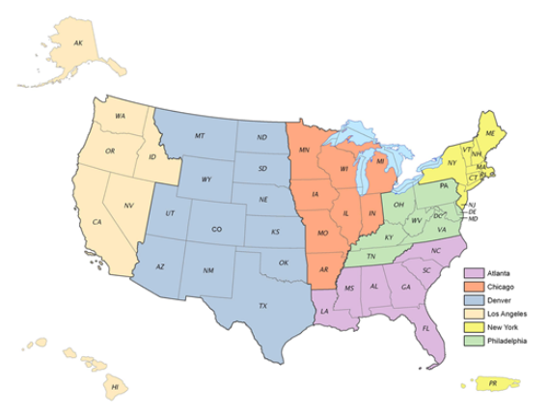
Need Local Stats?
Assistance Near You!
Our regional data staff can help you access local statistics from the ACS or offer training to help build your skills. Contact us at the following address: clmso.ddb.questions@ census.gov
42
Notes:
As a reminder, we have Data Dissemination Specialists throughout the country who can provide data workshops locally. If you’re interested in a workshop, please contact clmso.ddb.questions@census.gov.
Cities:
Atlanta, Miami, Charlotte
Chicago, Minneapolis, Little Rock
Denver, Albuquerque, Dallas, Houston
Los Angeles, Seattle, San Francisco, Nevada
NYC, Boston, CT/RI, NJ/PR
Philadelphia, Columbus, Richmond, Nashville, DC

Slide 43
Outline
American Community Survey (ACS) basics
Resources for learning more
Accessing block groups in American FactFinder
Stay in Touch
Questions

