Slide 1
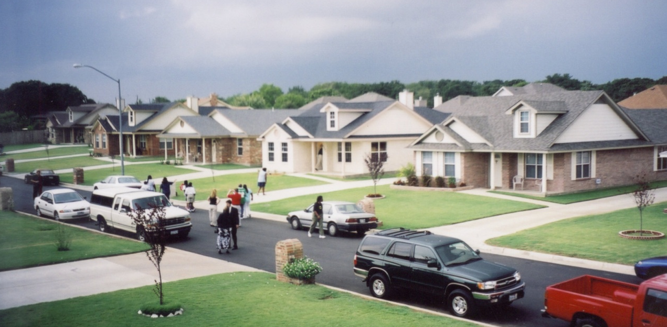

DJM Sourcing
Innovative
CHDO
Projects
July 30th 2012
National Community Development Association
46th Annual Conference
June 24-27, 2015

Slide 2
About TCHP
  TCHP is a non-profit organization founded in 1991 to revitalize distressed neighborhoods and to increase the amount of quality, affordable housing available to low and moderate income families and individuals with special housing needs.
  TCHP provides free programs and services including:
  Housing Counseling & Education
  Down Payment Assistance Programs
  Affordable Housing Development
  Property Management & Realty Services

Slide 3
Single Family Development
Resources
  Capital
  Line of Credit, EQ2, Development Reserve
  Grants
  Priority Markets, Enterprise, Federal Home Loan Bank, Home Depot Foundation
  HOME – State, County, City
  Partnerships
  City incentives/waivers for permit fees, demo, lots
  Gifts In Kind donations (Home Depot)
  Bank REO discounts
  Volunteer labor

Slide 4
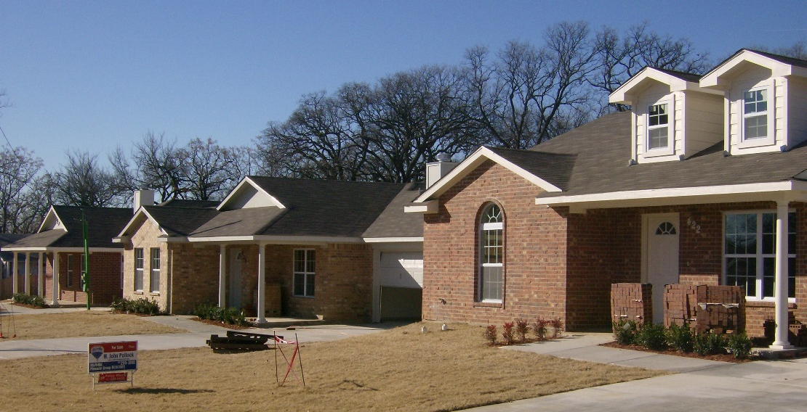
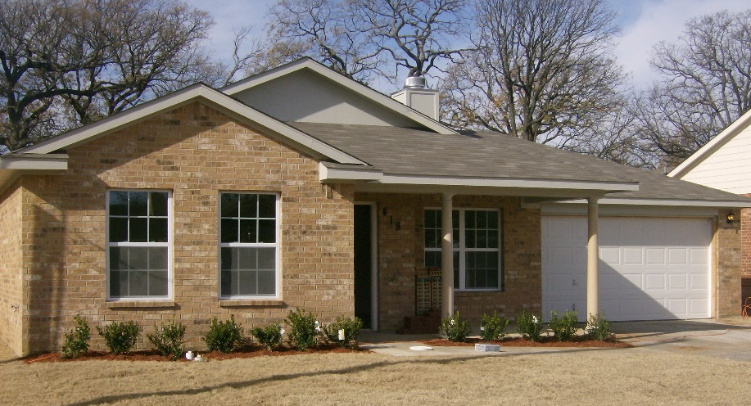
CHDO Project Examples
Jordan Lane New Construction
Partnered with the City of Arlington with HOME funding and CHDO proceeds
Previous vacant, dilapidated, neighborhood blight
City demolished homes prior to sale
Homes sold to first-time LMI homebuyers
Provided $7,500 in down payment assistance
Tax value increase from $11,000 to $118,000

Slide 5
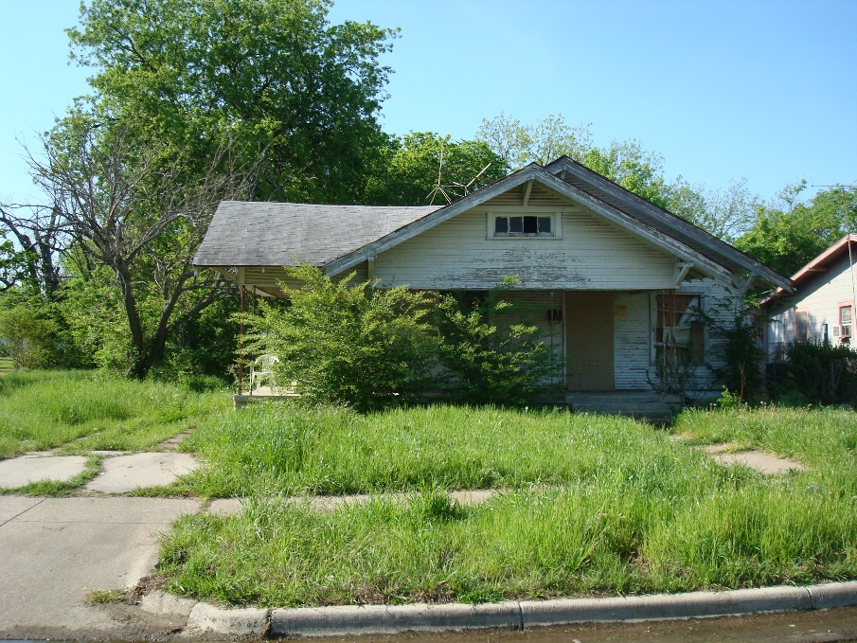
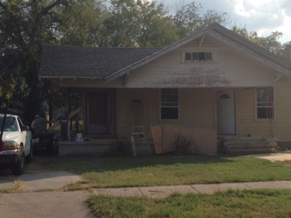
Hillside ‘Green’ Revitalization Project
Partnered with City of Fort Worth for infill new construction in target neighborhood
City retained ownership and conveyed lots during phases to decrease holding costs
Located in Neighborhood Empowerment Zone (NEZ) decreased development costs and provided property tax abatement for 5 years to LMI buyer.
Layered HOME funds with private Foundation contributions
Holistic revitalization approach as ‘Promise Neighborhood’ designation
Served as catalyst for private investors to expand revitalization efforts

Slide 6
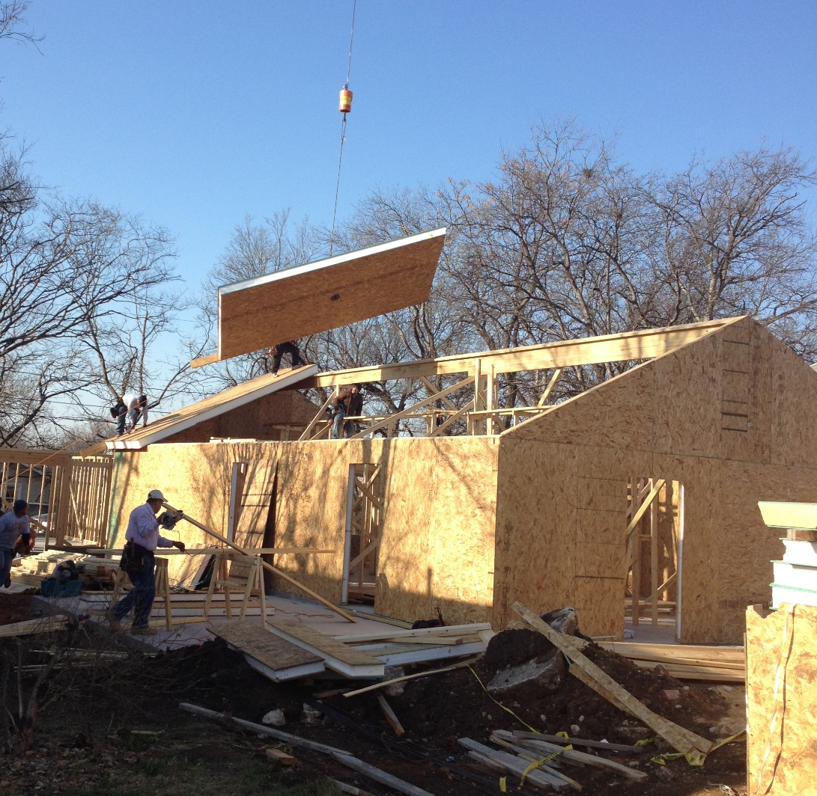
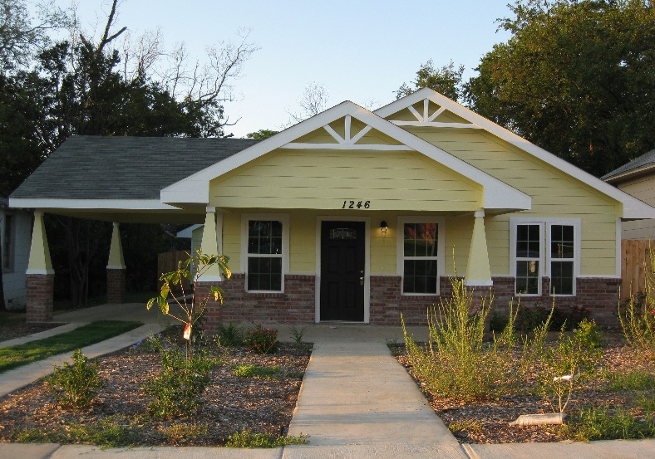
Hillside ‘Green’ Revitalization Project
Utilizing a pioneering green building method, construction featured installation of Structural insulated panels (SIPs) – a high performance building system consisting of an insulating foam core sandwiched between two oriented strand boards (OSB):
SIP construction – R17 walls, R38 roof
15 seer HVAC
Low flow plumbing fixtures
Energy star appliances
Energy star light bulbs
Energy star exterior doors
.23 Energy coefficient windows
2014 Aug – Sept electric bill $42.63

Slide 7
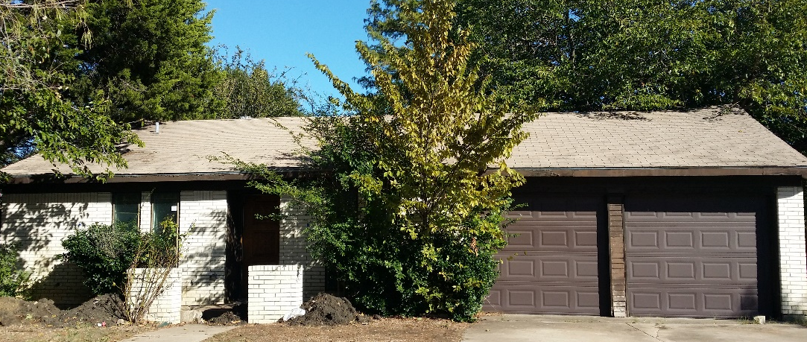
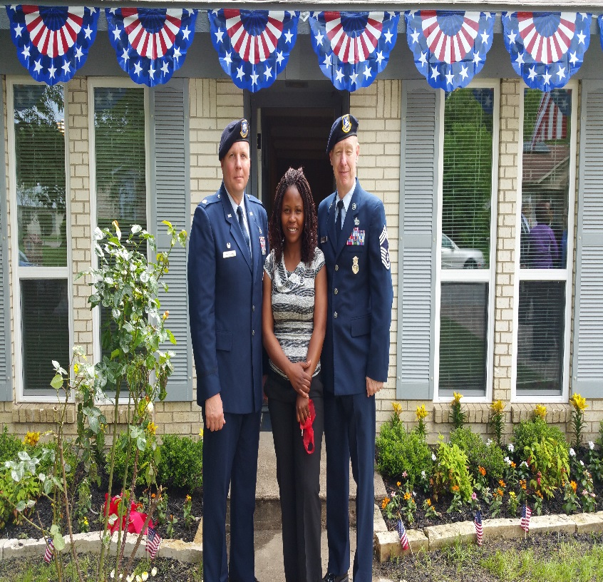
Homes with Honor Veteran Program
Banks discount or donate vacant, distressed foreclosures to nonprofit partner for affordable housing
Partners provide volunteer labor, discounts on services
Home Depot Foundation donated funding for rehab materials
Gap funding with HOME grants from City of Arlington and Tarrant County
Work with veteran agencies to identify LMI military buyer/donee
Purchase discount of 25% provided to buyer
Up to $7,500 in down payment assistance through AHAP
Before

Slide 8
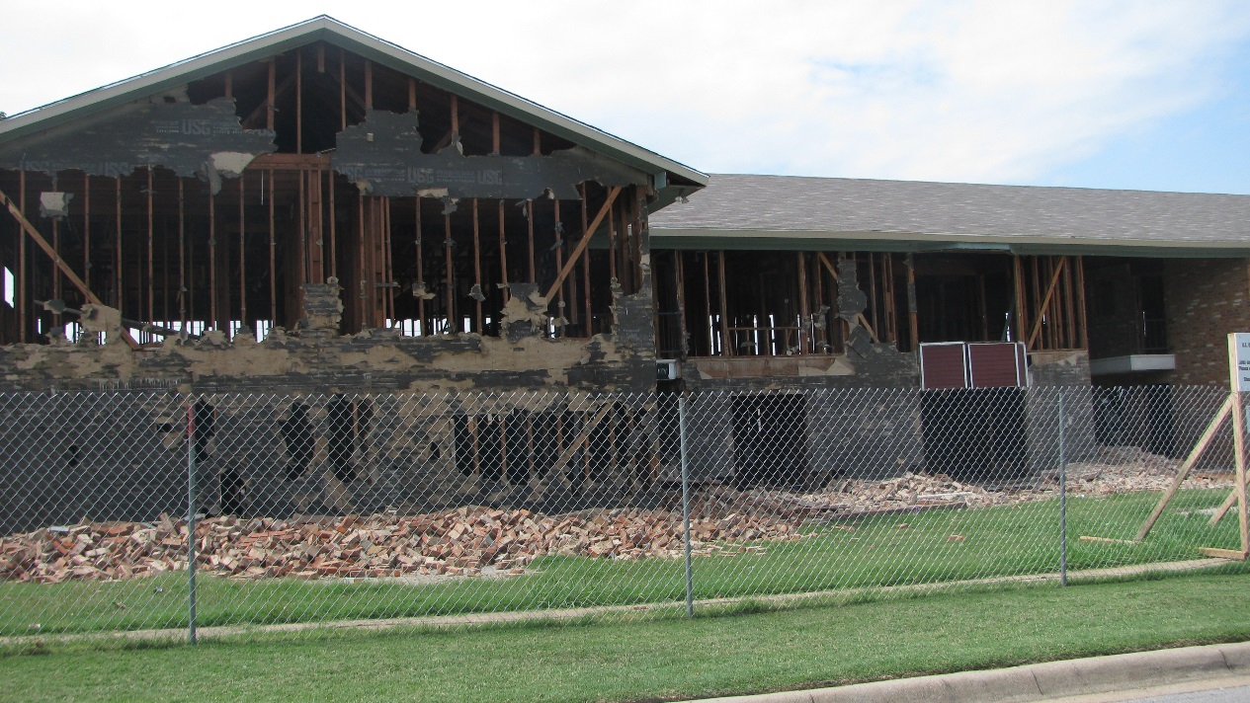
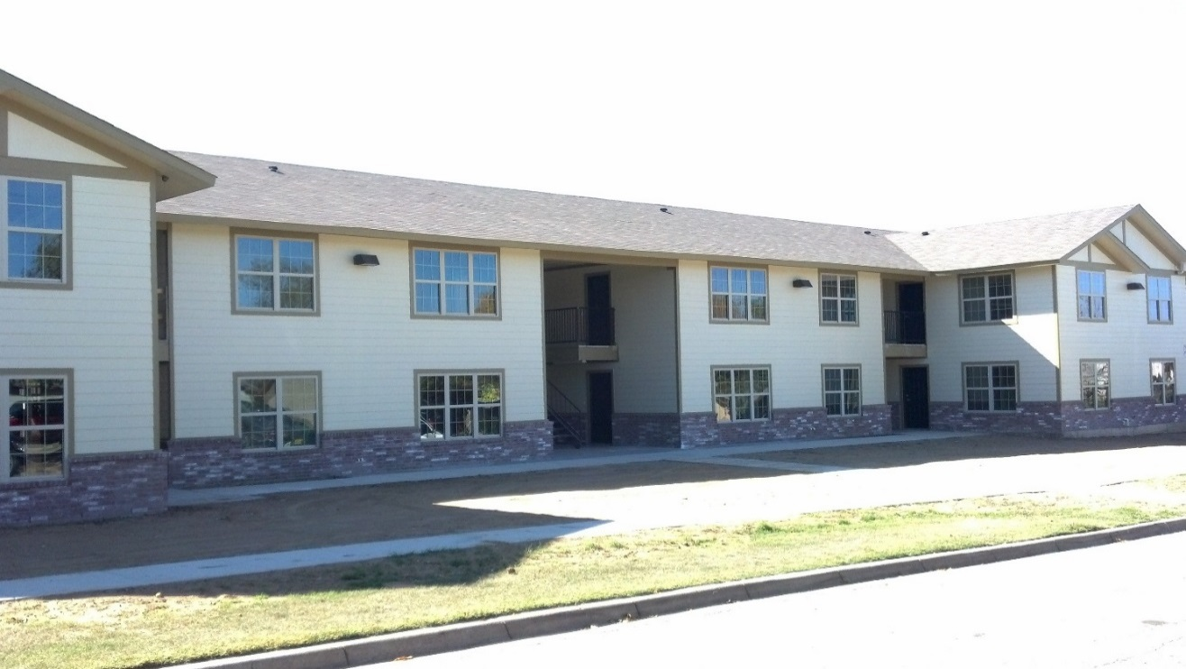
Beaty Street Apartments
Before
Combined HOME, NSP, Weatherization and private financing
Partnered with Home Depot for volume discounts on higher quality materials
Added insulation, energy efficient windows, doors
Worked with local police sub station on crime prevention program
Installed security surveillance system
Key card program for on-site laundry facility
After school and summer programs for kids
After

Slide 9
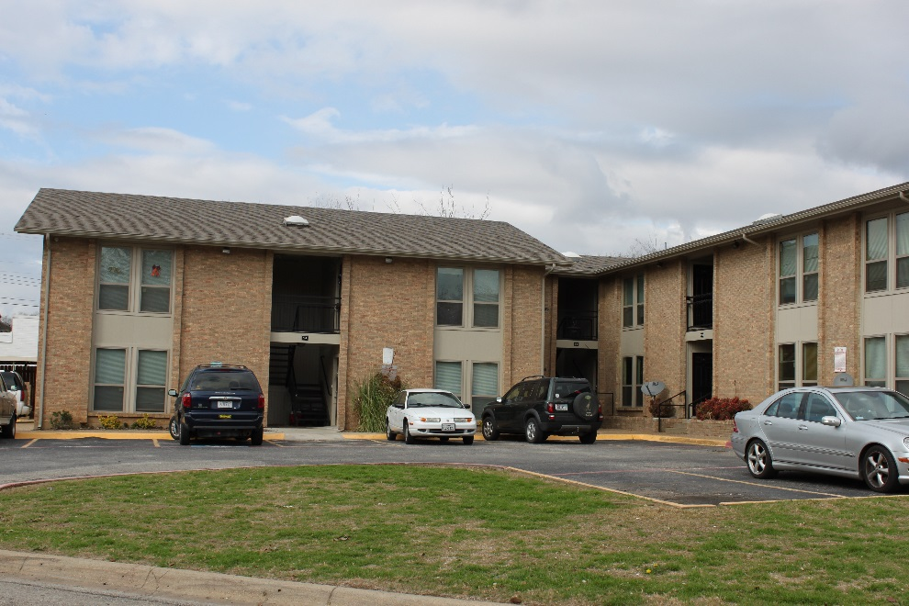
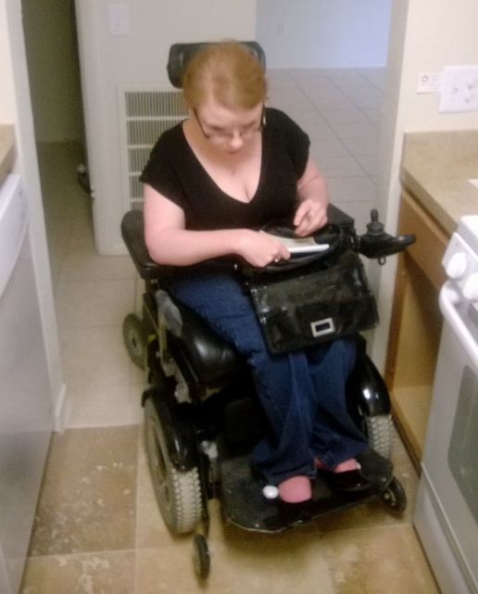
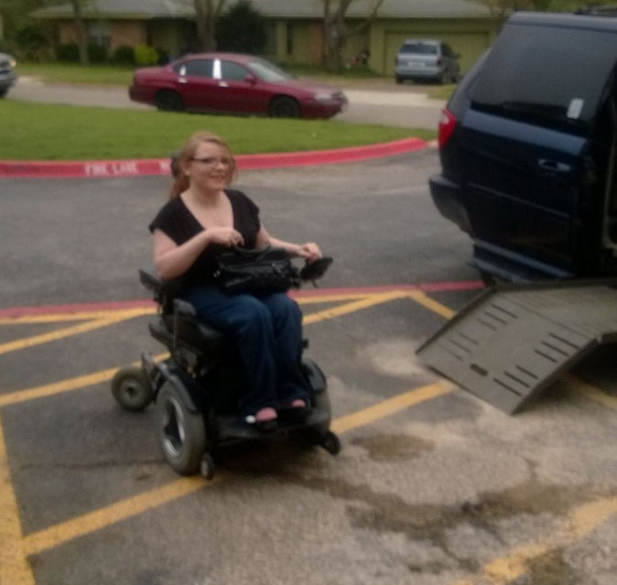
Plaza Apartments
Layered Tarrant County HOME funding with private financing
Focused on increasing energy efficiency with new HVAC systems, windows, doors and insulation
Created new ADA units to increase opportunity for special needs housing
Unique location with access to public transportation
Partnered with new Walmart for tenant recruitment
Enrichment programs for financial literacy and credit counseling

Slide 10
Generating CHDO Income
Operating expenses not covered by CHDO funds, foundations and donors contribute to program and services instead of capacity building, thus CHDOs are tasked with finding alternatives sources of income to support operations.
CHDO expenses:
Annual audit
Insurance – General Liability, Construction, Crime, D&O, Health
Salaries (paid employees vs. volunteers)
Office, utilities, equipment, technology
CHDO challenges:
Target areas, crime
Divided support
HOME regulations, Davis Bacon, Section 3
Design standards
Match requirement
Audits, monitoring visits
Challenging buyers
Potential Income Sources:
Developer fee income
Program income generated from multifamily assets
Development activities utilizing CHDO’s own capital
Social Enterprise

Slide 11
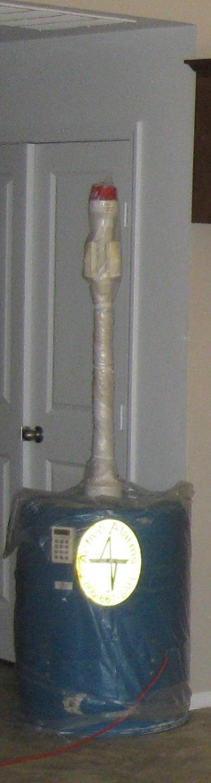
Best Practices – Lessons Learned
Neighborhood meetings / Charrettes / NIMBY education
Public official support
Leverage/Layer financial resources
PJ staff support / Inter-department collaboration / Technical
assistance vs. punitive action
Know your market for design, floor plan, amenities and pre-sell
Enterprise Green Communities Criteria
Construction Security - HVAC Cages, Barrel Alarms, Storage
Trailer, Work with Neighborhood PD, Builder’s Risk Insurance
Marketing
Partnerships

Slide 12

To request additional information please contact:
Donna VanNess– President
3204 Collinsworth St., Fort Worth, TX 76107
p 817.924.5091 ext.110
donna@tchp.net
www.tchp.net

