Slide 1

Introduction & Overview
Notes:
I’m here to introduce the Community Loan Center-providing a better alternative to payday loans.

Slide 2
Payday and Auto Title Loans are Draining Community Resources
The State May Act, but Will Not Do Enough.
Texans pay more than borrowers in most other states for the same loans:
Notes:
However, Texas has some of the most lenient payday and auto title lending regulations of any state. Unlike many other states, that have basic standards for affordable consumer credit, in Texas, payday and auto title loan businesses operate outside of the standards set by state consumer finance laws. As a result, there is very little protection for consumers beyond some recently-passed loan disclosure requirements and a basic licensing structure. In Texas, there is no limit on the number of back-to-back loans and no requirement that the loans be tailored to borrowers’ capacity to repay on time. 17 states explicitly enforce restrictions that effectively halt high-cost payday lending, 26 states have interest rate caps. Texas is one of only 7 states that have no meaningful rate caps so predatory lenders can charge whatever the market will bear. There is also no state regulatory cap on A typical $500 payday loan for 14 days costs Texas borrowers $115, while the same loan in Oklahoma is $65 and in Florida only $55. Payday and auto title businesses remain fiercely protective of Texas’ “free-wheeling” market that is responsible for more than 60% of this industry’s annual profits nationwide.

Slide 3
Statewide Payday and Auto Title Loans
Payday loan borrowers pay average of $23 for every $100 borrowed for 2-3 week loans.
50%-70% of payday and auto title borrowers must refinance loans. Average loan refinances 1.5 times in Texas in 2014
Over 846 cars are repossessed in Texas every week.
32% of nonprofit clients asking for financial assistance have used a payday or auto title loan.
We need a market solution!

Slide 4
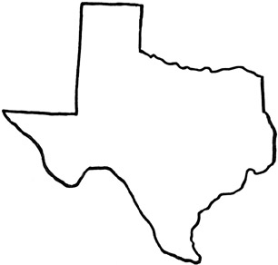
THE PROBLEM:
PAYDAY & AUTO TITLE LOANS
Texas
in 2014
3,498
Payday and Auto Title Lenders
$1.53 Billion
Fees charged Texans in 2014
44,052
Cars repossessed in Texas
$5.8 Billion
The industry of payday and auto-title lending in our state
Waco Community
1.94 Refinances on Average in Waco: 1.50 Statewide
36
Payday & Auto Title lenders
$9.8
Million
Fees charged
690
Cars repossessed
A $1,000 payday loan
costs a borrower
664% APR
EMPLOYEES’
FINANCIAL STRESS
Waco MSA in 2014
Sources: Office of Consumer Credit Commissioner website

Slide 5
THE PROBLEM:
PAYDAY & AUTO TITLE LOANS
Texas
in 2014
3,498
Payday and Auto Title Lenders
$1.53 Billion
Fees charged Texans in 2012
44,052
Cars repossessed in Texas
$5.8 Billion
The industry of payday and auto-title lending in our state
Our Community
Millions of dollars are stripped from our community every year!
527
Payday & Auto Title lenders
$263
Million
Fees charged
7,817
Cars repossessed
A $1,000 loan
costs a borrower in Corpus Christi
664% APR
EMPLOYEES’
FINANCIAL STRESS
Dallas MSA in 2014
Sources: Office of Consumer Credit Commissioner website

Slide 6
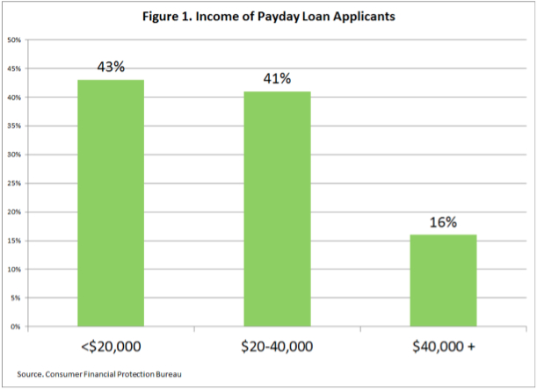
Payday Borrowers By Income
Payday Lenders By Income
Notes:
Who are payday borrowers?
43 % of payday borrowers earn <$20,000/yr
41 % earn $20,000-$40,000/yr
16 % earn over $40,000/yr

Slide 7
Graphic from ACE Cash Express Training Guide
Notes:
The Community Loan Center network was created to compete directly with payday and car title lenders by offering affordable credit and structured to support repayment. To create this new loan program, an advisory committee of experts in financial services, non profit management and law was assembled to provide guidance in program design.
As a result, the CLC program was created which provides a fairly priced small-dollar consumer loan alternative to much higher priced options. CLC loan program was designed to be administered by nonprofits as a sustainable social enterprise with the potential to outgrow the need for subsidy by generating revenue to the non profit. Finally, the CLC loan program was designed to be replicated across the state and beyond.

Slide 8
The Solution: Community Loan Center
Alternative: Market-Based Approach
  Fairly priced small-dollar loans with reasonable terms
  Direct competition to high costs lenders
  Employer based loan to workers
Sustainable and Scalable
  Need a program that can outgrow the need for subsidy and generate revenues
  Program designed to be replicated across state and beyond
Notes:
The Community Loan Center network was created to compete directly with payday and car title lenders by offering affordable credit and structured to support repayment. To create this new loan program, an advisory committee of experts in financial services, non profit management and law was assembled to provide guidance in program design.
As a result, the CLC program was created which provides a fairly priced small-dollar consumer loan alternative to much higher priced options. CLC loan program was designed to be administered by nonprofits as a sustainable social enterprise with the potential to outgrow the need for subsidy by generating revenue to the non profit. Finally, the CLC loan program was designed to be replicated across the state and beyond.

Slide 9
The Solution (cont.)
Employer Based
  Payroll Deduction
  No storefront reduces costs of operations
  No cost to employers/Marketed as Benefit
Improved Efficiencies
  Online proprietary interface for loan origination
  Outsource Loan Processing
  Outsource Loan Servicing
Nonprofit driven
  Grants, Program Related Investments, low cost debt financing
  Community Reinvestment Act credits for Bank Investors
Notes:
The CLC program is Employer Based. Each CLC affiliate recruits local employers into the program who offer the CLC loans to their employers, at no cost to the employer. Loans are repaid through payroll deduction so loan payments are made whenever the borrower is paid. To offer the low interest rate of 18%, operation costs are reduced by automation and no loan stores. Improved efficiencies result from a website for loan origination, which is outsourced along with loan servicing.
The CLC program is Nonprofit driven. Each CLC affiliate solicits their own loan capital from grants, program related investments from foundations, or other low cost debt financing. Bank investors should be eligible for credit under the Community Reinvestment Act.

Slide 10
Community Loan Center Terms
$1,000 Loan Maximum
  Or up to half of borrower’s monthly gross pay
  One Year Loan term
18% Interest (21.83% APR)
$20 origination fee
Relaxed underwriting
No collateral
No Prepayment Penalties
Reports to Credit Bureaus
Repayments $23.38/week or $94/month
Notes:
The terms of the CLC loans are $1,000 loan maximum or up to half of the employee’s monthly gross pay with up to one year loan term. The interest rate is 18% and there is a $20 loan origination fee. There are no prepayment penalties, CLC reports to credit bureaus so with timely loan payments, borrowers can improve their credit score. Loan repayment for a $1,000 loan is $23.38/week or about $96/mo. Underwriting is limited in order to offer an application process that is comparable to the loan store products.

Slide 11

Small Dollar Loans Comparison
 | Affordable Small Dollar Loan | Payday Loans
Loan Amount | $1,000 | $1,000
Administrative Fee | $20 | $0
Term | 12 months | 14 to 30 days
Interest Rate | 18% | n/a
Financial Fee | n/a | $300 * / $600**
Total Interest/Fees | $122.16 | $900
Annual Percentage Rate | 21.8321% | 782.14%
Monthly Payment | $93.51 | $1,300 due in 14 days
*1st 14 day fee is $300, if renewed an additional $300 fee is required. **If loan is extended (as indicated by research) two times.
Notes:
According to a payday lending study conducted by Pew Charitable Trusts, only 14 % of payday loan borrowers can afford enough out of their monthly budgets to repay an average payday loan.
The federal Consumer Finance Protection Bureau recently found that 80% of payday loan borrowers are unable to repay loan and have to refinance

Slide 12


Who We Are
Notes:
CLC created by the Rio Grande Valley Multibank, CDFI founded 1995
Consulted with experts to create affordable small-dollar consumer loan program
and comprised of 9 bank investors who offer a range of financial services to benefit lower income borrowers and community groups in South Texas.
Pilot program of employer based, affordable payday loan alternative
TCC network administrator to rollout the CLC statewide
TCC is nonprofit created in 2004 by TACDC to provide specialized loan products to under-served Texas communities to enhance the quality of life of low-to-moderate income persons.

Slide 13
The Community Loan Center is a subsidiary of the Rio Grande Valley Multibank CDFI (RGVMB). RGVMB was founded in 1995 by local investor stockholder banks.

Slide 14
Texas Community Capital (TCC) is a 501(c)(3) non-profit organization that provides loan and investment products, development services, and other related activities to Community Development Financial Institutions (CDFIs), community-based non-profit organizations and similar organizations, and to the low-to-moderate income households they serve.
The mission of TCC is to provide specialized loan and investment products and services that promote economic and community development in under-served Texas communities to enhance the quality of life of low-to-moderate income persons.

Slide 15
What We Do
Rio Grande Valley CLC
  Contracted to Originate and Service All Loans
  Developing Software and Intellectual Property
Texas Community Capital
  Sublicenses Software and IP to Local CLC Lenders
  Recruit New Local Lenders Into CLC Program
  Create Intellectual Property, including Marketing Materials, Co-Branding, and Program Guidelines
  Also a Licensed Lender in Balance of State Areas
Local CLC Lenders
  Recruit Employers to Participate in Program
  Raise Loan Capital to Fund the Loans
  Become a Licensed Lender via Texas OCCC

Slide 16
Texas Community Loan Center Relationships
Notes:
Texas Community Capital serves as network coordinator for Community Loan Centers (CLC), the brand name of a network of nonprofit lenders administering our employer-based, small-dollar loan program in Texas. The innovative CLC loan program extends credit to lower paid workers in Texas by providing an affordable alternative to expensive payday and car title loans. Each network affiliate is a regulated lender licensed by the State of Texas, Office of Consumer Credit Commissioner, and TCC assists affiliates in applying for this license. TCC also contracts with each affiliate use the CLC brand and lending software in their assigned territory. TCC provides training to affiliates to market the loan program and originate loans to employees of participating employers in their territory. Services to network affiliates include: recruiting affiliates, program marketing, contracting, trademark usage, software training, technical assistance and marketing materials to CLC network affiliates throughout Texas. The local affiliates then recruit employer who offer the CLC loan program to any interested employees as a fringe benefit. When an employee wants to apply for a CLC loan, they just go on line and complete the application on our website and when the employer verifies employment, the loan is approved and funds are automatically transferred into the borrowers bank account.

Slide 17
CLC Program Success
792 Loans in first year of Operation in Brownsville
  Over 5,500 loans to date
  Dallas, Houston, Laredo, Austin, & Brazos Valley
  Next: Waco, San Antonio, El Paso, Your State
Active at 68 employers covering over 29,000 employees
3.5% Loan Loss
Saved borrowers over $3 million
Notes:
Refer to slide

Slide 18
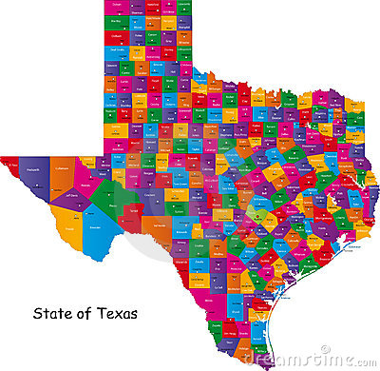
Statewide Expansion
  To date, we have CLC partners in the following areas:
  Rio Grande Valley
  Laredo
  Houston
  Austin
  Dallas
  Brazos Valley Council of Governments area
  Discussions with Beaumont, Denton, Corpus Christi, Georgetown/Round Rock, and San Antonio

Slide 19
System Structure
Online Application
Employer Portal
Financial Partner Admin Portal
Administrative Portal
Jobs and Processes Automated for Efficiency

Slide 20
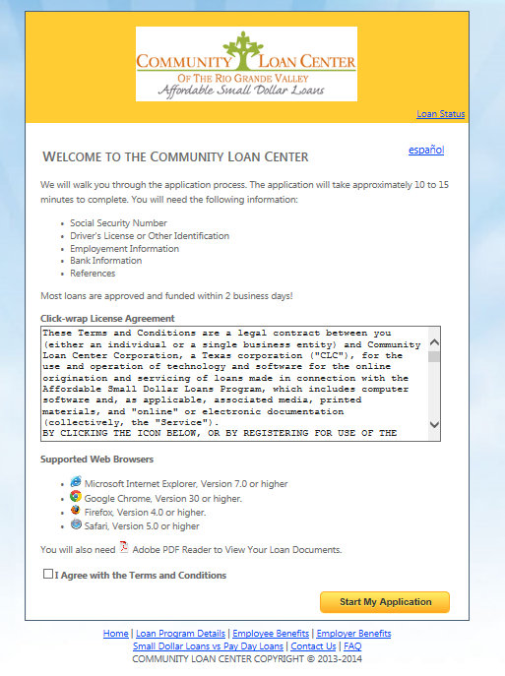

Slide 21
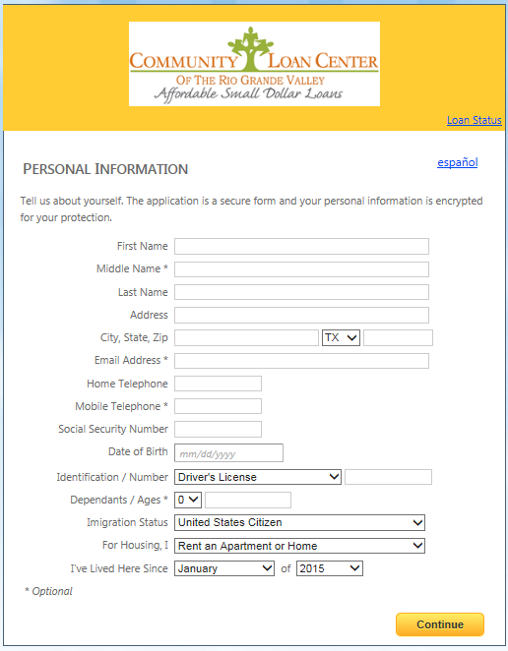

Slide 22
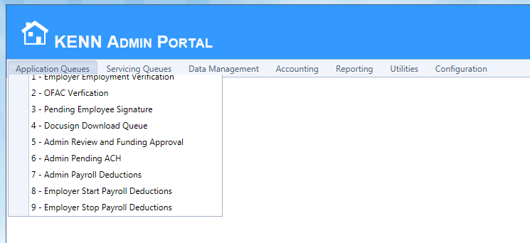

Slide 23
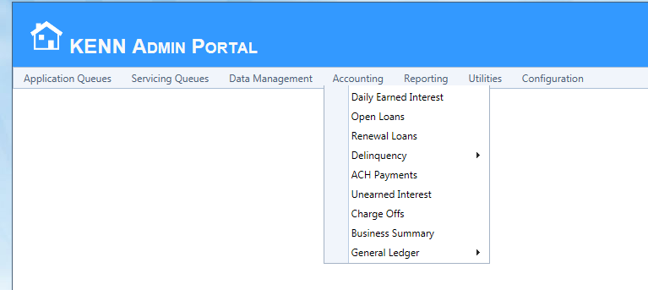

Slide 24
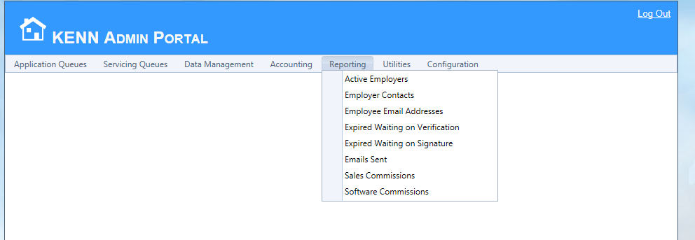

Slide 25
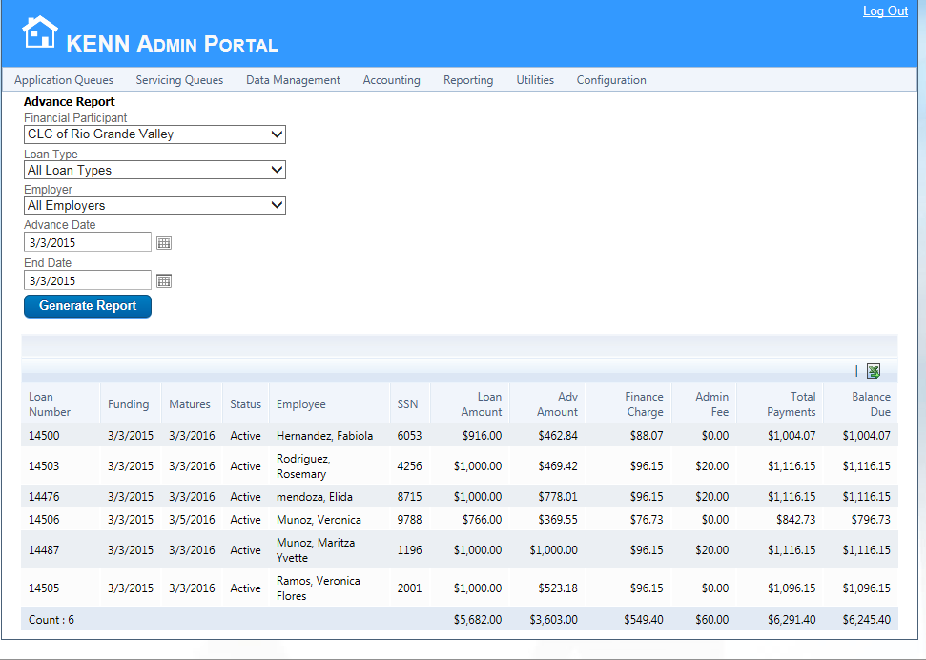

Slide 26
Program Goals and Impacts
Short Term: Create successful program that has real impact in workers lives.
  10 Licensed CLC Lenders in next 24 months
  10,000 loans in next 24 months
Long Term: Build a sustainable social enterprise for nonprofits that is scalable both locally and nationally.
If we only serve 7,000 clients and save each only $400 ($778 Avg.), we give $2.8 million back to borrowers

Slide 27
Program Evaluation
The CLC Program will be evaluated initially on the following criteria:
• Total loans originated
• Total capital lent to borrowers
• Total loan originated per location and employer
• Rate of Delinquencies
• Rate of Defaults
• Number of CLCs operating
• Estimates on savings per borrower and community.
• Texas A&M hired for more in-depth survey and analysis

Slide 28
CLC Advisory Committee
Ann Baddour, Texas Appleseed (Chair)
Woody Widrow, Raise Texas
Nick Mitchell, Rio Grande Valley Multibank
Tom Wilkinson, Brazos Valley Council of Governments
Don Baylor, Center for Public Policy Priorities
Kevin Jewell, Consultant
Debbie Taylor, Citi
Susan Hoff, United Way of Metropolitan Dallas
Eliza Platts-Mills, Univ. of Texas Comm. Dev. Law Clinic
Alfreda Norman, Federal Reserve Bank of Dallas
Shannon Van Zandt-researcher TX A&M
Catherine Meyrat-InnoStratX
Edwina Carrington, Consultant

Slide 29
Bringing the CLC to Your State
Need Intermediary Statewide Organization
  Research Lending Laws, Compliance, Etc.
  Will Serve as Statewide Lender When Needed
Recruit Nonprofits as Lenders and Provide T.A.
  Need Capacity to Operate Program
  Need Ability to Recruit Employers-Raise Loan Capital
  Pay One Time Licensing Fee or Annual Fee
Goal to raise $500,000 in Loan Capital for Year 1
Main funding will come from Banks, Foundations, Public Sources, and other institutional investors.

Slide 30
Bringing the CLC to Your City
Need Local Lender or CLC of Your State
  Local Lender to be OCCC Licensed
Goal to raise $500,000 in Loan Capital
  Administrative Support for 1 FTE
Recruit Employers (public and private)
  3,000 Employee Initial Goal Year One
Main funding will come from Banks, Foundations, Public Sources, and other institutional investors.
Partnerships to recruit employers

Slide 31
CLC Revenue
18% interest on $1,000 loan ($96.41/loan)
$10 of the $20/loan origination fee
$10/loan of the $20 loan origination fee
  Paid by borrower to RGVCLC for software, etc.
Servicing Fee .45%/mo. of Loan Balance
  For 12 month $1,000 loan, total fee is $30
Annual OCCC Licensing Fee $600-$1,250
CLC Fees
Notes:
Most program expenses are staff costs
Break even point assumes that additional program staff are hired
If existing staff are utilized break even point may occur in only 3 months

Slide 32
Funding and Investment Options
Local CLC Administrative Funds for admin fund
Capital for a Local CLC Loan Pool
  Grants, Program Related Investments, Lines of Credit, etc.
  $706,000 Goal
Capital for a Statewide Loan Pool
  Grants, Program Related Investments, Lines of Credit, etc.
  $1.5 million Goal
State and Local Loan Loss Reserve Pool

Slide 33
What Are We Asking
Consider participating in the program
Become a licensed regulated lender by your state
$10,000 CLC licensing Fee (paid through grant in TX)
Dedicate a staff person to recruiting and training businesses
Proof of D&O liability insurance
Work with TCC to raise lending capital
Work with your borrowers if loans become delinquent

Slide 34









Who are we?
Requirements for approval
Minimum age of 18
Currently working on the job for three months
A bank checking account
Valid picture ID and social security card
Four personal references
Small Dollar LOANS
The Rio Grande Valley Multibank (RGVMB) is a United States Department of Treasury certified Community Development Financial Institution.
Founded in 1995, it is comprised of nine banking and community development institutions that pool their resources together to address and change community conditions.
Our Financial Supporters:
In order to access the Small Dollar Loans program, your employer must have signed an agreement with Community Loan Center.
The low-cost alternative to
payday & auto title loans
Ready to enjoy
the benefits?
J.P. Morgan Chase
Wells Fargo Bank
IBC Brownsville
IBC McAllen
Bank of America
Frost Bank
Lone Star National Bank
BBVA Compass Bank
National Community Impact Corp. Washington D.C.
Apply online at www.rgvcommunityloancenter.com
E-mail application to clcsupport@cdcb.org
Wait for employment verification from your company’s HR department
Electronically sign loan documents
Funds will be deposited to your bank account
Pay through your employer payroll deduction
!
A community development financial institution (CDFI) - is a financial institution that provides credit and financial services to underserved markets and populations.
Our Community Supporters:
Financial Education
In addition to low-interest loans, we offer
FREE Financial Counseling.
Learn about money management, budgeting, and credit. Also available: savings & retirement workshop, and predatory lending workshop.
901 E. Levee St. Brownsville, TX 78520
956.541.4955
clcsupport@cdcb.org
www.rgvcommunityloancenter.com
For the savvy borrower who wants to avoid high interest fees

Slide 35


Need money AND don’t want to pay EXORBITANT
interest fees?
Immediate savings & peace of mind with
Community Loan Center
Small Dollar Loans
Compare Costs
A $1,000 loan
CLC Small Dollar Loan
vs
Payday Loans
CONVENIENT
Online origination & servicing. Easy payments through payroll deduction
Let’s face it. There comes a time when we all need money urgently. When you are short of cash, a number of payday loan and auto title stores offer you tempting loans on the agreement that you pay when you get your next paycheck.
Chances are, your situation won’t have improved by then and you will have to re-finance. The accumulation of those high fees can make you pay an effective interest rate of 400 percent!!!
By the time you finish paying your initial debt, you will have paid the debt up to 3 to 4 times.
In addition to the obvious economic burden, you get unnecessary stress, which can negatively affect you at home and at work.
AFFORDABLE
Low-interest
12-month loans from $400 up to $1,000
$20 | Administration Fee | $0
12 months | Pay in | 14 to 30 days
18% | Your interest rate | 0%
$0 | Financial Fee | *$244.70 **$530.99
$93.34 monthly | Due payment | $1,300 in 14 days
$120.08 | Total interest & fees | $775.69
HELPFUL
Free financial counseling available
*1st. 14 day fee is $244.70, if renewed an additional $244.70 fee is required.
** Research shows that each loan is renewed 2.11 times in the RGV.
If only a risk-free, low-interest loan program existed…
Other advantages
No credit history needed
No collateral
Take up to 12 months to pay
No prepayment penalties
Money deposited directly into your checking account within one day of employment verification from your company.
Save money and worry less with our Small Dollar Loan program!
Lucky you. There’s one now.
Minimum Amount Monthly Terms
$400 - $575 6 months
$600 - $775 9 months
$800 - $1,000 12 months

Slide 36
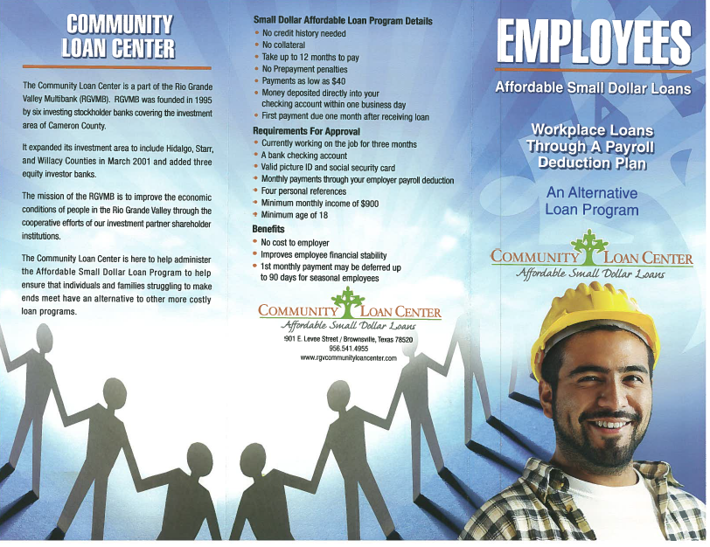

Slide 37
Contact
Nick Mitchell-Bennett
Rio Grande Valley Multibank
956.541.4955
nmitchell@cdcb.org
Matt Hull
Texas Community Capital
512.916.0508
matt@tacdc.org
Notes:
consider participating in the Community Loan Center
bring this needed alternative loan program to your community
Become a community lender to build a viable social enterprise
Support the small-dollar loan program as a donor or investor

