Slide 1

Coordinated
Response to Disaster
A Panel Discussion for the National Community
Development Association 46th Annual Conference
Hagerty Consulting
847-492-8454
www.hagertyconsulting.com

Slide 2
Introductions and Overview
Public Assistance Program
Hazard Mitigation
Community Development Block Grant – DR
Questions for Expert Panel

Slide 3





Introductions
Mark Misczak, CEM
  Director of Recovery
  Hagerty Consulting
  mark.misczak@hagertyconsulting.com
Deborah Seifert, JD
  Practice Lead, CDBG-DR
  Hagerty Consulting
  deborah.seifert@hagertyconsulting.com
Courtney Ring, CEM
  Director of Development
  Hagerty Consulting
  courtney.ring@hagertyconsulting.com
Leland Baker
  Recovery Emergency Analyst
  FEMA Region VI
  lee.baker@fema.dhs.gov
Kathy Fedler
  Housing and Community Investment Manager
  Longmont, CO
  kathy.fedler@longmontcolorado.gov

Slide 4


Disaster recovery is extremely costly
Since 2000, there have been 103 natural disasters that individually exceeded $1 billion in damages
In 2014 alone, eight disasters exceeded $1 billion in damages
Since 2000, the United States has incurred more than $700 billion in disaster damages
In 2005, Hurricane Katrina cased more than $150 billion in damages to the Gulf Coast
In 2012, Hurricane Sandy caused $60 billion+ in damages
$700B
Notes:
Source for this information is:
National Oceanic and Atmospheric Administration, Centers for Environmental Information, Billion-Dollar Weather and Climate Disasters: Table of Events. Data is for events between 2000 and 2014. Dollars adjusted for inflation.
https://www.ncdc.noaa.gov/billions/events

Slide 5
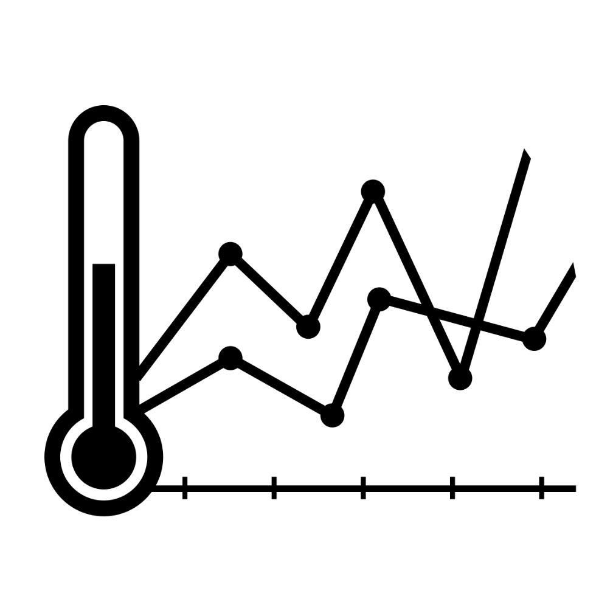
climate change will increase Frequency and intensity
Climate models predict major changes to the global climate
These changes will result in more intense and frequent natural disaster
  Higher maximum temperatures and more extremely hot days
  Increased tropical cyclone peak activity
  Intensified floods and droughts
Notes:
Source for this Information:
Intergovernmental Panel on Climate Change, Final Assessment Report (AR5).
The World Meteorological Organization
Headquarters in Geneva. IPCC Secretariat
is hosted by WMO
The Intergovernmental Panel on Climate Change (IPCC) is the leading international body for the assessment of climate change. It was established by the United Nations Environment Programme (UNEP) and the World Meteorological Organization (WMO) in 1988 to provide the world with a clear scientific view on the current state of knowledge in climate change and its potential environmental and socio-economic impacts. In the same year, the UN General Assembly endorsed the action by WMO and UNEP in jointly establishing the IPCC.

Slide 6

Why this Maters to you?!?!
Since 1993, HUD has provided more than $47 billion in CDBG-DR funds for impacted communities in 19 allocations.
The first allocation (1993 Andrew) was $85 million. While the most recent allocation was $16 billion (2013 Sandy)
These funds were provided for all forms of hazards.
YOU may be called upon to help implement community recovery and utilization of these Federal funds
Notes:
Source for this Information:
Intergovernmental Panel on Climate Change, Final Assessment Report (AR5).
The World Meteorological Organization
Headquarters in Geneva. IPCC Secretariat
is hosted by WMO
The Intergovernmental Panel on Climate Change (IPCC) is the leading international body for the assessment of climate change. It was established by the United Nations Environment Programme (UNEP) and the World Meteorological Organization (WMO) in 1988 to provide the world with a clear scientific view on the current state of knowledge in climate change and its potential environmental and socio-economic impacts. In the same year, the UN General Assembly endorsed the action by WMO and UNEP in jointly establishing the IPCC.

Slide 7
Disaster Preparedness
Your CDBG funding can be used to assist your community with planning for and preparing to respond and recover from disasters. Planning can help reduce impacts and recovery time for your most vulnerable populations.
What plans and assessments does my community want or need?
Gap Analysis & Capabilities Assessments
Phased Plan Development
  Continuity of Operations Plan
  Emergency Operations Plan
  Long-term Recovery and Redevelopment Plan
  Hazard Mitigation Plan
  Disaster Debris Management Plan
Training and Exercise Development

Slide 8



Overview Disaster Assistance Recovery Programs
4
?
?
Major Federal Disaster Recovery Programs
Differing Eligibility and Compliance Requirements
Funding Can Be Layered to Increase Efficiency
Programs Designed to Work Together
Notes:
Programs:
Public Assistance (FEMA)
Section 406 Hazard Mitigation (FEMA)
Hazard Mitigation Grant Program (FEMA)
Community Development Block Grant – Disaster Recovery (HUD)

Slide 9
Introductions and Overview
Public Assistance Program
Hazard Mitigation
Community Development Block Grant – DR
Questions for Expert Panel

Slide 10

FEMA Public Assistance (PA) Foundation and Purpose
Authorized by the Stafford Act
Grants the President authority to administer Federal disaster assistance
Reimburses eligible local governments and non-profit applicants for response and recovery activity costs
Federal cost share of no less than 75%
Federal cost share may be raised
Notes:
KILL THE ROCKET

Slide 11
Building blocks of PA eligibility
Cost
Work
Facility
Applicant
Notes:
Legal responsibility runs throughout the pyramid
You can be an eligible applicant, but not have eligible facility
You can be an eligible applicant, have an eligible facility, but not have eligible work
You can be an eligible applicant, have an eligible facility, have eligible work, but not have eligible costs

Slide 12







Categories of Emergency Work
A: Debris Removal
B: Emergency Protective Measures
C: Road Systems & Bridges
E: Building, Contents, Equipment
D: Water Control Facilities
F: Utilities
G: Parks, Recreational, Other
Notes:
Treatment of Force Account Labor for Debris Removal: Reimbursing your physical plant employees for both straight time and overtime for one consecutive, 30-day period
Sheltering and Temporary Essential Power Program: Using the more flexible Section 403 authorities to create a

Slide 13
Categories of Permanent Work
A: Debris Removal
B: Emergency Protective Measures
C: Road Systems & Bridges
E: Building, Contents, Equipment
D: Water Control Facilities
F: Utilities
G: Parks, Recreational, Other
Notes:
The Public Assistance Alternative Procedures Pilot Program
Permanent work grants made on a capped estimate basis
New Small and Large Project Thresholds
Increasing the large project threshold to $120,000
Increasing the minimum amount that can be claimed on a project worksheet to $3,000

Slide 14
Introductions and Overview
Public Assistance Program
Hazard Mitigation
Community Development Block Grant – DR
Questions for Expert Panel

Slide 15


406 Hazard Mitigation – Foundation & Purpose
Authorized under Stafford Act, Section 406
Must improve the damaged element
Cost effective and technically feasible
Non-Competitive, based on value of a permanent work PW
The Stafford Act
Section
406
Notes:
Up to 15% of total eligible project repair cost
Up to 100% of total eligible repair cost for certain pre-approved measures
Determined cost effective through a cost/benefit analysis

Slide 16
404 HMGP – Foundation & Purpose
Authorized under Stafford Act, Section 404
Protects undamaged assets
Capped and competitive
Statewide funding determined by a formula based on eligible damages
The Stafford Act
Section
404
Notes:
Funding Formula: up to 15% of first $2B of estimated aggregate amount of disaster assistance, up to 10% for amounts between $2B and $10B, and up to 7.5% between $10B and $35.3B

Slide 17
Introductions and Overview
Public Assistance Program
Hazard Mitigation
Community Development Block Grant – DR
Questions for Expert Pannel

Slide 18

What is CDBG-DR?
Community Development Block Grant – Disaster Recovery
  Administered by the US Department of Housing and Urban Development (HUD)
  Funds appropriated by Congressional Act
  Funds allocated and governed by Federal Register Notices
What are the basic differences between CDBG and CDBG-DR?
  Comply to rules, waivers, and alternatives defined by the Federal Register Notice allocating the funds (changes each disaster)
  Address a disaster related impact identified in an Unmet Needs Assessment and approved Disaster Action Plan
  Benefit over 50% Low- to Moderate-Income (LMI) individuals instead of 70%
  Do not duplicate other previous disaster assistance (Stafford Act)
  Being an entitlement does not guarantee a direct allocation

Slide 19
PA Program compared to CDBG-DR
FEMA Public Assistance | HUD CDBG - DR
Reimbursement based on expenditures after the fact Funds Emergency Measures and Permanent Restoration Includes a cost share requirement Costs must be approved by FEMA before reimbursement | Reimbursement only for activities in approved Action Plan Funds all costs eligible under CDBG Regulations if tied back to the disaster Can cover FEMA PA cost share Funds drawn directly from HUD

Slide 20
Introductions and Overview
Public Assistance Program
Hazard Mitigation
Community Development Block Grant – DR
Questions for Expert Panel

Slide 21



About US
250+
Help our clients to prepare for and recover from disasters
Over a decade of experience managing disaster recovery operations
Involved in the largest recovery operations:
  World Trade Center Disaster (9/11)
  Hurricane Katrina
  Hurricane Sandy
12+
National
Disaster Recovery Experience
Notes:
Emphasize Hagerty’s role in aiding recovery from some of the largest add most disruptive disasters in the nation’s history.
Consistently recognized as an innovator.
Overwhelmingly positive ratings from present and past clients.
Strong reputation with FEMA

Slide 22
LESSONS FROM PRACTITIONERS
Mark Misczak, CEM
  Director of Recovery
  Hagerty Consulting
  mark.misczak@hagertyconsulting.com
Deborah Seifert, JD
  Practice Lead, CDBG-DR
  Hagerty Consulting
  deborah.seifert@hagertyconsulting.com
Courtney Ring, CEM
  Director of Development
  Hagerty Consulting
  courtney.ring@hagertyconsulting.com
Leland Baker
  Recovery Emergency Analyst
  FEMA Region VI
  mark.price@fema.dhs.gov
Kathy Fedler
  Housing and Community Investment Manager
  Longmont, CO
  kathy.fedler@longmontcolorado.gov

